Slide 1
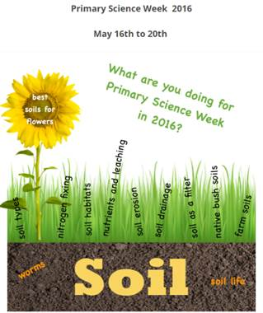
Primary Science Week
Unpacking the national soil activities
Andrea Soanes with
Professor Louis Schipper and Angela Schipper
5 May 2016
@NZScienceLearn
www.sciencelearn.org.nz
© 2015 The University of Waikato | www.sciencelearn.org.nz

Slide 2


What is the Science Learning Hub?
A trustworthy online resource – produced by educators and scientists
Based on world-class New Zealand science research
Supported by learning activities, information about the key science ideas and concepts, multimedia tools and other resources
Written for New Zealand teachers and students

Slide 3

A new Hub website design
© Copyright University of Waikato. All rights reserved.

Slide 4
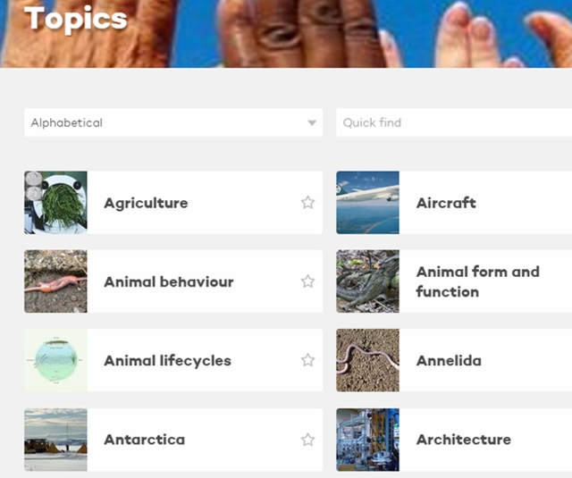
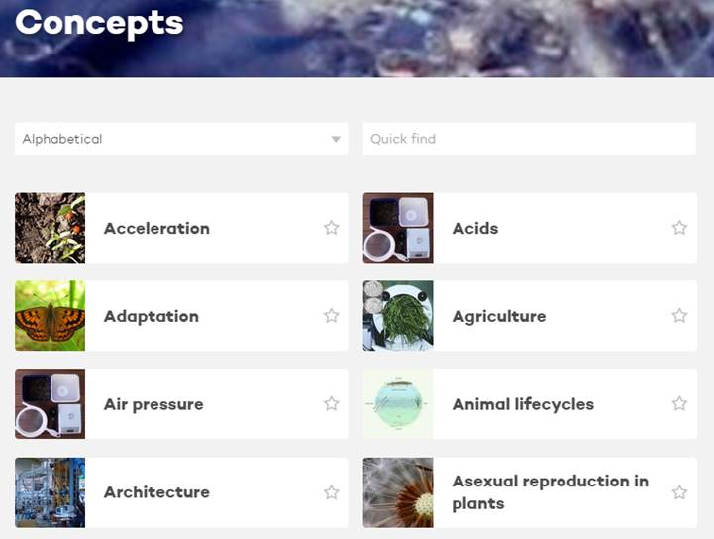
Search by topic or concept
We will host webinars about the new Science Learning Hub on 16 and 30 June.
All images are copyrighted. For further information, please refer to enquiries@sciencelearn.org.nz
© Copyright University of Waikato. All rights reserved.

Slide 5
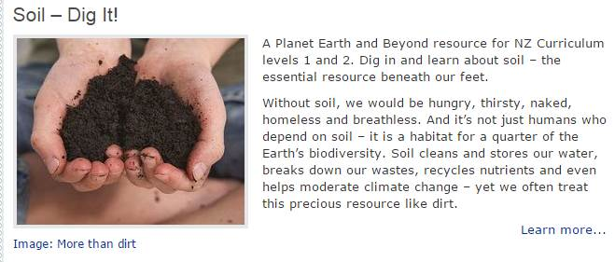
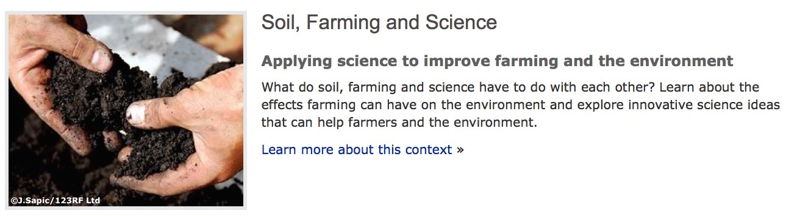
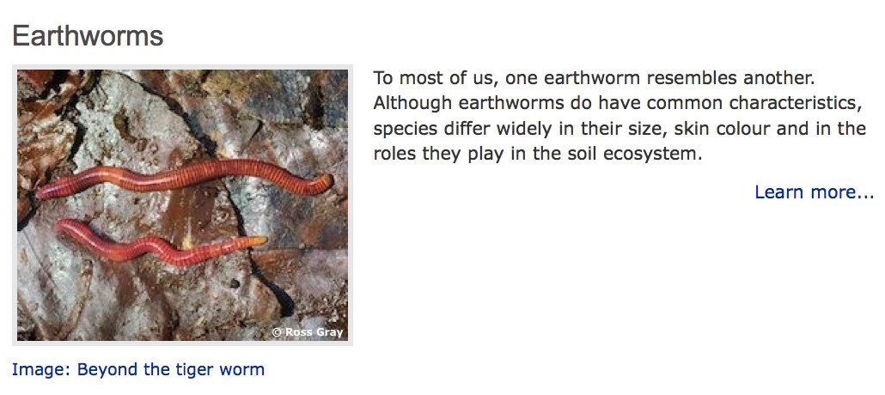
Hub soils resources levels 1 - 5
© Copyright University of Waikato. All rights reserved.

Slide 6

What is Primary Science Week?
Monday 16 May to Friday 20 May 2016
The topic is soil
Primary Science Week is an annual event that provides opportunities for all New Zealand schools to engage in science learning.
It is organised by the New Zealand Association of Primary Science Educators (NZAPSE). Their role is to celebrate science in primary schools and to enhance the teaching and learning of science at primary level.
© Copyright University of Waikato. All rights reserved.

Slide 7
Choosing the activities
UN International Year of Soils
Collaboration between teachers, soil scientists and writers
Minimal equipment
Suitable for lower and upper primary students
Gather data to share
Interesting!
Image courtesy of http://nzapse.nzase.org.nz/
© Copyright University of Waikato. All rights reserved.

Slide 8
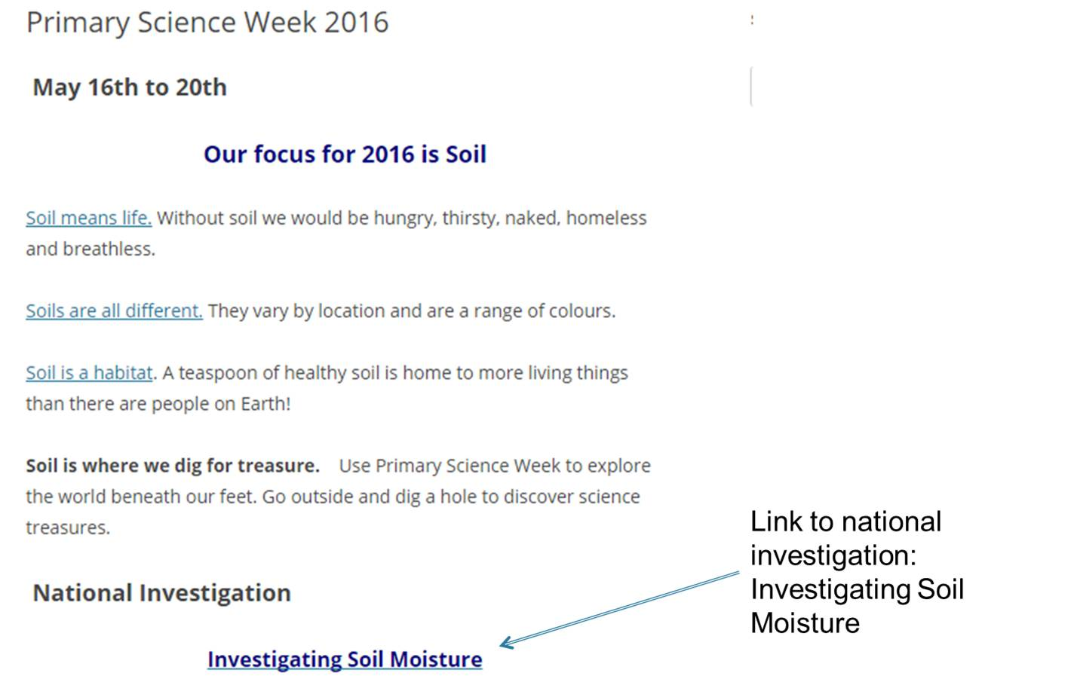
© Copyright University of Waikato. All rights reserved.

Slide 9
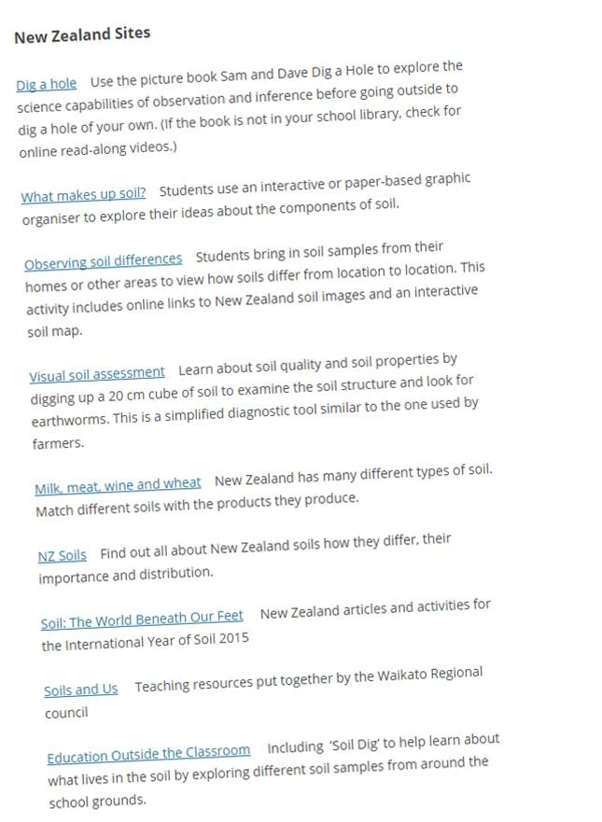
NZAPSE website has links to soils resources from the Hub, BSC series and other sites.
© Copyright University of Waikato. All rights reserved.
Notes:
NZAPSE page has links to multiple NZ and overseas sites. Building Science Concepts.

Slide 10
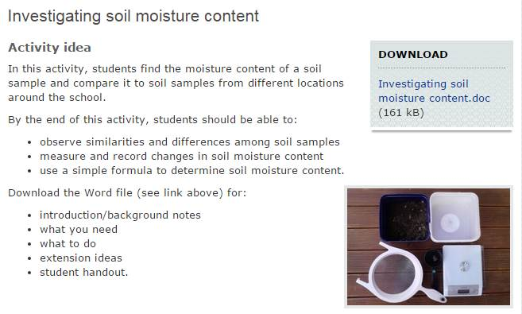
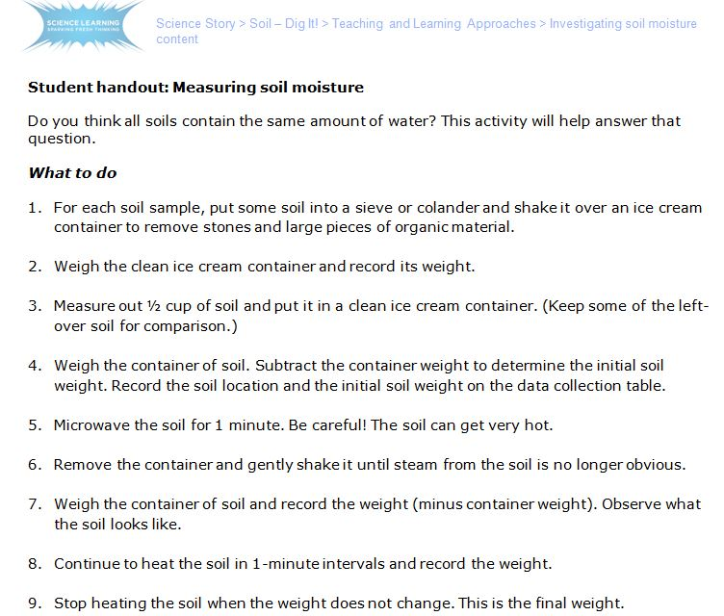
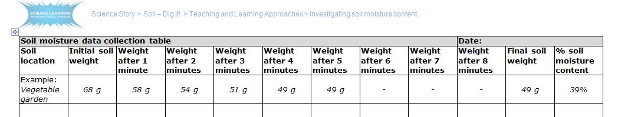
© Copyright University of Waikato. All rights reserved.

Slide 11
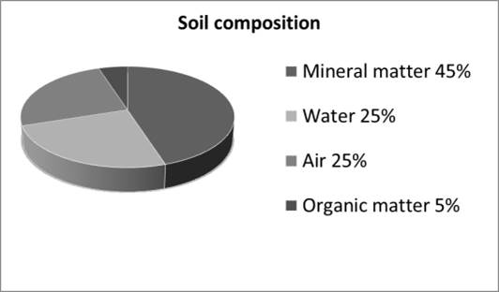
National Experiment
Primary Science Week 2016 – National Experiment
Soil Moisture
Soil is made up of dirt, right?
Actually, soil is made up of inorganic mineral particles, organic matter, air and water.
Air and water usually make up about half the volume of soil.
Plants and other soil creatures rely on soil moisture and air to survive.
© Copyright University of Waikato. All rights reserved.

Slide 12
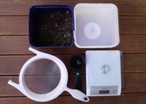
Aim: To find the moisture content of a soil sample and compare it with soil samples from different locations.
Method:
What you need
Soil samples
Ice cream containers
Sieve
½ cup measure
Kitchen scale
Microwave oven
© Copyright University of Waikato. All rights reserved.

Slide 13
For each soil sample:
Put some soil into a sieve or colander and shake it over an ice cream container to remove stones and large pieces of organic material.
Weigh the clean ice cream container and record its weight.
Measure out ½ cup of soil and put it in a clean ice cream container. (Keep some of the left-over soil for comparison.)
Weigh the container of soil. Subtract the container weight to determine the initial soil weight. Record it on the table provided.
© Copyright University of Waikato. All rights reserved.

Slide 14

Microwave the soil for 1 minute. NOTE: the soil can get very hot.
Remove the container and gently shake it until steam from the soil is no longer obvious. Observe what the soil looks like.
Weigh the container of soil and record the weight (minus container weight).
Continue to heat the soil in 1-minute intervals and record the weight.
Stop heating the soil when the weight does not change. This is the final weight.
© Copyright University of Waikato. All rights reserved.

Slide 15
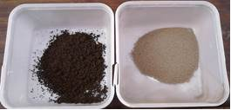
Observe changes to the soil. Return the sample to the ½ cup measure to look at any change in the volume of soil. Use the senses of sight and touch to observe before and after samples.
To determine the percentage soil moisture content:
  (initial weight – final weight) ÷ final weight = soil moisture content
Vegetable garden soil
Before and after 5 minutes in the microwave
Initial weight: 68 g
Final weight: 49 g
Soil moisture content: 39%
© Copyright University of Waikato. All rights reserved.

Slide 16
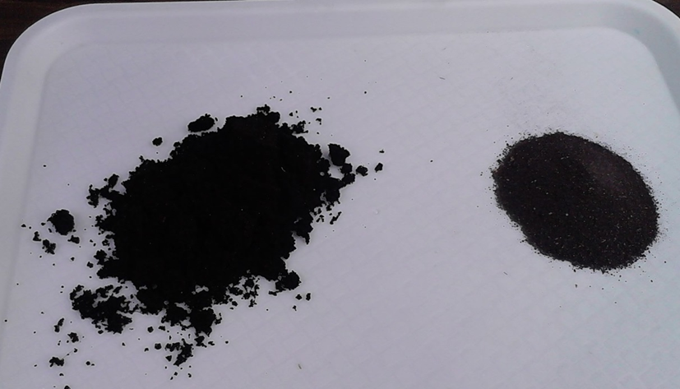
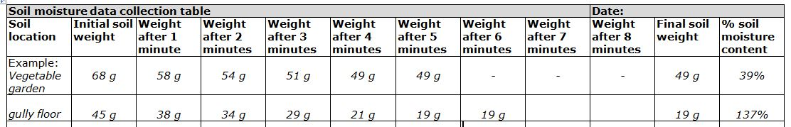
Compare the data from the other soil samples. What might explain differences in soil moisture content?
Native forest (gully)
Before and after 6 minutes in the microwave
Initial weight: 45 g
Final weight: 19 g
Soil Moisture content: 137%
© Copyright University of Waikato. All rights reserved.

Slide 17
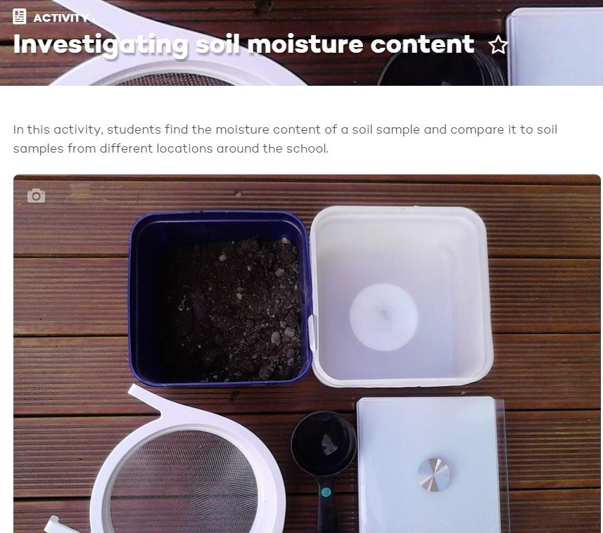
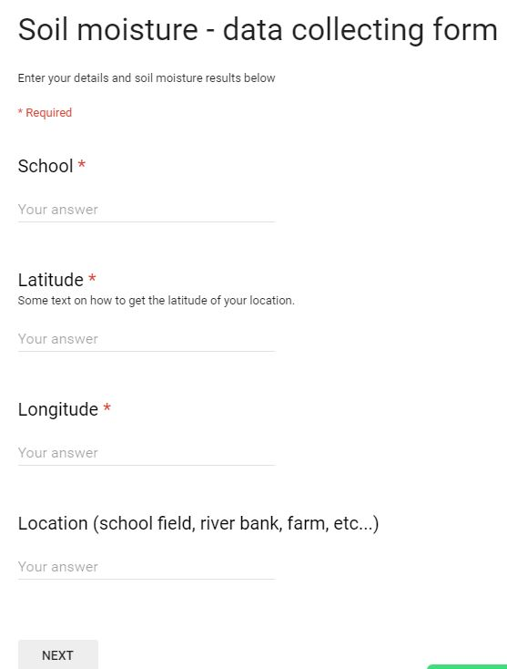
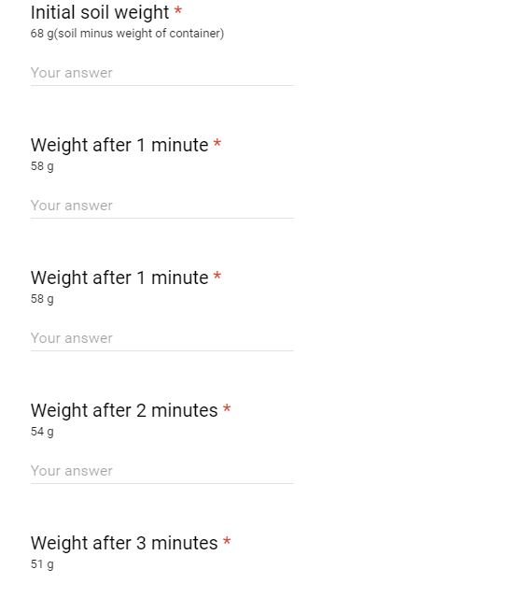
Uploading data from your investigation
https://beta.sciencelearn.org.nz/resources/736-investigating-soil-moisture-content
© Copyright University of Waikato. All rights reserved.

Slide 18
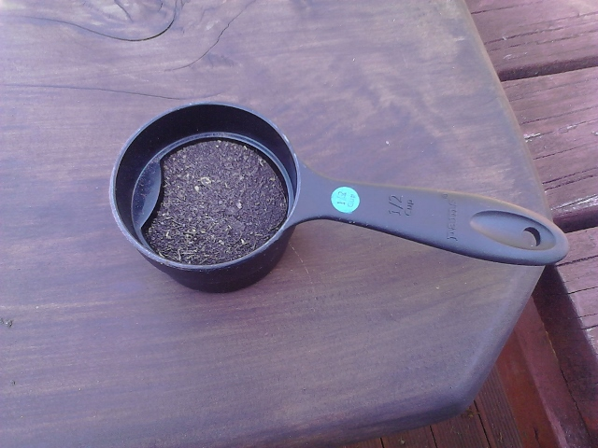
Extension Ideas – monthly changes
Choose one or two locations and repeat the experiment each month to see how soil moisture changes during the seasons.
19 Jan 58%
14 Apr 55%
© Copyright University of Waikato. All rights reserved.

Slide 19
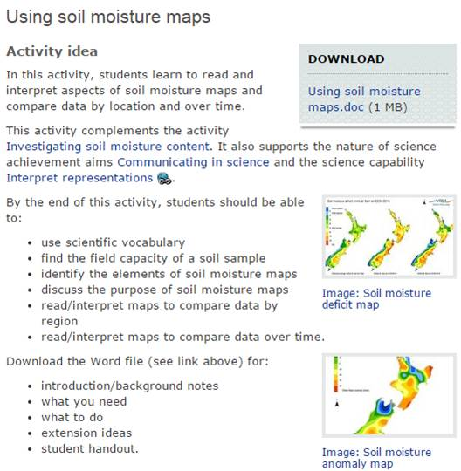
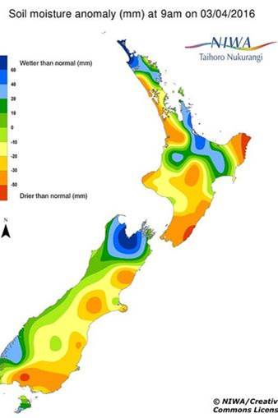
Extension ideas – climate maps
NIWA daily climate maps: https://www.niwa.co.nz/climate/daily-climate-maps
Images courtesy of NIWA/http://creativecommons.org/licenses/by/4.0/
© Copyright University of Waikato. All rights reserved.

Slide 20
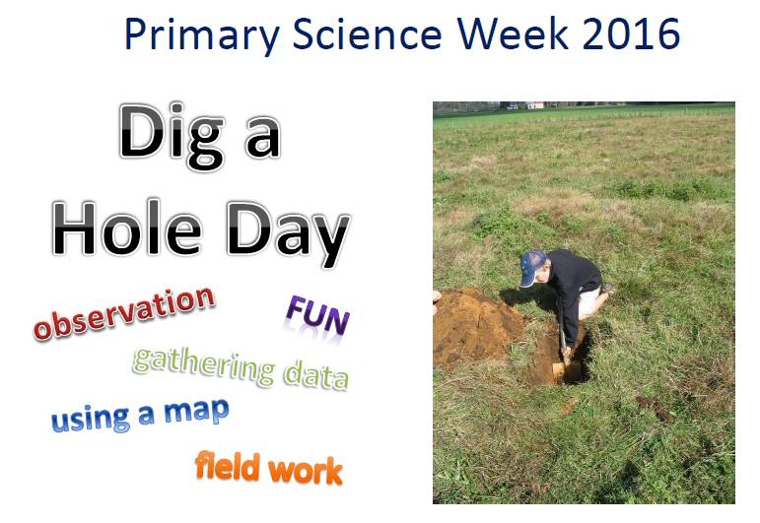
© A. Schipper
© Copyright University of Waikato. All rights reserved.

Slide 21
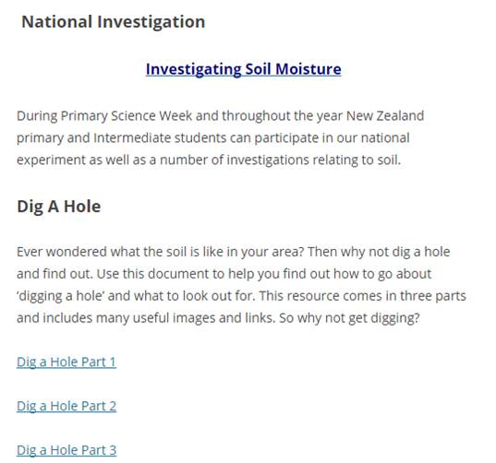
Dig A Hole instructions are under the National Investigation.
http://nzapse.nzase.org.nz/primary-science-week/
© Copyright University of Waikato. All rights reserved.

Slide 22
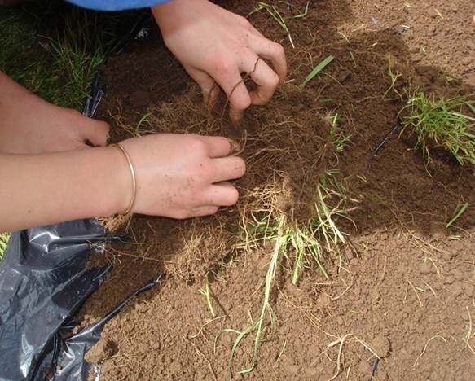
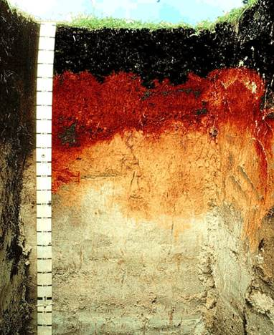
Why dig a hole?
Most people think soil looks like this:
But if you dig deeper, it may look like this:
©WRC/www.nzsoils.org.nz/
What’s under the ground at your school? Will it be the same as the soil at your home?
© Copyright University of Waikato. All rights reserved.

Slide 23

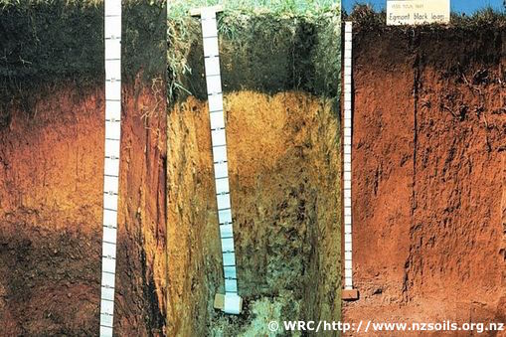
Soils are the same but different
Humans have lots in common but we are all different in many ways.
It’s the same with soils. The soil in one area is not identical to the soil in a different location.
© Copyright University of Waikato. All rights reserved.

Slide 24

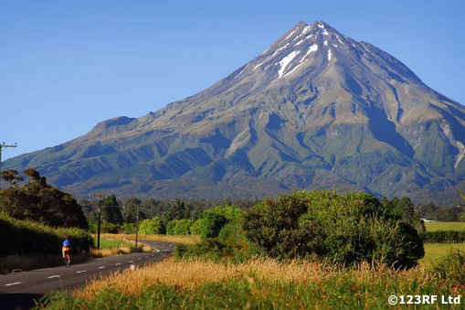
Parents are a factor
Humans have parents – our DNA helps to form who we are.
Soils have parent materials – for example, volcanoes form pumice soils.
© Copyright University of Waikato. All rights reserved.

Slide 25
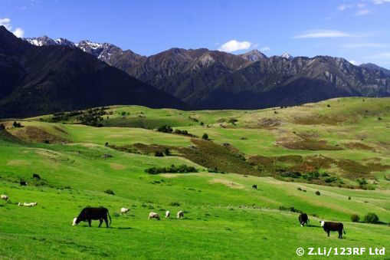
Other factors
Mountains, rivers, rainfall, temperature and living things influence what the soil will be like.
Time also makes a difference. Some soils are very old, and some soils are recent.
Soils are all different
© Copyright University of Waikato. All rights reserved.

Slide 26
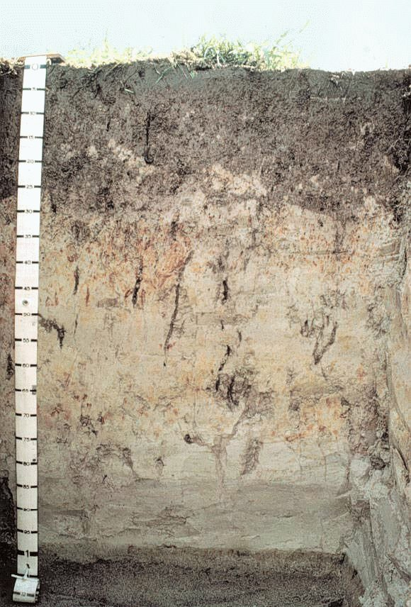

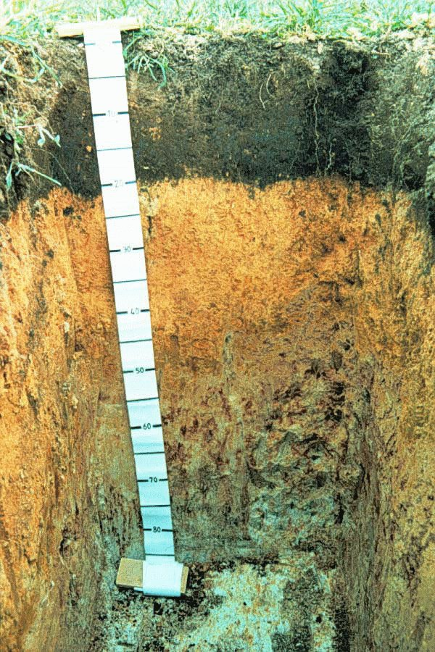
The soil-forming factors can change over short distances – so the soils change too!
© WRC/www.nzsoils.org.nz/
© Copyright University of Waikato. All rights reserved.

Slide 27
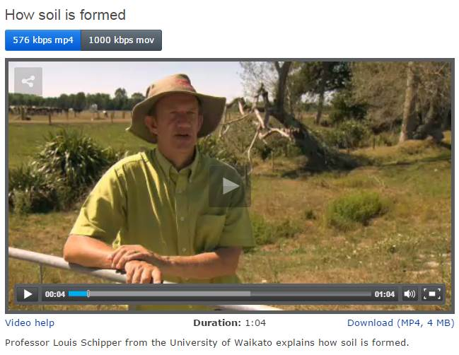
How soil is formed
© Copyright University of Waikato. All rights reserved.

Slide 28
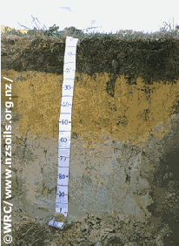
What will you see when you dig a hole?
Your soil/hole may look different to the photos we use.
These holes go down 1 m or more – hard work!
Photos of road cuttings or construction sites work too.
© Copyright University of Waikato. All rights reserved.

Slide 29
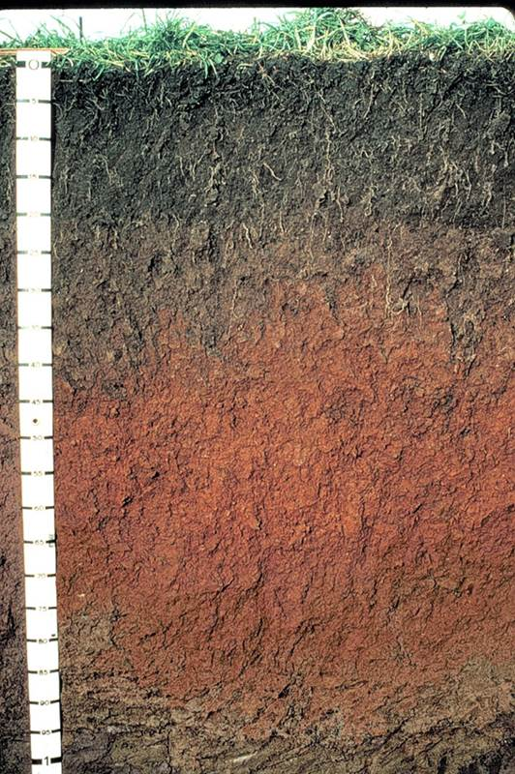
Some clues for your dig
Topsoil – dark, roots, creatures.
Subsoil – various colours (red, yellow, white, brown, orange) and mottles.
Bottom half of subsoil can be a different colour.
©WRC/www.nzsoils.org.nz
© Copyright University of Waikato. All rights reserved.

Slide 30
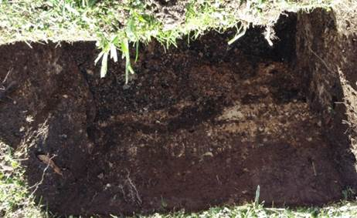
Get out and dig a hole!
What you need
Spade
Ground sheet
Hand lenses
Tablet or recording device
Boots, sturdy shoes or a willing caretaker!
© Copyright University of Waikato. All rights reserved.

Slide 31
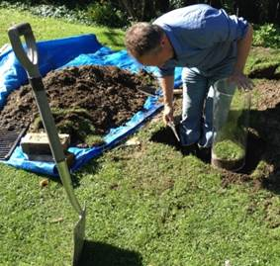
Find a suitable place to dig a hole.
Dig out two spade widths of turf and lay it on a ground sheet.
Dig down to get another two spade widths of soil and place it below the turf roots. This is the beginning of a soil profile. A profile shows what the soil looks like from the surface downwards.
Notice if the soil changes as you dig deeper. Does the soil have the same colour? Does it feel the same if you rub some between your fingers?
© Copyright University of Waikato. All rights reserved.

Slide 32
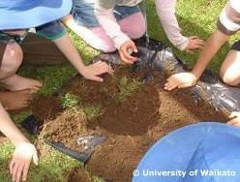
Look through the turf and roots for soil animals like earthworms or insects.
Break clods apart to observe what is inside or to see if the soil colours change.
Measure the length/depth of plant roots.
Use hand lenses to examine the soil. Use tablets or similar to take photos and record student observations.
Continue to dig and observe.
Stop when the ground becomes too hard.
Return the soil to the hole.
© Copyright University of Waikato. All rights reserved.

Slide 33
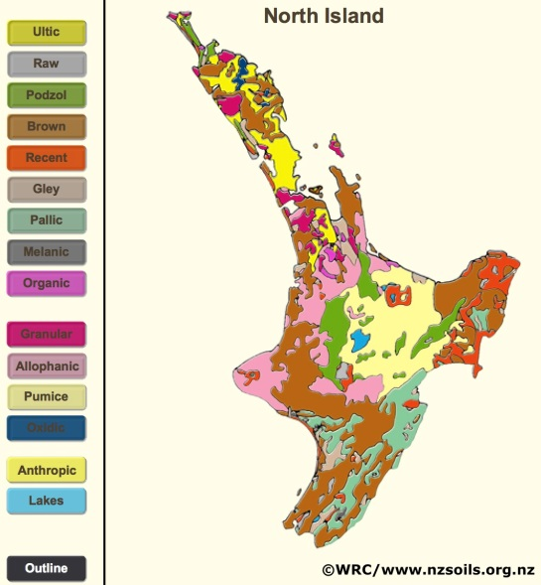
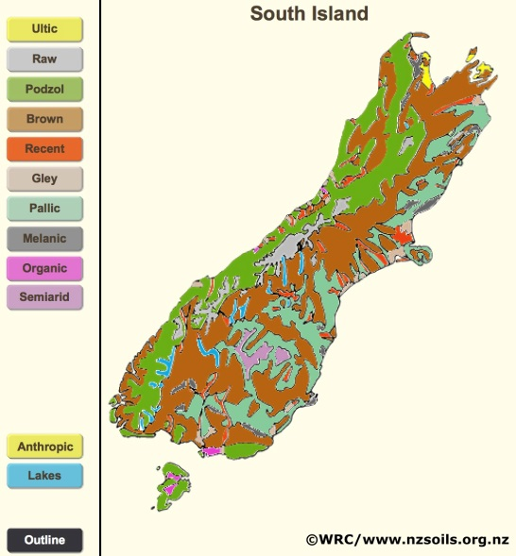
Part 3: Digging deeper
There are about 1,800 soil series in New Zealand! You can find your soil on a soil map – but not all of the maps are online yet.
It will be easier to find your soil order on the interactive Soil Order Maps.
© Copyright University of Waikato. All rights reserved.

Slide 34
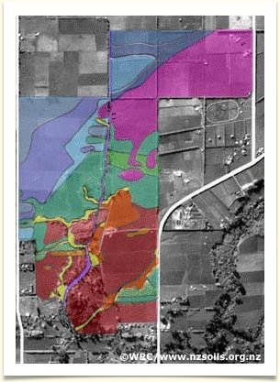
Farm map – changes in soil types and how scientists map soils
Soils have different names. Soil names
Māori soil science
© Copyright University of Waikato. All rights reserved.

Slide 35
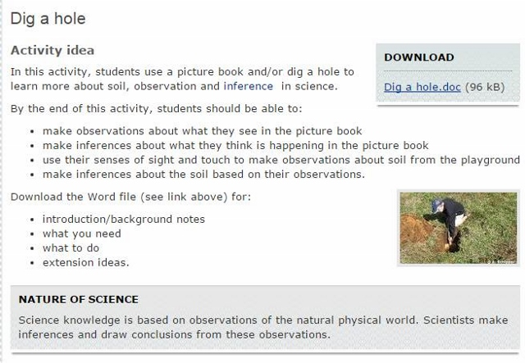
Dig a hole – SLH activity
© Copyright University of Waikato. All rights reserved.

Slide 36
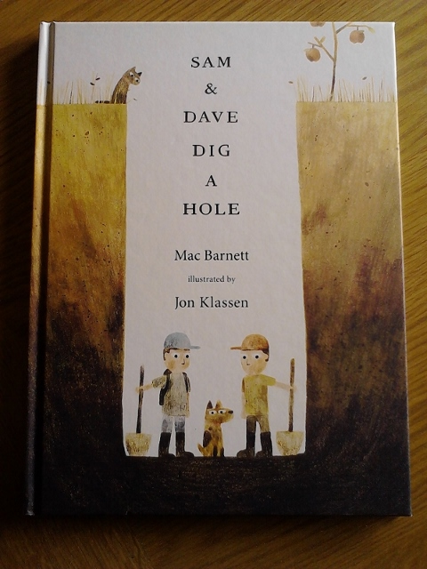
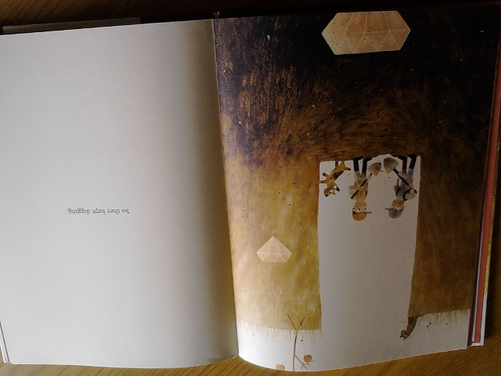
Literacy and science capabilities
Sam & Dave Dig a Hole by Mac Barnett (Walker Books, 2014)
© Copyright University of Waikato. All rights reserved.

Slide 37
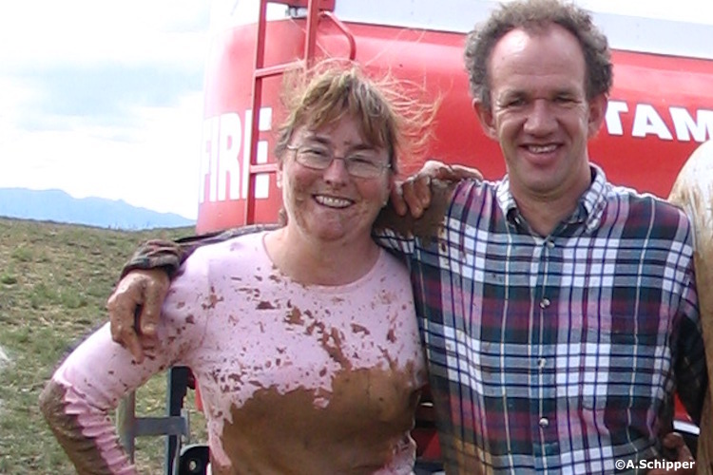
Questions about soil?
Email us enquiries@sciencelearn.org.nz
© Copyright University of Waikato. All rights reserved.

Slide 38




Would you like a promo pack?
Packs of bookmarks and flyers available – email us enquiries@sciencelearn.org.nz
Follow us on Twitter: https://twitter.com/NZScienceLearn
Like us on Facebook: www.facebook.com/nzsciencelearn
Explore our Pinterest Boards: www.pinterest.com/nzsciencelearn
Join us in the Pond: www.pond.co.nz/community/214015/science-learning-hub
© Copyright University of Waikato. All rights reserved.

Slide 39
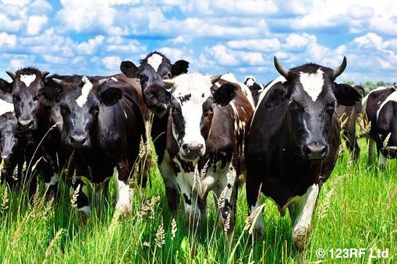
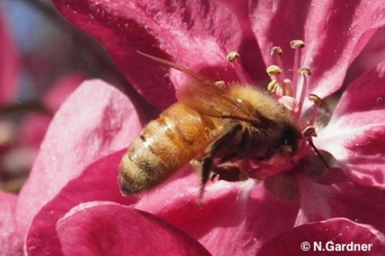
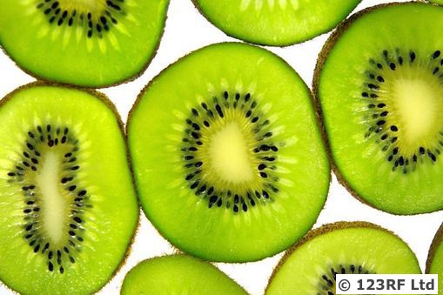
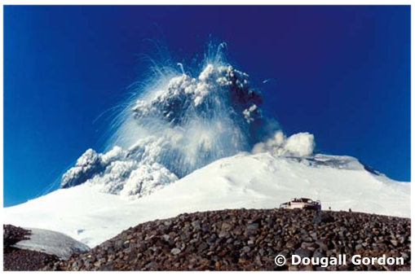

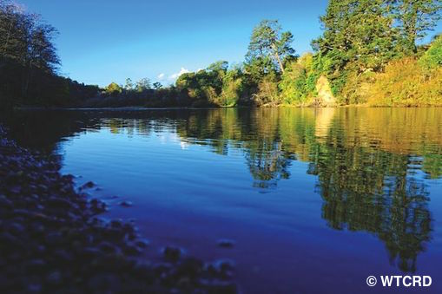


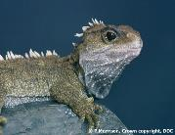

Thanks!
Questions and comments?
The images contained within this PowerPoint presentation are copyrighted to the University of Waikato and other third-party individuals and organisations. Any reuse beyond the classroom as per the intended use of these resources should be cleared with the copyright owner/s.

