Slide 1
The Science
Learning Hub
Resources supporting the teaching and learning about NZ scientists and their research
Kate Rice
19 May 2015
4.00–4:45pm
@NZScienceLearn
www.sciencelearn.org.nz
Notes:
Welcome to the Science Leaning Hub, where you will find a wide variety of science resources designed especially for primary and secondary teachers and students. It is funded by the Ministry of Business, Innovation and Employment.

Slide 2

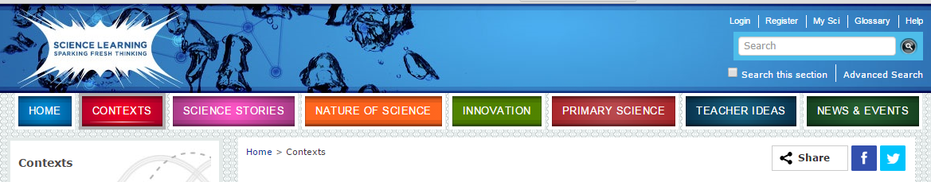
First approach: review the Contexts using the “Sort order” of “Most Recent”
© 2015 The University of Waikato | www.sciencelearn.org.nz
Notes:
http://sciencelearn.org.nz/contexts

Slide 3
Another way to explore what's there … use the top “search” box
Type “recent research” into the search box
© 2015 The University of Waikato | www.sciencelearn.org.nz
Notes:
Enter in quotes “recent research” so it searches for the phrase

Slide 4
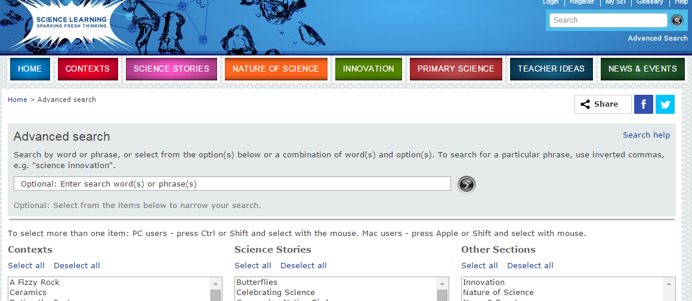
… or use the advanced search option
Fill in details here about the science research you are interested in and select the sections to consider
© 2015 The University of Waikato | www.sciencelearn.org.nz
Notes:
http://sciencelearn.org.nz/search

Slide 5
Resources identified using Contexts search
Context: Gases and Plasma
NZ research includes articles on:
Heat pump design for timber drying
Lightning location network
Plasma spray gun research
Context: Toku Awa Koiora
NZ research includes articles on:
Huntly power station
Trapping koi carp
Wetlands the rivers kidneys
Context: Soil, Farming and Science
NZ research includes articles on :
Inhibiting nitrous emissions –
Denitrification beds
Managing nutrients
Context: Satellites
NZ research includes articles on:
Satellites measure ice thickness
Satellites and weather
Innovation Stories - Biospife
NZ research includes articles on:
The Zespri Biospife article and video
© 2015 The University of Waikato | www.sciencelearn.org.nz
Notes:
http://sciencelearn.org.nz/Contexts/Gases-and-Plasmas
http://sciencelearn.org.nz/Contexts/Toku-Awa-Koiora
http://sciencelearn.org.nz/Contexts/Soil-Farming-and-Science
http://sciencelearn.org.nz/Contexts/Satellites
http://sciencelearn.org.nz/Innovation/Innovation-Stories/Biospife

Slide 6
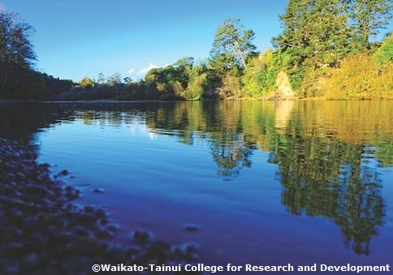
From the huge list you get, I have selected some research to follow up:
From Toku Awa Koiora
Wetlands – the rivers kidneys because it demonstrates
links between scientists, students and iwi
Tuna working with glass eels because it shows that
sometimes science research outcomes may be commercially
viable, but other considerations might be important
Trapping koi carp shows the response of scientists to an
environmental problem by relying on careful observation to lead to an effective outcome
Whitebaiting models links between scientists and other groups where anecdotal information can help scientists see the bigger picture
These could be developed to use in a teaching sequence
© 2015 The University of Waikato | www.sciencelearn.org.nz
Notes:
http://sciencelearn.org.nz/Contexts/Toku-Awa-Koiora/Sci-Media/Images/Waikato-River

Slide 7
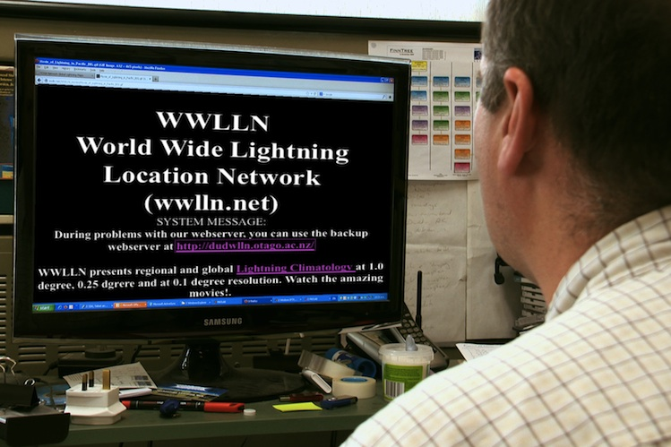
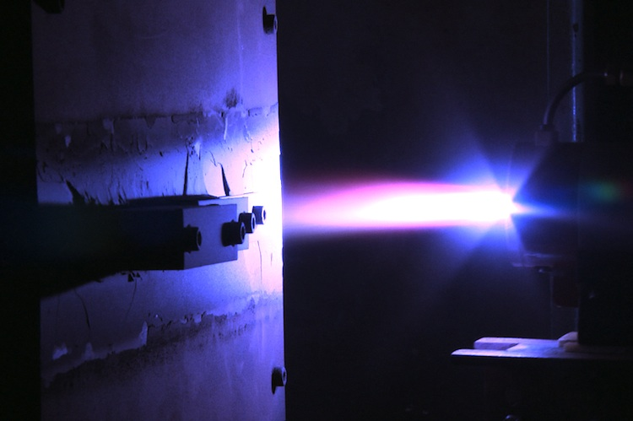
From Gases and Plasmas
Lightning location network might not sound exciting – but Dr Craig Rodger has developed and run a world wide network used to detect and locate lightning strikes.
Heat pump for timber drying demonstrates how scientists can link with technologists to provide an efficient solution that has not been economically viable.
Plasma spray splat patterns demonstrates how a team of scientists worked to solve a problem – with major impact for the aluminium industry – Professor Margaret Hyland led the team.
© 2015 The University of Waikato | www.sciencelearn.org.nz
Notes:
http://sciencelearn.org.nz/Contexts/Gases-and-Plasmas/Sci-Media/Video/What-is-WWLLN
http://sciencelearn.org.nz/Contexts/Gases-and-Plasmas/Sci-Media/Video/Plasma-spray-research

Slide 8
Two possible teaching activities using the Science Capabilities
Using Evidence - Science Capability
This capability can be used to support students to use information from annotated diagrams to explain scientific observations. In this activity, students use the Heat and change of state diagram to write an explanation of how heat energy is involved in the change of state as ice changes to water and then to water vapour.
Interpreting Representations Science Capability
Students need to be supported to find and process information from visual representations. In this activity, the Basic heat pump cycle diagram is used to enable students to think about the information in the diagram and how it is presented to help them understand how a heat pump works.
© 2015 The University of Waikato | www.sciencelearn.org.nz

Slide 9
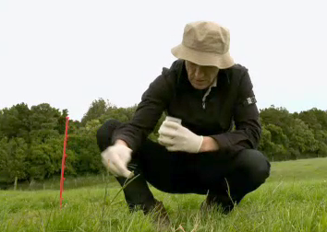
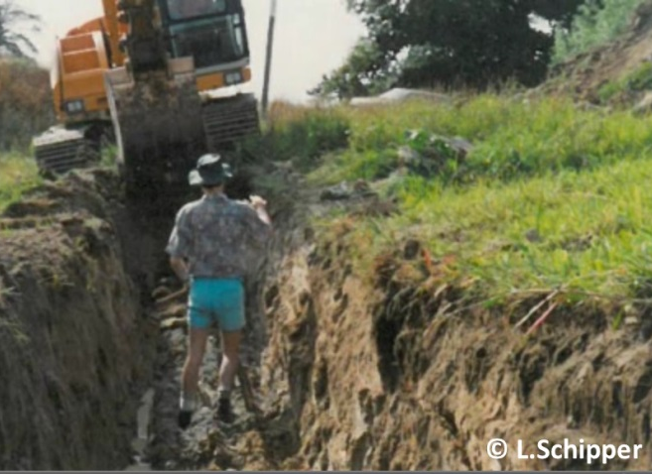
From the Context Soil, Farming and Science
Inhibiting nitrification and Inhibiting nitrous emissions – where science may provide possible solutions, but industry and trade issues may not allow the solution to the issue to be implemented.
Denitrification beds – a creative approach – demonstrates that creativity is an essential part of seeking solutions to scientific problems – and that international cooperation can lead to solutions to worldwide issues.
Managing nutrients - shows that a team approach to a problem can allow different aspects of the problem to be modelled and possible solutions developed, however the economic and practical considerations may outweigh the uptake of the scientists’ suggestions when they presented to the primary producers.
© 2015 The University of Waikato | www.sciencelearn.org.nz
Notes:
http://sciencelearn.org.nz/Contexts/Soil-Farming-and-Science/Sci-Media/Video/Nitrification-inhibitors
http://sciencelearn.org.nz/Contexts/Soil-Farming-and-Science/Sci-Media/Video/Denitrification-beds-and-walls

Slide 10
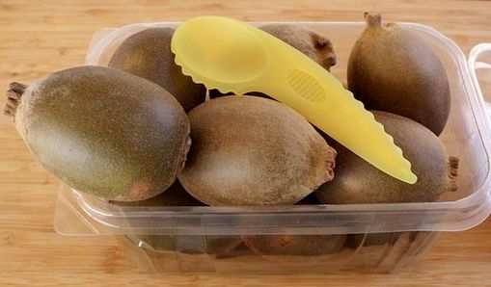
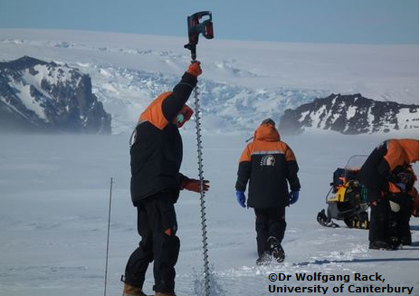
From the context Satellites
From the
Innovation story Biospife
The Zespri biospife – both the article and the videos help build for students an understanding of the many facets of research and innovation involved in developing a solution to a problem.
Satellites measure sea ice thickness, Satellites to study Antarctic atmosphere – present ways that scientists work with other agencies – in this case to verify the information being recorded using satellites by using hand measurements and specially designed devices such as the EM bird and
specially developed
weather stations.
© 2015 The University of Waikato | www.sciencelearn.org.nz
Notes:
http://sciencelearn.org.nz/Contexts/Satellites/Sci-Media/Images/Dr-Wolfgang-Rack-drills-through-the-Ice
http://sciencelearn.org.nz/Innovation/Innovation-Stories/Biospife/Images/Pack-of-kiwifruit

Slide 11
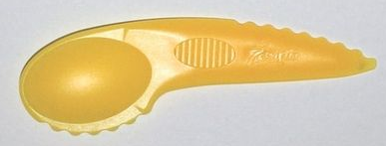
Quiz on the research involved in the biospife
Who was involved in the production of biospife?
What is special about the properties of the biospife?
Why was it important to develop the biospife?
Why are the improved features of the biospife important for the companies involved in its development and production?
ZESPRI and Scion as well as original plastic spife producer ALTO
It is made from bioplastic containing kiwifruit residues and is compostable
To satisfy consumer demand for environmentally friendly products and to meet more stringent regulations for overseas markets
They are meeting an international consumer market focussed on using sustainable materials and reducing wastes, also reducing the carbon footprint.
© 2015 The University of Waikato | www.sciencelearn.org.nz
Notes:
http://sciencelearn.org.nz/Innovation/Innovation-Stories/Biospife/Images/ZESPRI-spife

Slide 12
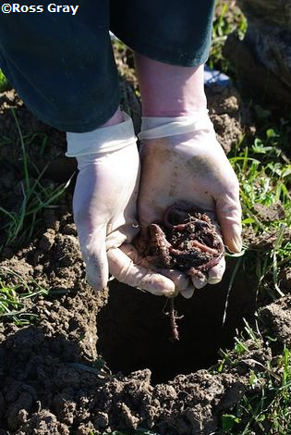
Resources to introduce ideas about the
NZ science research is by using some of the Nature of science focussed articles
A great starting point is the Earthworms Science Story, which introduces the aspects of the curriculum relating to:
investigating in science and
the role of observation in science.
the ethics of keeping earthworms in the classroom
These three aspects can introduce ideas on how scientists work and use models to explore an issue, seek solutions to a problem or simply find evidence to back up an observation or a “hunch”.
Find this resource at: http://S
© 2015 The University of Waikato | www.sciencelearn.org.nz
Notes:
http://sciencelearn.org.nz/Science-Stories/Earthworms/Sci-Media/Images/Earthworm-research

Slide 13

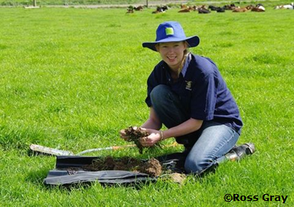
Developing understanding the role of observation in NZ Science Research
Use a guided reading process with the Science Ideas and Concepts resource “The role of observation in science”.
1. Reading on the lines:
List three main ideas covered in this reading
List two tools scientists use to help observe
What did Darwin observe earthworms to find out about
2. Reading between the lines:
How do scientists use observation to carry out their
research?
Why did Dr Fraser use CAT scans?
3. Reading beyond the lines:
Why is observing and knowing about earthworms important for our future?
© 2015 The University of Waikato | www.sciencelearn.org.nz
Notes:
Image handsorting earthworms from Science Stories Earthworms – the role of observation in science
http://sciencelearn.org.nz/Science-Stories/Earthworms/Sci-Media/Images/Hand-sorting-earthworms -

Slide 14
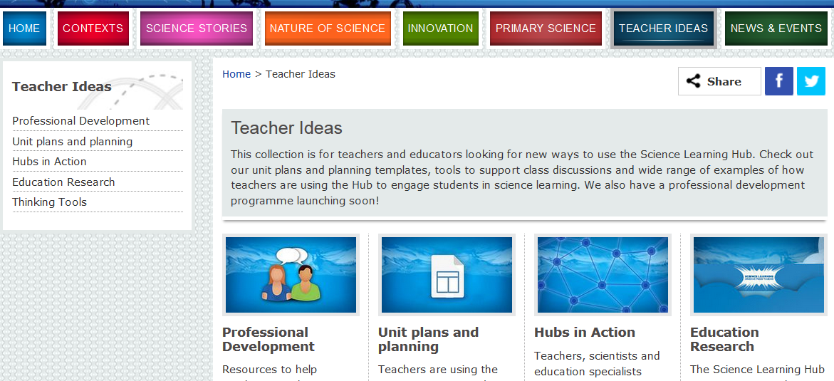
Other useful places for Teacher ideas on SLH
© 2015 The University of Waikato | www.sciencelearn.org.nz

Slide 15
Accessing today’s resources
This power point will be added to the Teacher Ideas section under the Professional Development section
Other useful resources can be found in the Unit Plans and Planning section
COMING SOON -
This will include resources useful to develop scientific literacy and aspects of Communicating in Science
© 2015 The University of Waikato | www.sciencelearn.org.nz

Slide 16
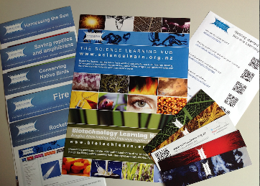


Would you like a promo pack?
Packs of bookmarks and flyers available – email us enquiries@sciencelearn.org.nz
Follow us on Twitter: https://twitter.com/NZScienceLearn
Like us on Facebook: www.facebook.com/nzsciencelearn
Explore our Pinterest boards: www.pinterest.com/nzsciencelearn
© 2015 The University of Waikato | www.sciencelearn.org.nz

Slide 17
Thank you
Questions and comments?
The images contained within this PowerPoint presentation are copyrighted to the University of Waikato and other 3rd party individuals and organisations. Any reuse beyond the classroom as per the intended use of these resources, should be cleared with the copyright owner/s.
© 2015 The University of Waikato | www.sciencelearn.org.nz

