Slide 1

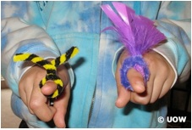
Science for juniors
Barb Ryan
March 2016
@NZScienceLearn
www.sciencelearn.org.nz
© 2015 The University of Waikato | www.sciencelearn.org.nz

Slide 2


What is the Science Learning Hub?
A trustworthy online resource – produced by educators and scientists
Based on world-class New Zealand science research
Supported by learning activities, information about the key science ideas and concepts, multimedia tools and other resources
Written for New Zealand teachers and students

Slide 3
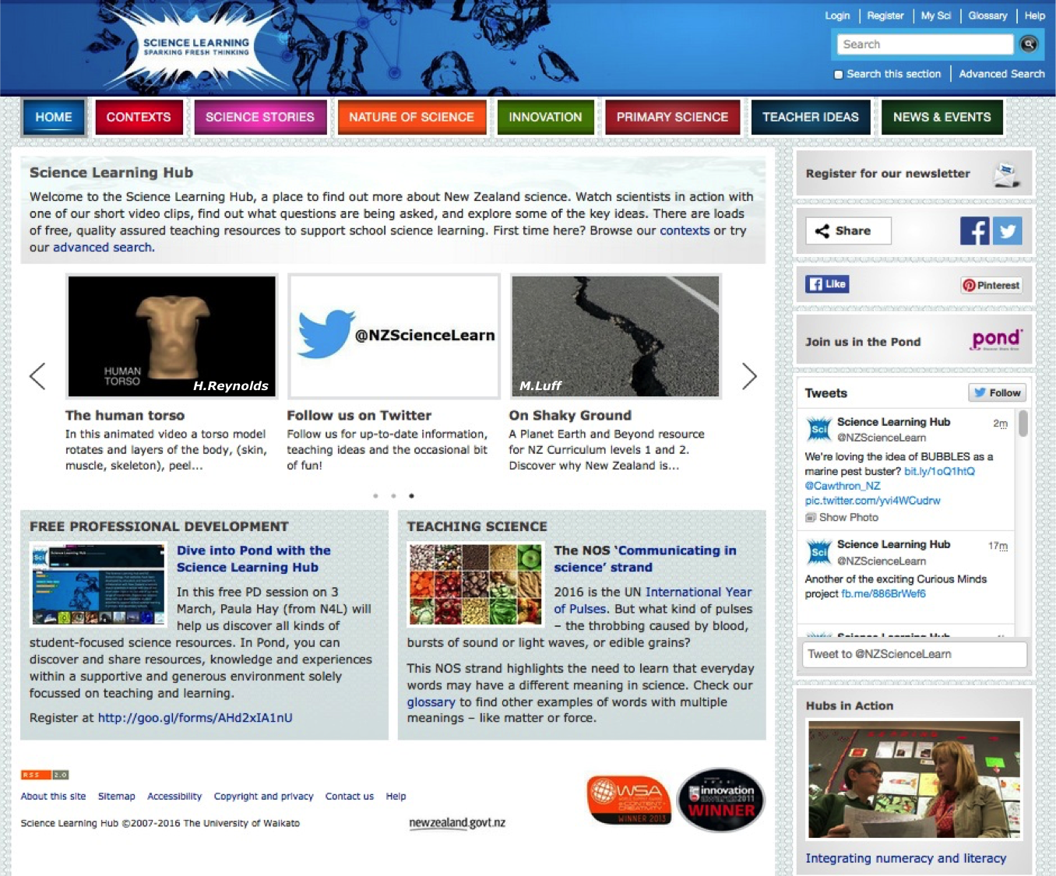

Slide 4
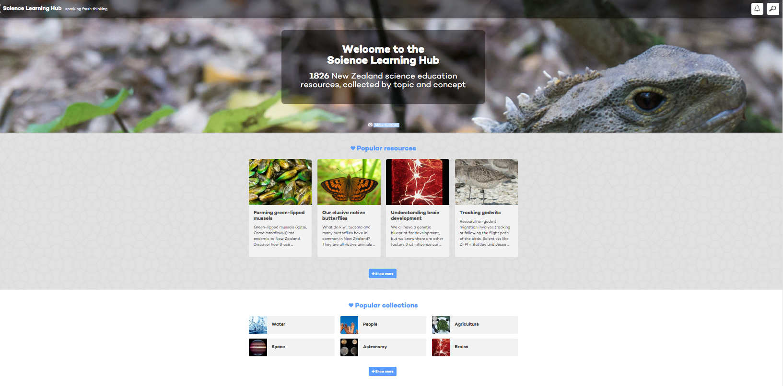
New look for the Science Learning Hub
All images are copyrighted. For further information, please refer to enquiries@sciencelearn.org.nz
© 2016 The University of Waikato | www.sciencelearn.org.nz

Slide 5
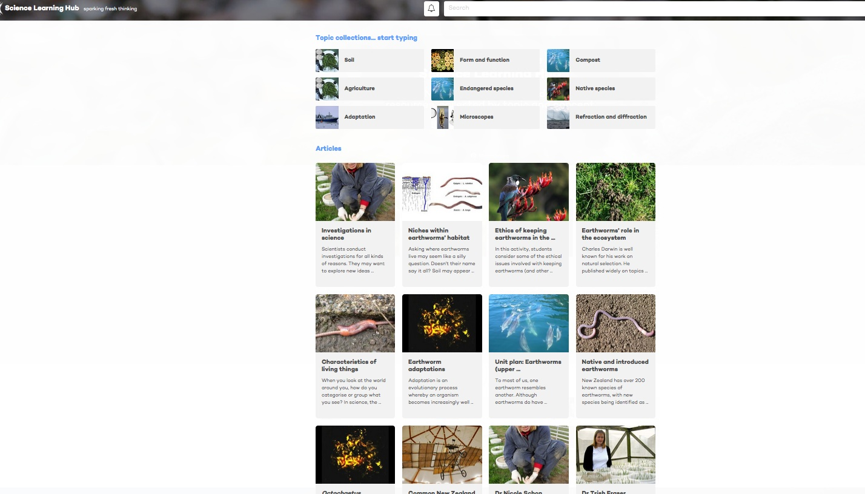
All images are copyrighted. For further information, please refer to enquiries@sciencelearn.org.nz
© 2016 The University of Waikato | www.sciencelearn.org.nz

Slide 6
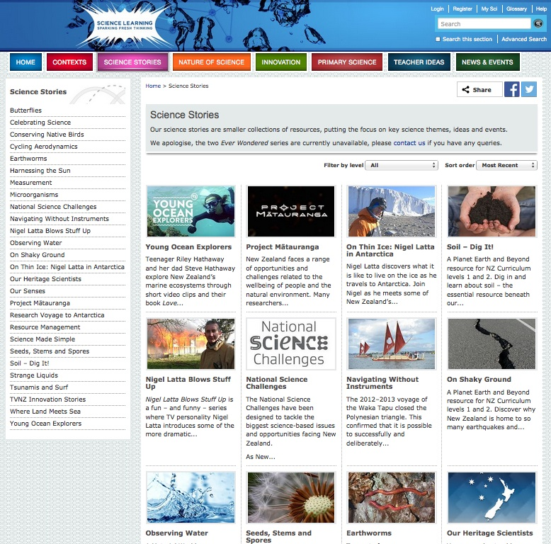
All images are copyrighted. For further information, please refer to enquiries@sciencelearn.org.nz

Slide 7
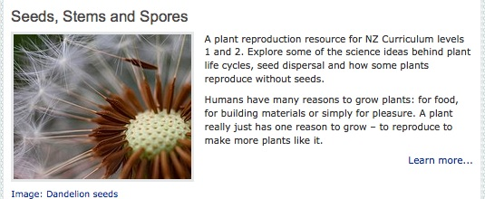
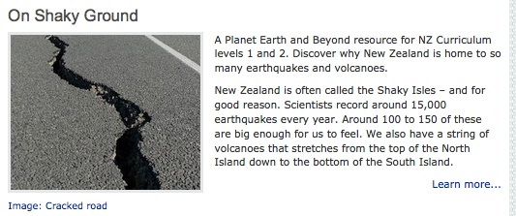
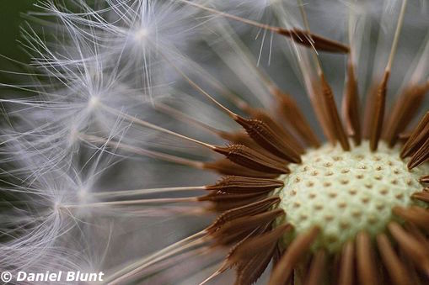
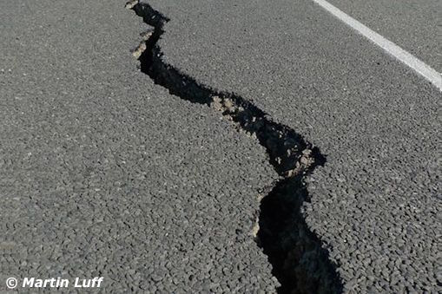
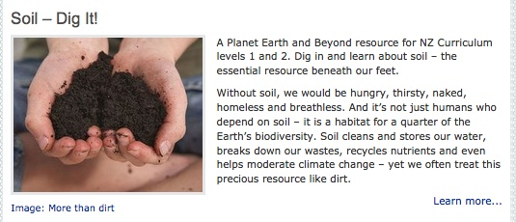
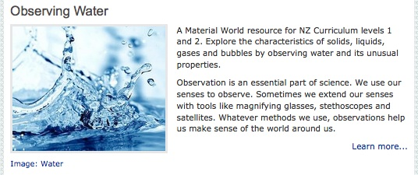
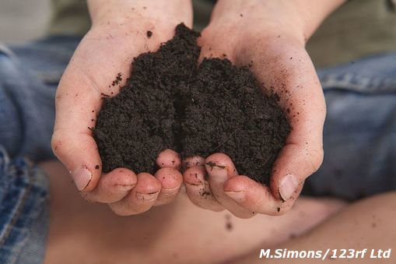
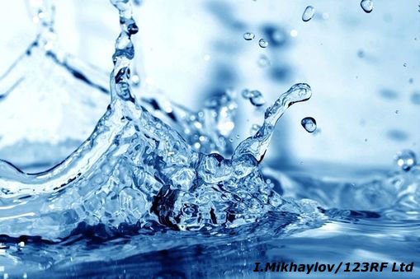
Four science stories for Level 1 and 2 children
© 2016 The University of Waikato | www.sciencelearn.org.nz

Slide 8
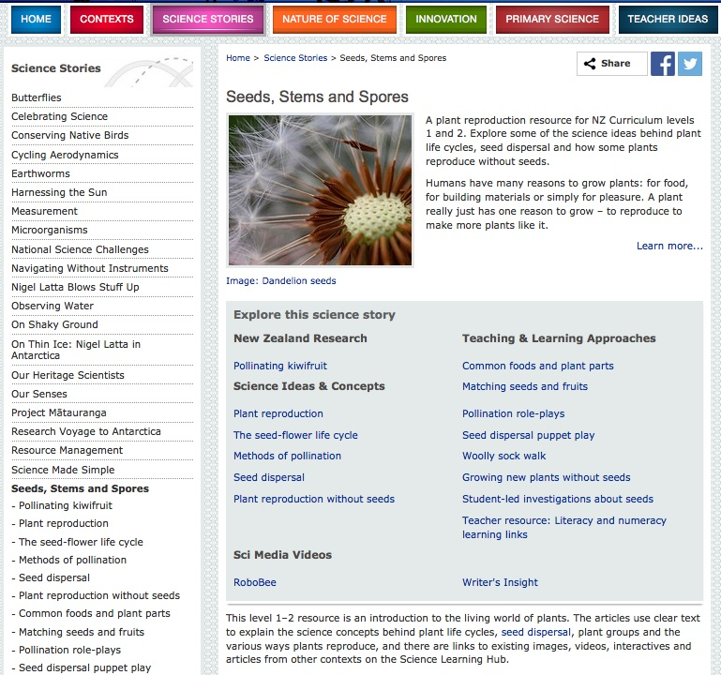

Slide 9
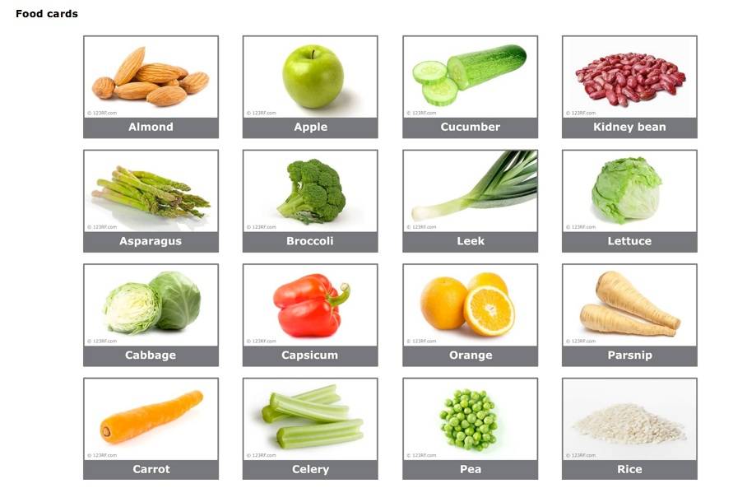
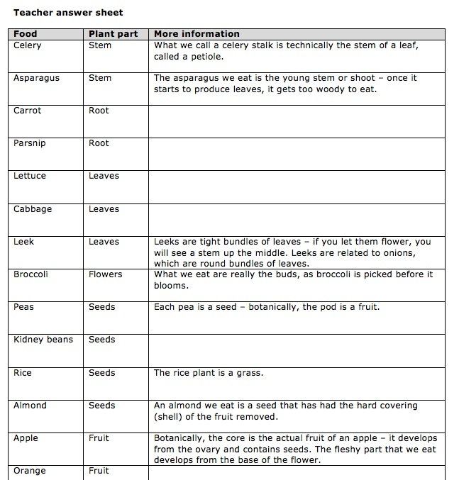
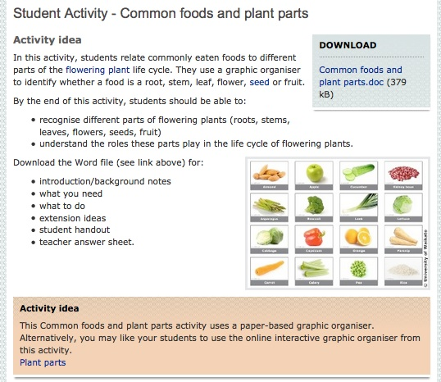
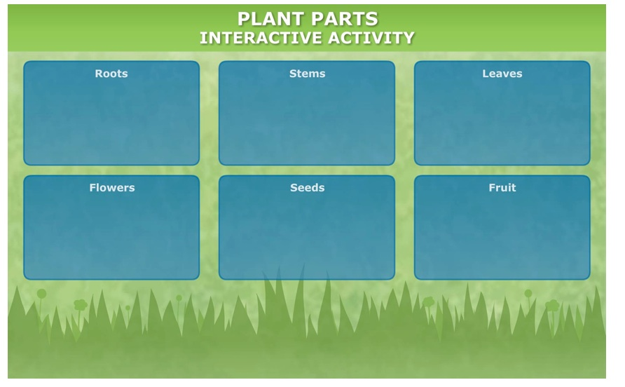
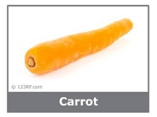
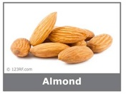
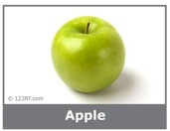
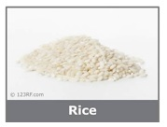
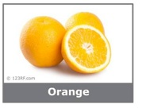
© 2016 The University of Waikato | www.sciencelearn.org.nz

Slide 10
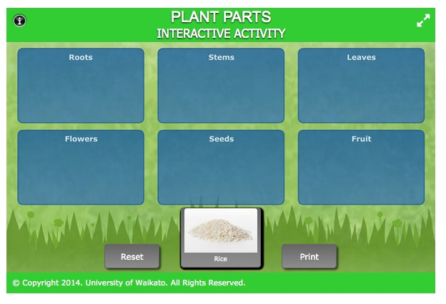
http://sciencelearn.org.nz/Contexts/Pollination/Teaching-and-Learning-Approaches/Plant-parts

Slide 11
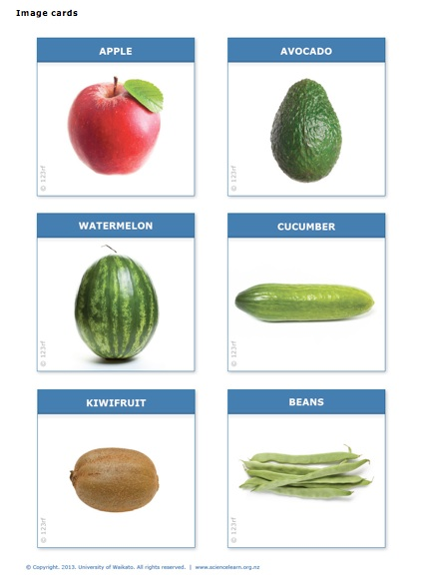
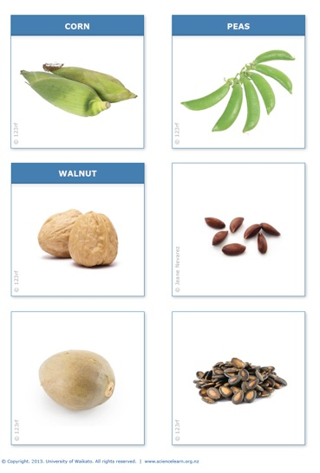
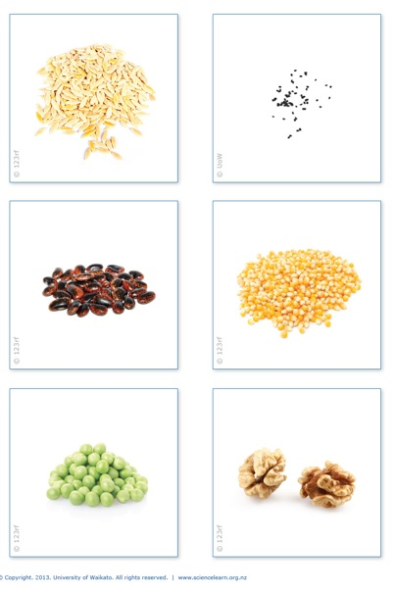
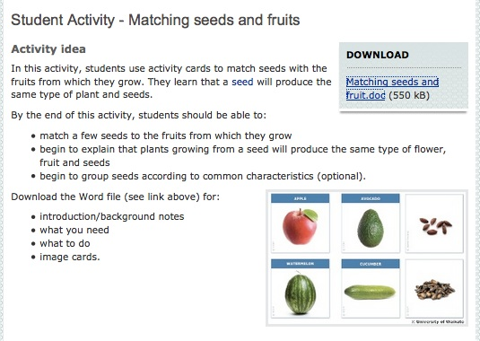
© 2016 The University of Waikato | www.sciencelearn.org.nz

Slide 12
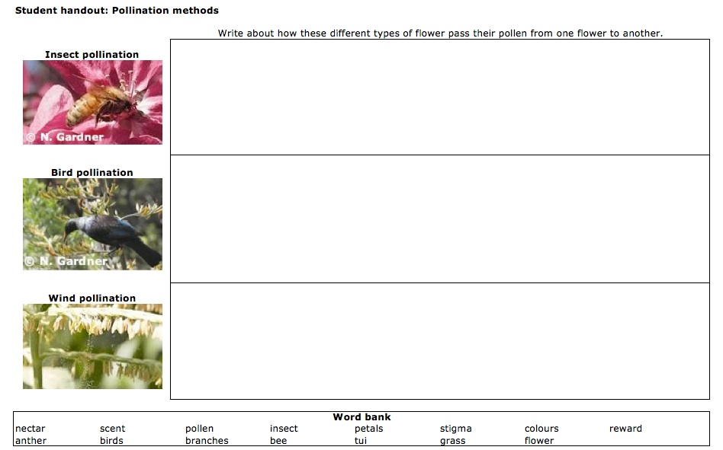
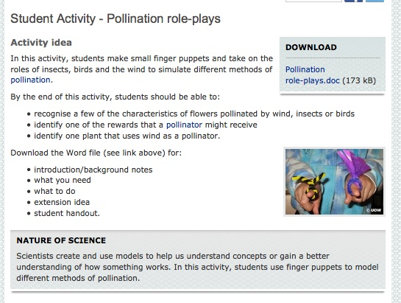
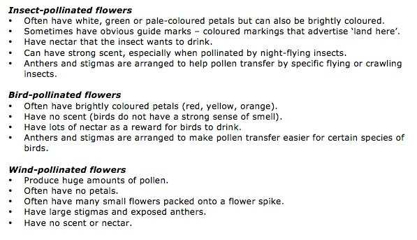
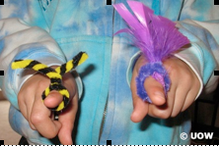
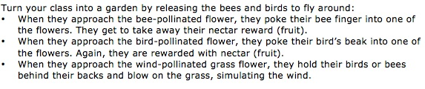
© 2016 The University of Waikato | www.sciencelearn.org.nz

Slide 13
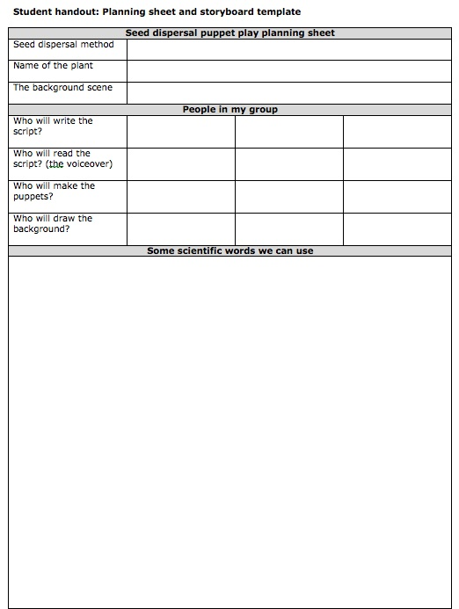
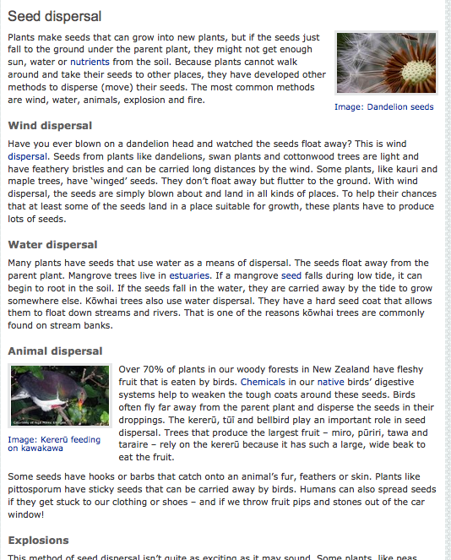
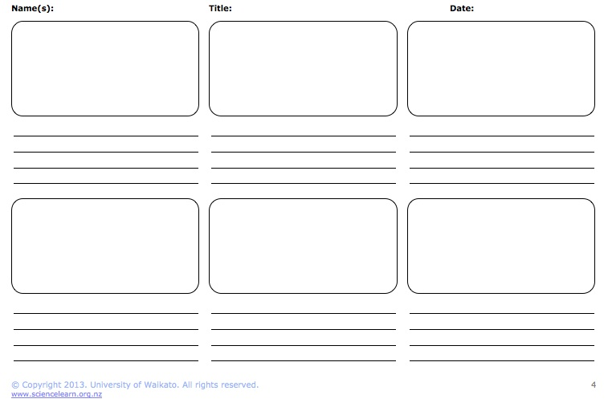
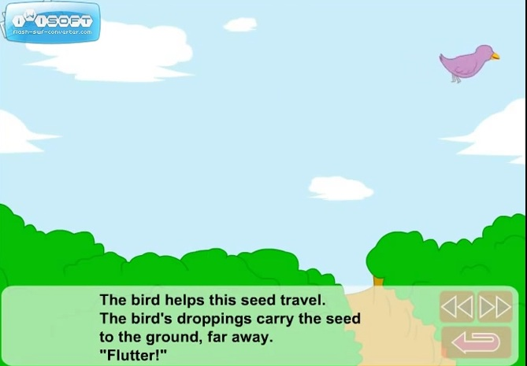

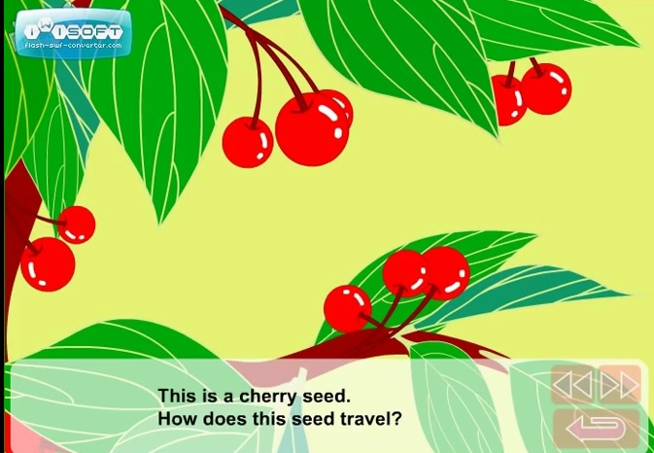
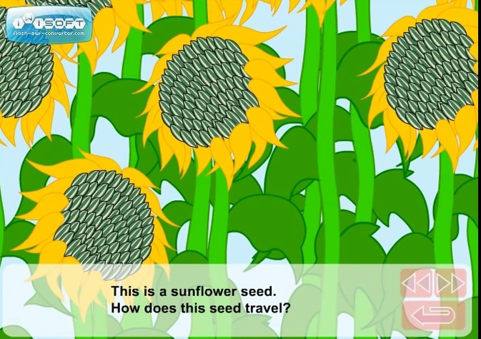
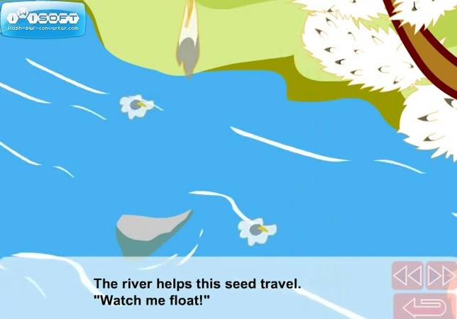
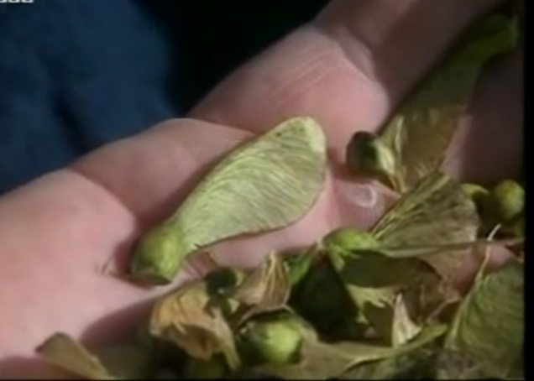

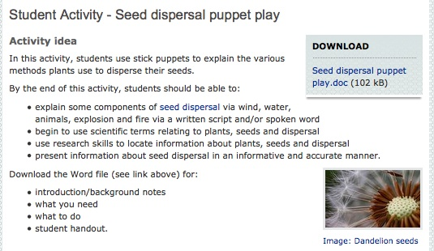

Slide 14
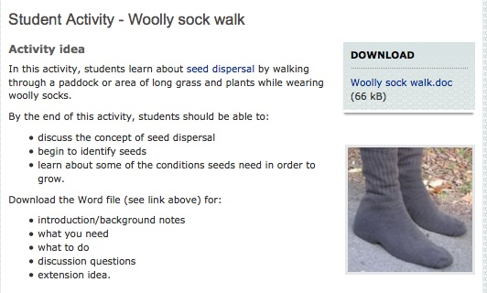
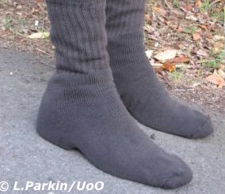

Slide 15
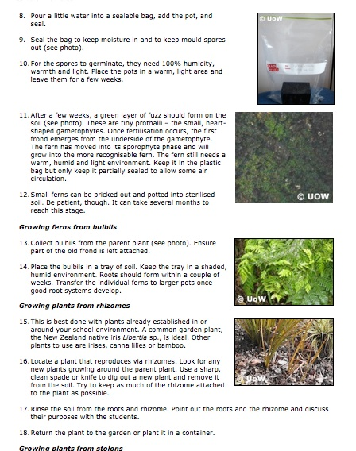
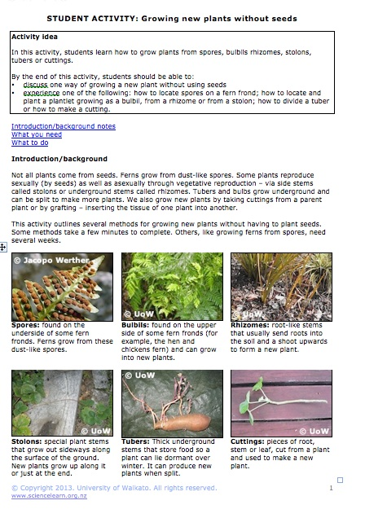
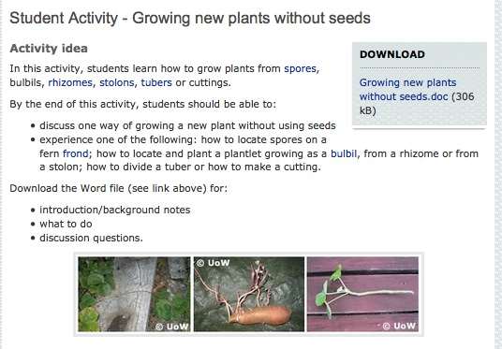
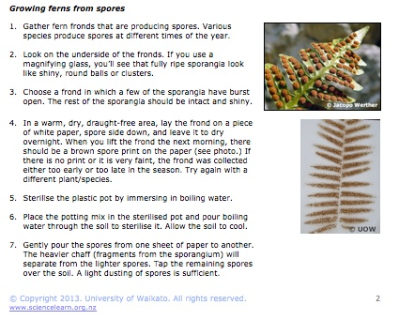

Slide 16
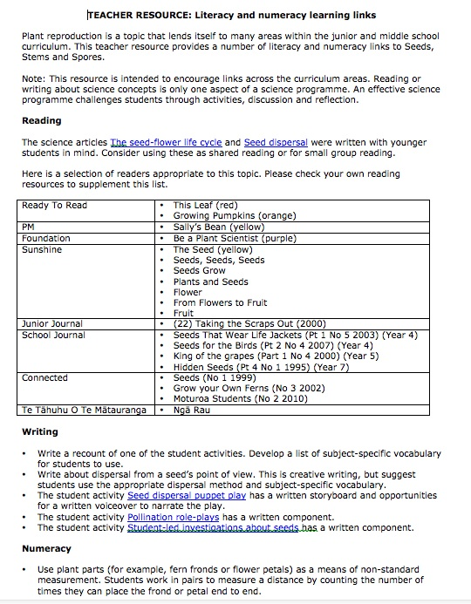
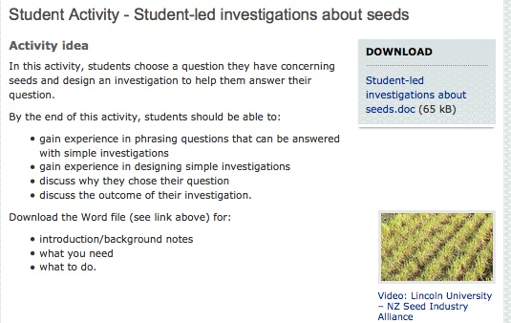

Slide 17





Science ideas and concepts

Slide 18


Slide 19




Slide 20



Video – Water is everywhere

Slide 21


Slide 22


Slide 23





Slide 24





Slide 25










Slide 26




Slide 27


Slide 28




Models of the Earth

Slide 29





Slide 30
Tectonic plates, volcanoes and earthquakes (video)

Slide 31




Slide 32





Slide 33




Science ideas and concepts for teachers
Mt Ruapehu photo © Dougall Gordon

Slide 34


Slide 35





Slide 36



Slide 37




Slide 38




Slide 39








Slide 40




Slide 41


Slide 42








Articles on soil
All images are copyrighted. For further information, please refer to enquiries@sciencelearn.org.nz

Slide 43




Would you like a promo pack?
Packs of bookmarks and flyers available – email us enquiries@sciencelearn.org.nz
Follow us on Twitter: https://twitter.com/NZScienceLearn
Like us on Facebook: www.facebook.com/nzsciencelearn
Explore our Pinterest Boards: www.pinterest.com/nzsciencelearn
Join us in the pond: www.pond.co.nz/community/214015/science-learning-hub
© 2016 The University of Waikato | www.sciencelearn.org.nz

Slide 44










Thanks!
Questions and comments?
The images contained within this PowerPoint presentation are copyrighted to the University of Waikato and other 3rd party individuals and organisations. Any reuse beyond the classroom as per the intended use of these resources, should be cleared with the copyright owner/s.

