Slide 3
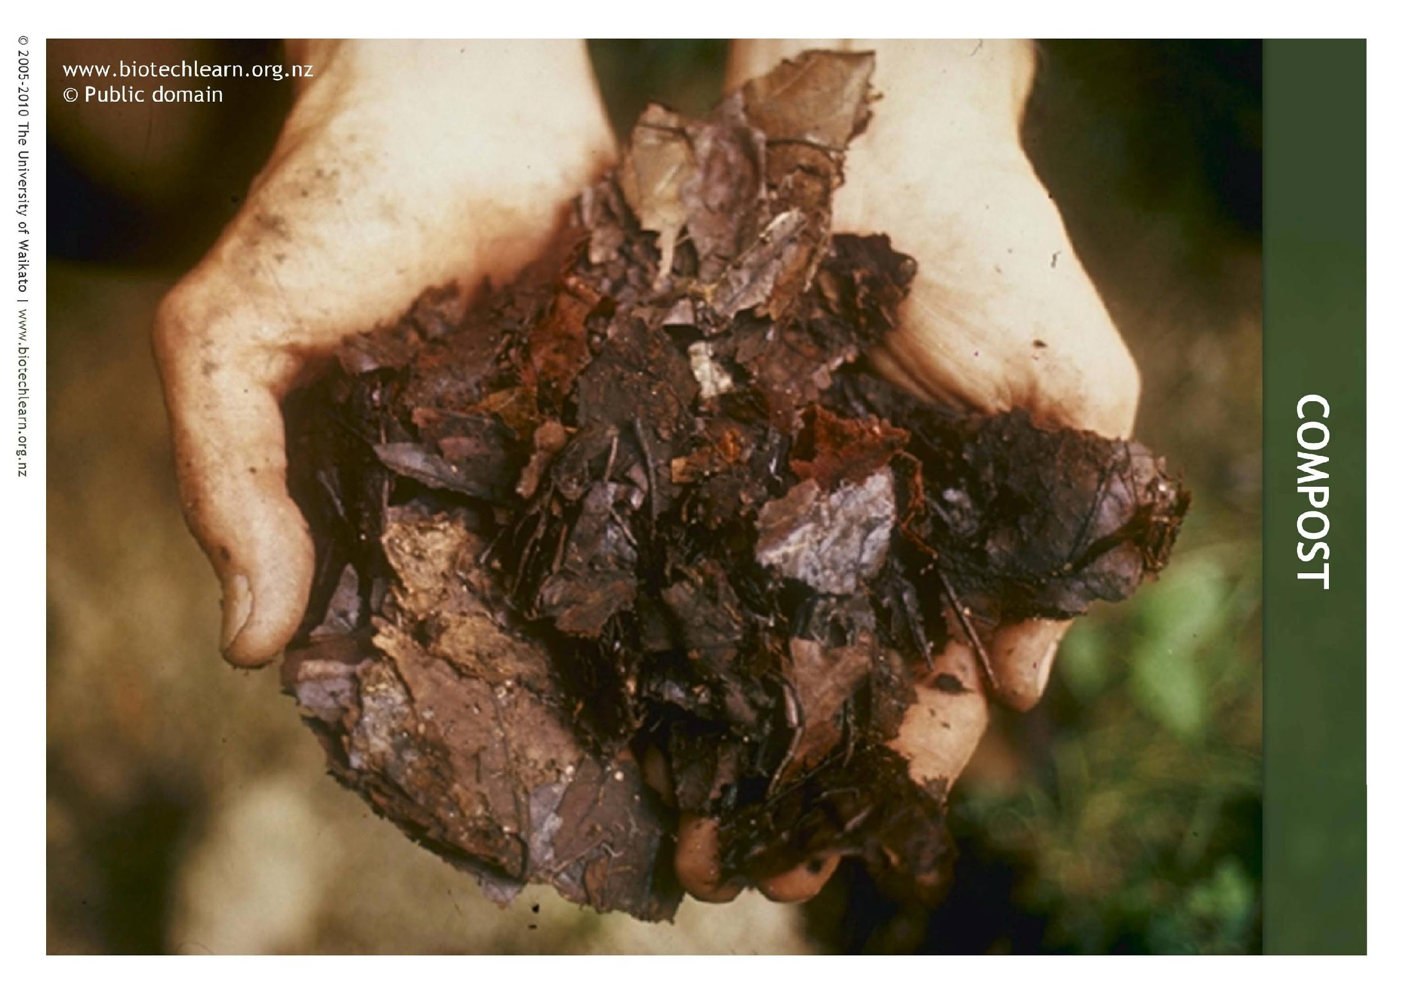

Slide 4
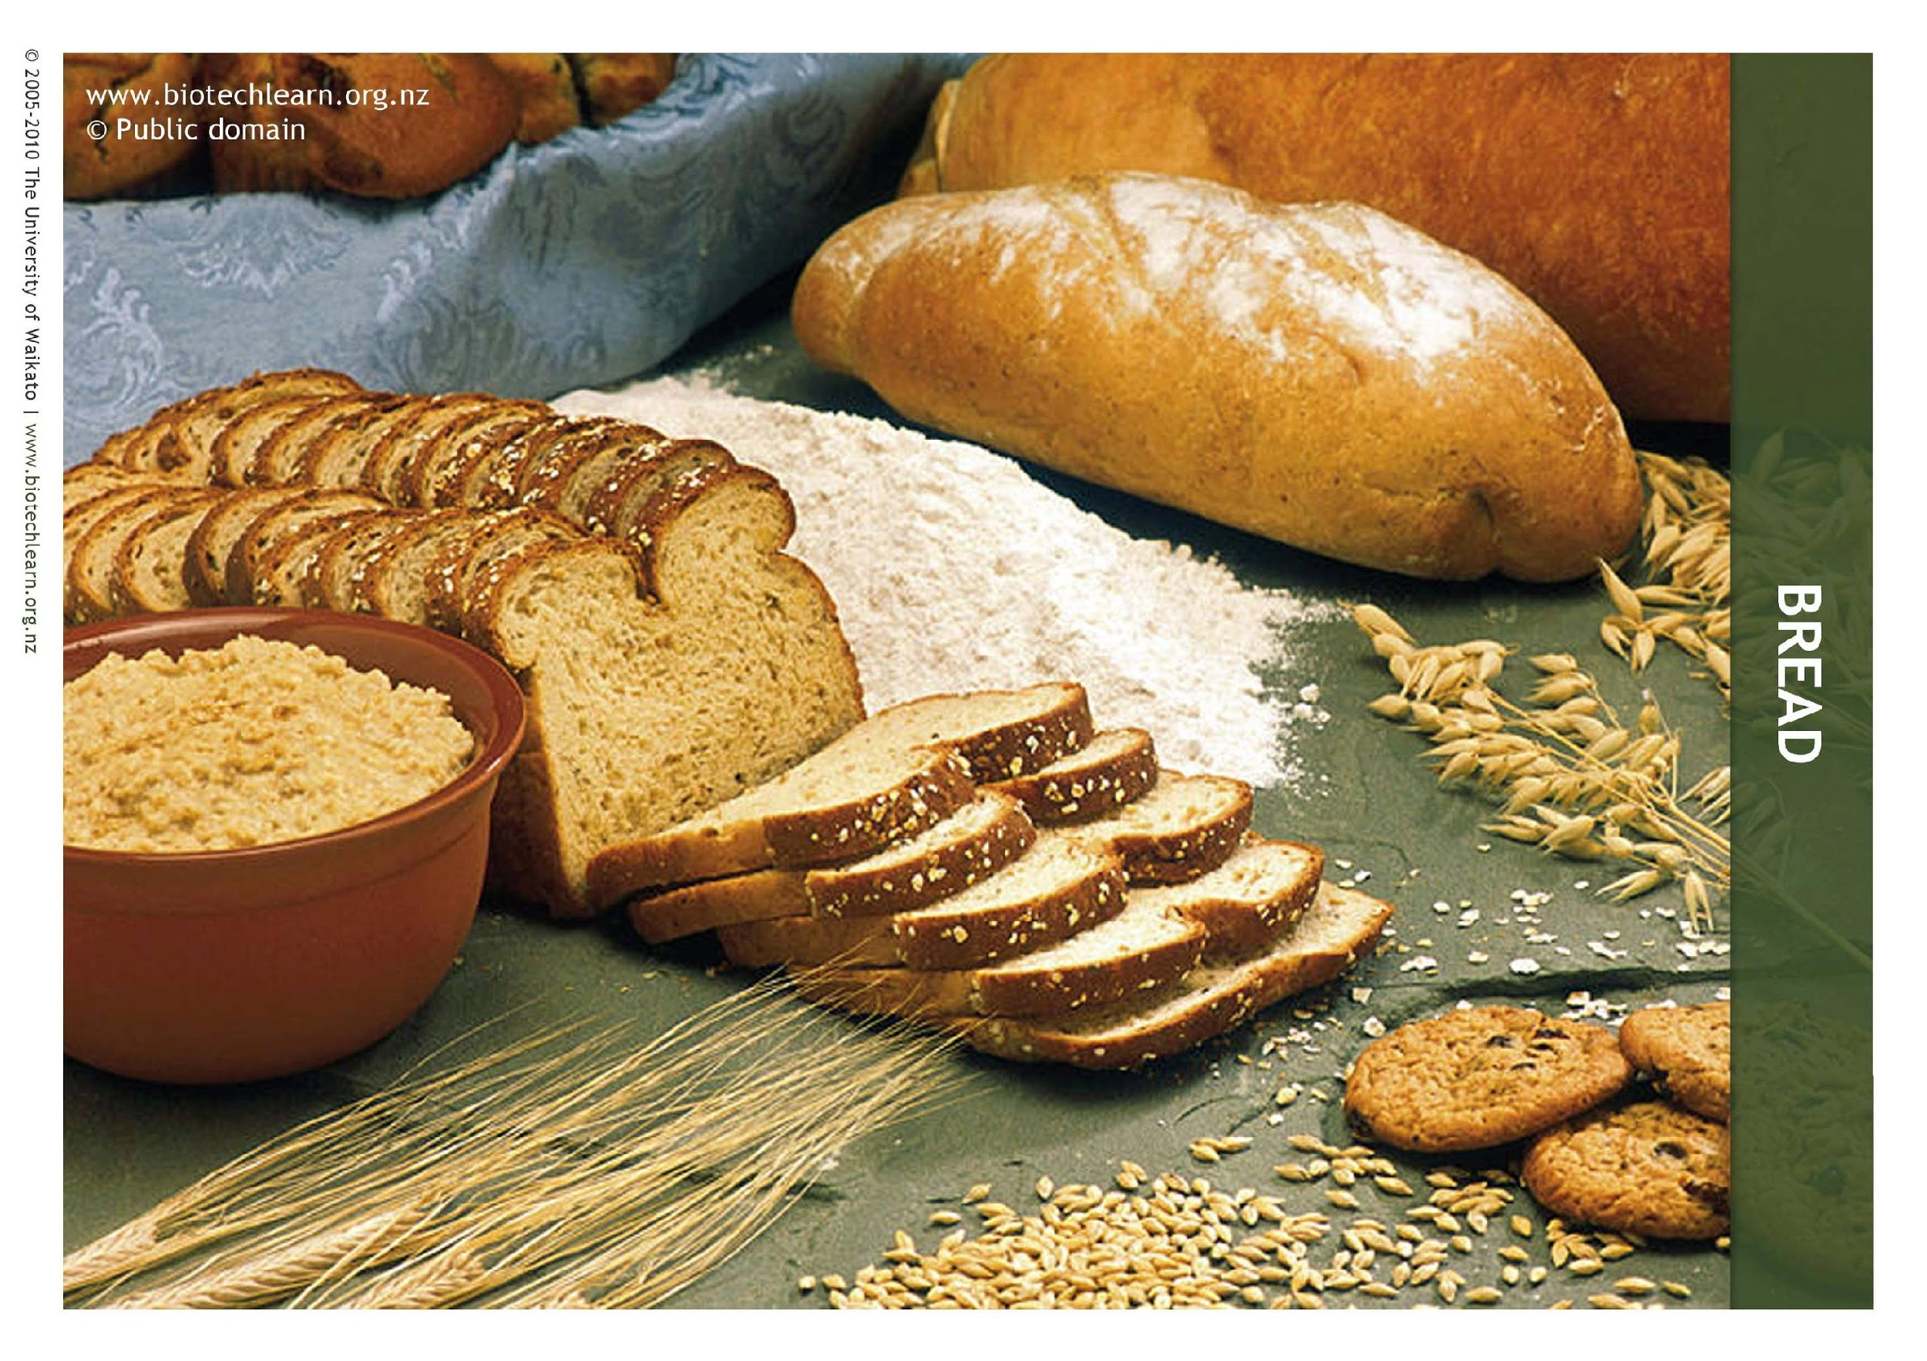

Slide 7
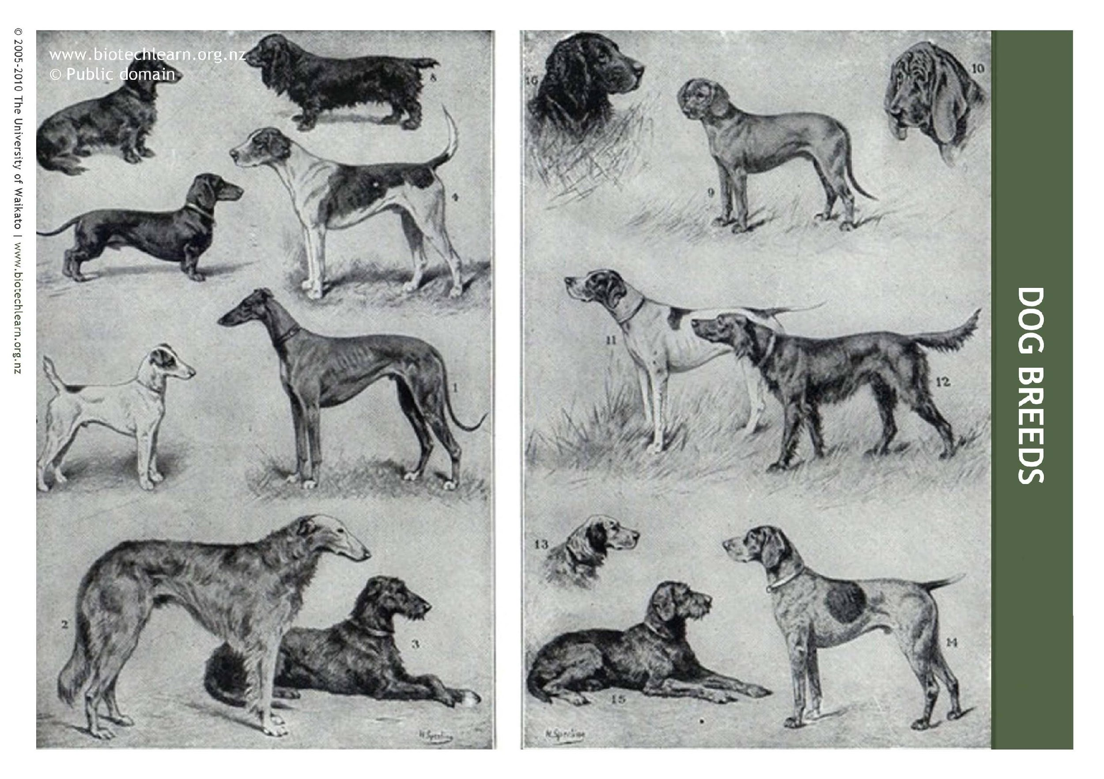

Slide 9
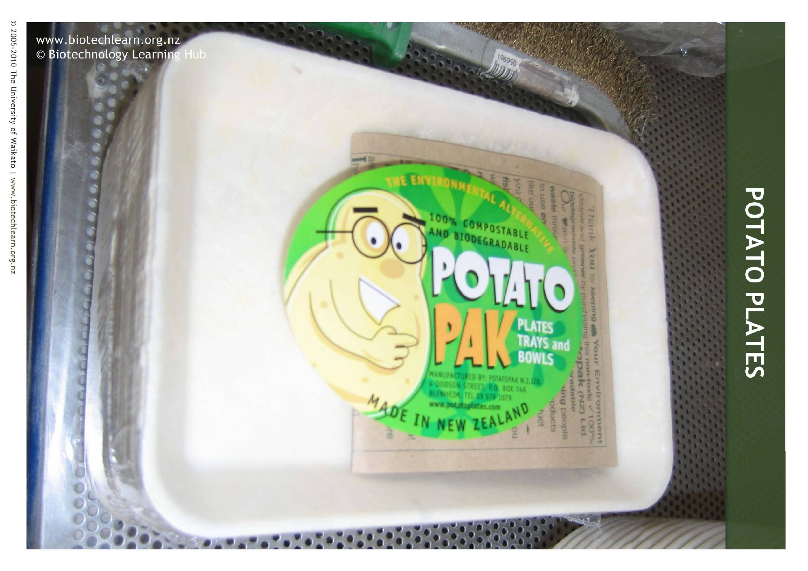

Slide 10
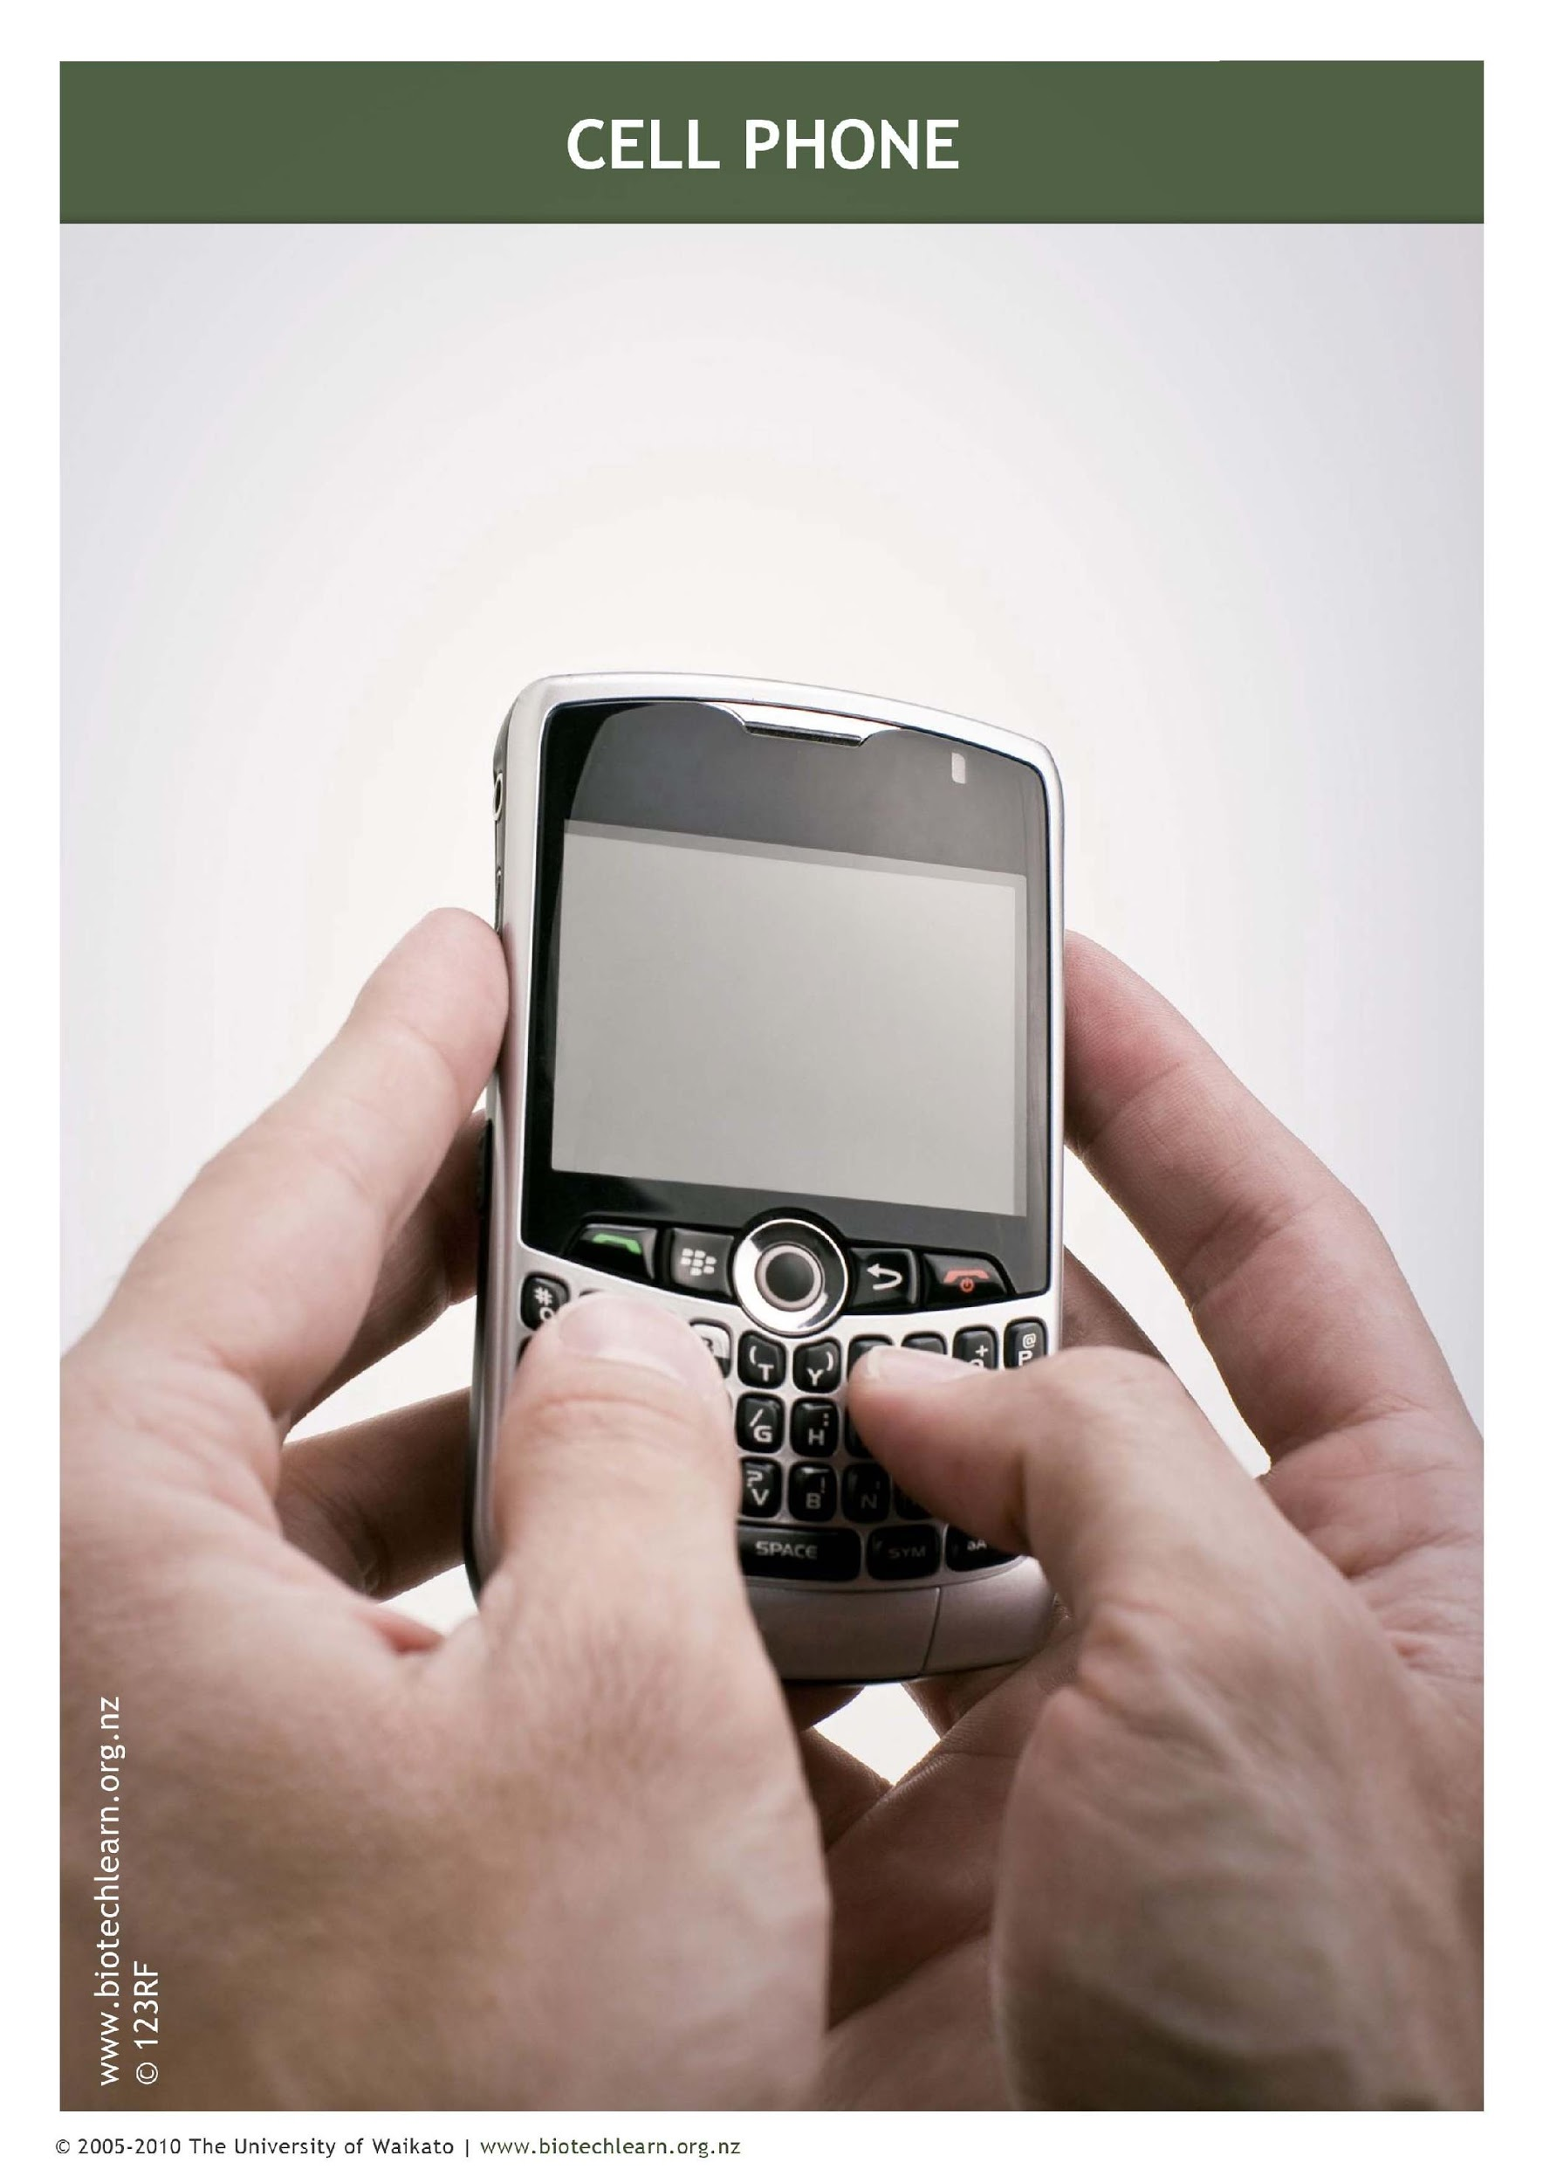

Slide 11
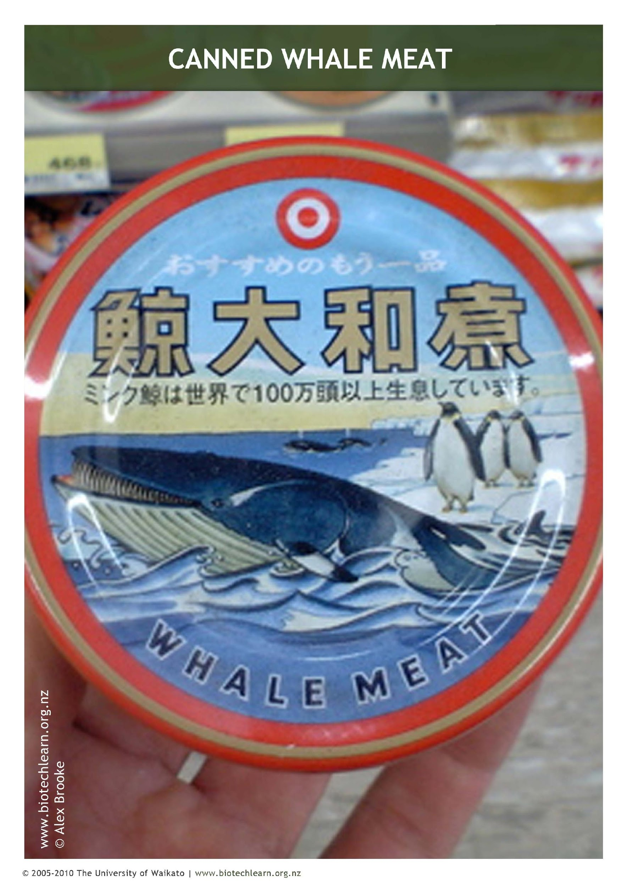

Slide 12
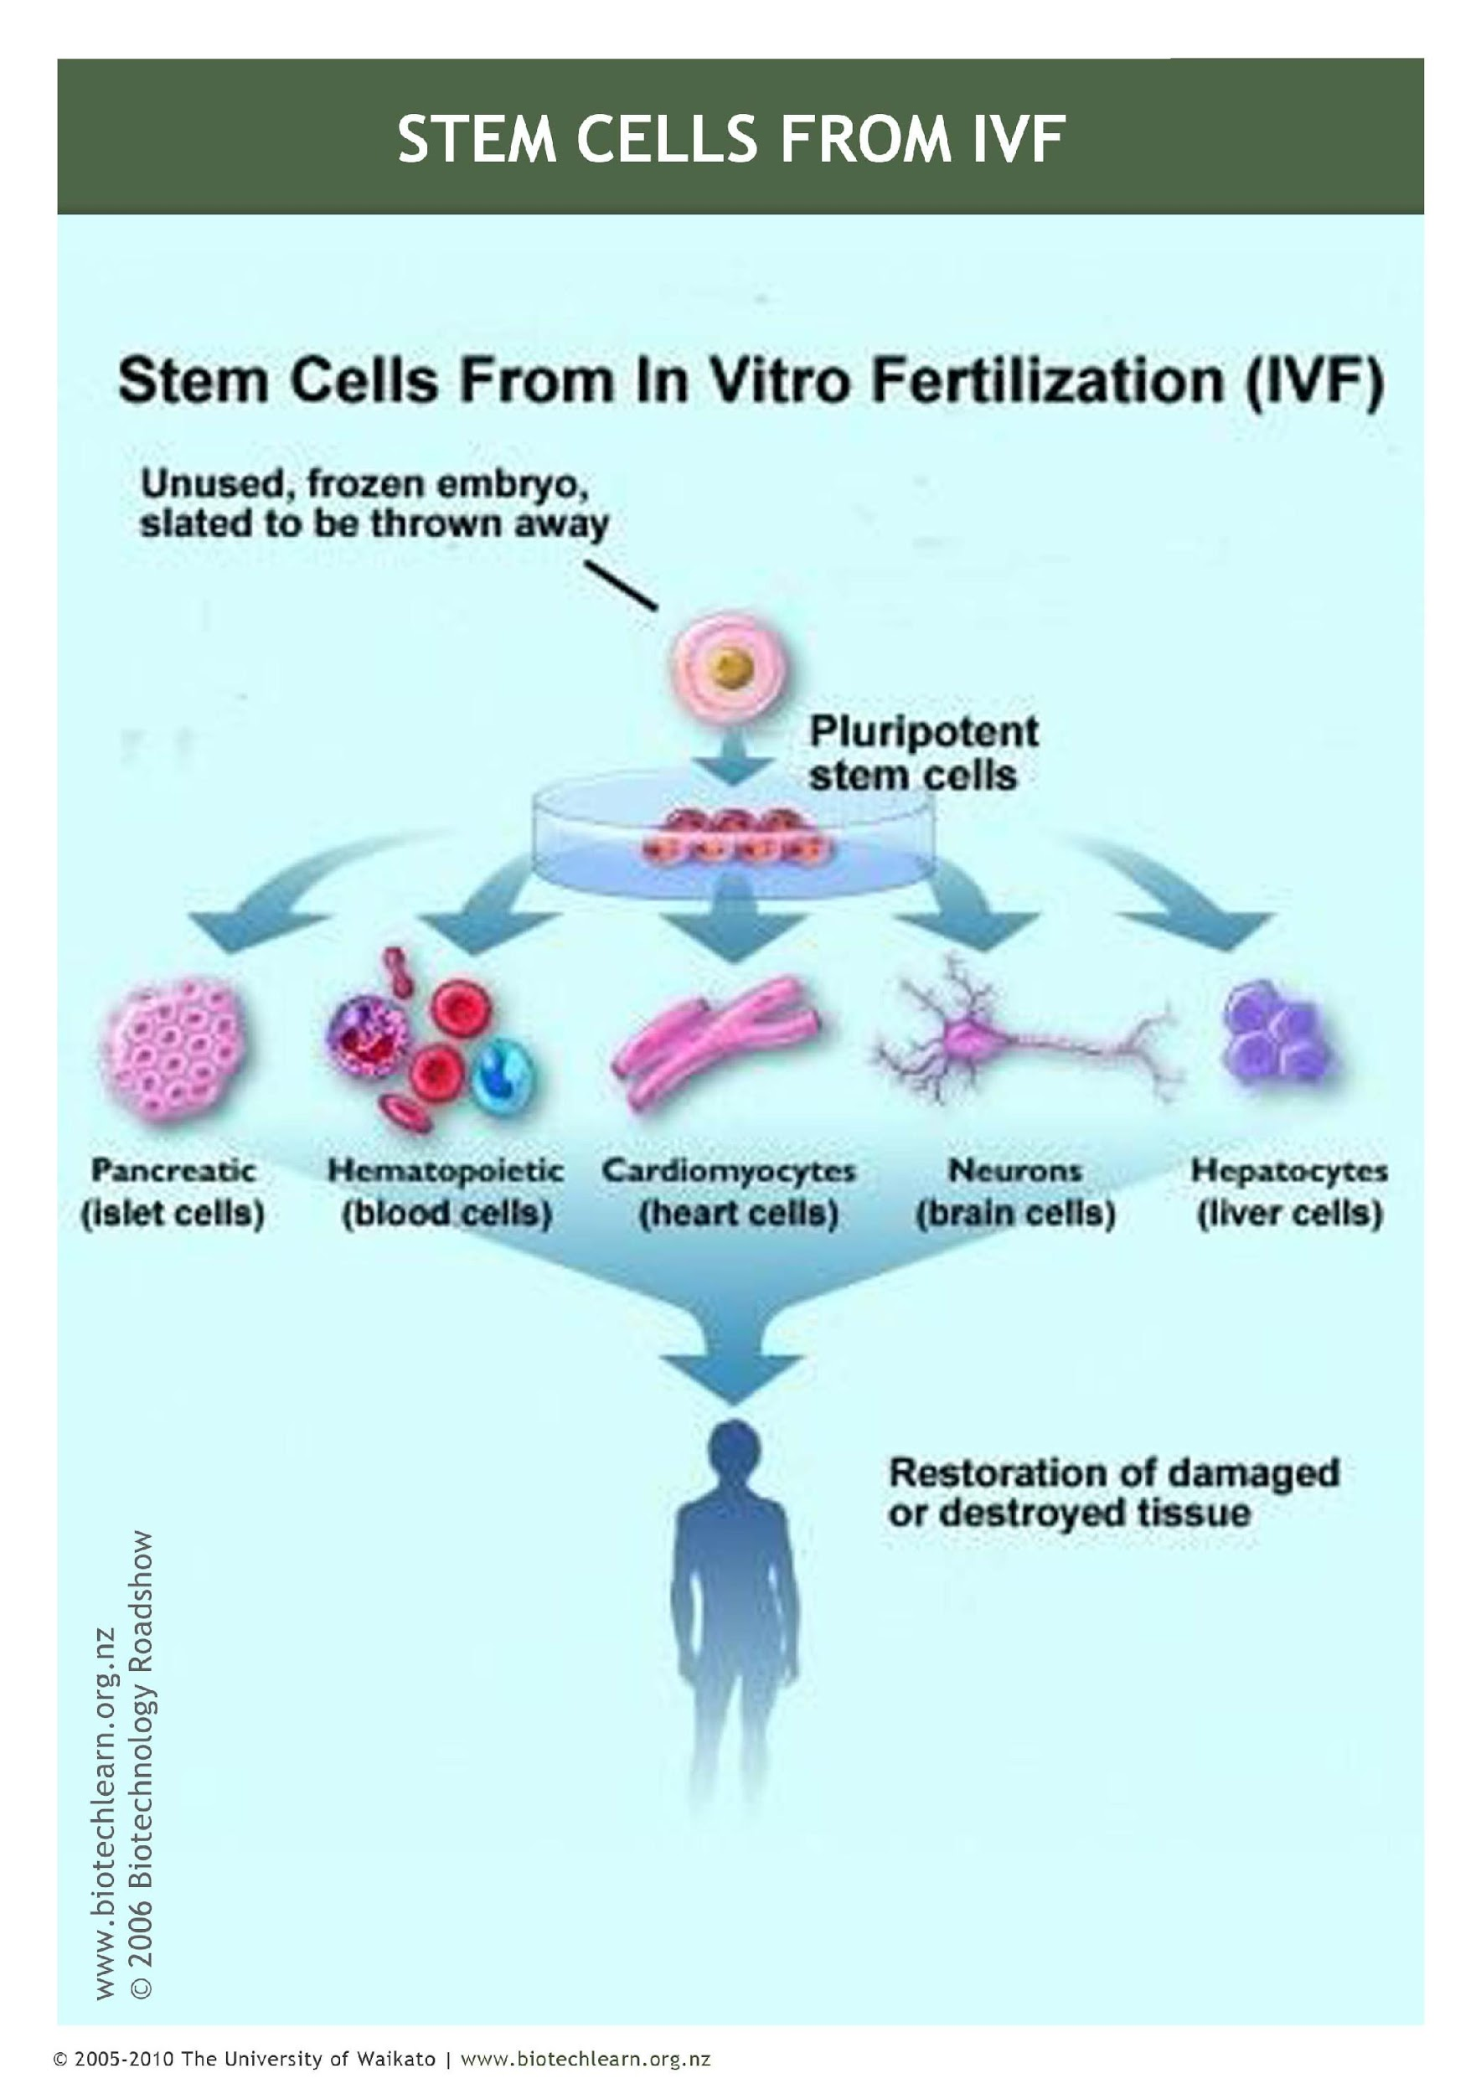

Slide 13
The Science Learning Hub would like to thank those that allowed the use of their images for this activity.
Note that the Biotechnology Learning Hub is now part of the Science Learning Hub.
© Copyright. University of Waikato. All Rights Reserved | www.sciencelearn.org.nz
All images are copyrighted. For further information, please refer to enquiries@sciencelearn.org.nz

