Slide 1
Megan on US Coast Guard Hercules aircraft en route to Antarctica – note the Antarctic clothing and earmuffs.
© Dr Megan Balks
© Copyright. University of Waikato. All rights reserved. | www.sciencelearn.org.nz

Slide 2
© Dr Megan Balks
Mt Erebus – an active volcano with steam coming from its crater.
© Copyright. University of Waikato. All rights reserved. | www.sciencelearn.org.nz

Slide 3
© Dr Megan Balks
The edge of the Antarctic continent viewed from about 10,000 metres altitude. The left-hand side of the photo shows the sea with sea ice and the right-hand side shows the snow-covered continent.
© Copyright. University of Waikato. All rights reserved. | www.sciencelearn.org.nz

Slide 4
© Dr Megan Balks
Scott Base, situated on the edge of Ross Island. Sea ice is in the foreground. Scott Base houses up to about 70 people.
© Copyright. University of Waikato. All rights reserved. | www.sciencelearn.org.nz

Slide 5
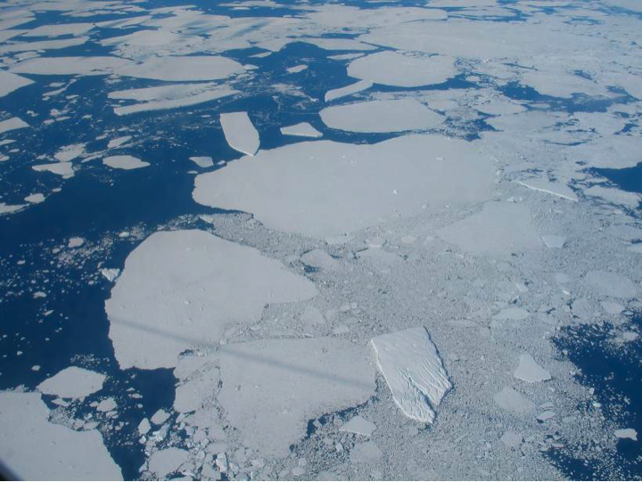
© Dr Megan Balks
Sea ice viewed from the aircraft.
© Copyright. University of Waikato. All rights reserved. | www.sciencelearn.org.nz

Slide 6
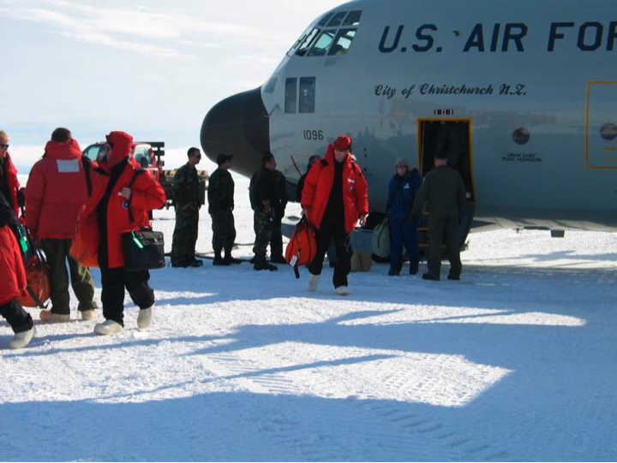
© Dr Megan Balks
Arriving in McMurdo.
© Copyright. University of Waikato. All rights reserved. | www.sciencelearn.org.nz

Slide 7
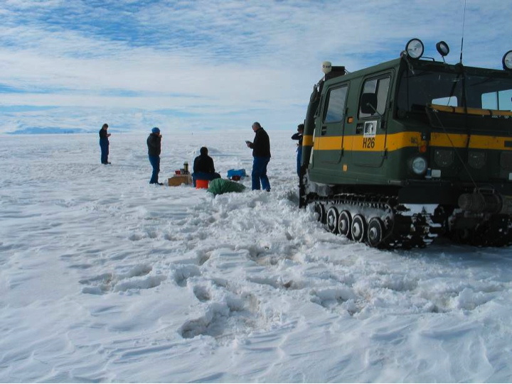
© Dr Megan Balks
A picnic lunch while travelling on the Ross Ice Shelf in a Hagglund tracked vehicle.
© Copyright. University of Waikato. All rights reserved. | www.sciencelearn.org.nz

Slide 8
© Dr Megan Balks
Sawing snow blocks in order to build a shelter in which to sleep the night. A part of the Antarctica survival training.
© Copyright. University of Waikato. All rights reserved. | www.sciencelearn.org.nz

Slide 9
© Dr Megan Balks
Further progress on the snow shelter – a trench for access – and once the mound is bigger, the inside will be hollowed out to make a place to sleep.
© Copyright. University of Waikato. All rights reserved. | www.sciencelearn.org.nz

Slide 10
© Dr Megan Balks
Megan looking out of the doorway of the completed snow shelter.
© Copyright. University of Waikato. All rights reserved. | www.sciencelearn.org.nz

Slide 11
© Dr Megan Balks
Megan’s colleagues Malcolm, Fiona and Jim on a glacial erratic boulder in the Wright Valley.
© Copyright. University of Waikato. All rights reserved. | www.sciencelearn.org.nz

Slide 12
© Dr Megan Balks
The Wright Valley – one of the Antarctic dry valleys where some of the landscape surfaces are millions of years old.
© Copyright. University of Waikato. All rights reserved. | www.sciencelearn.org.nz

Slide 13
© Dr Megan Balks
Field accommodation in tents. Inside, they are very cosy and comfortable.
© Copyright. University of Waikato. All rights reserved. | www.sciencelearn.org.nz

Slide 14
© Dr Megan Balks
Toilet facilities – all waste is carried out of Antarctica. Would you want to use them when it is snowing like in this picture?
© Copyright. University of Waikato. All rights reserved. | www.sciencelearn.org.nz

Slide 15
© Dr Megan Balks
The lower edge of the Goodspeed Glacier, an alpine glacier that comes off the Asgard Range into the edge of the Wright Valley.
© Copyright. University of Waikato. All rights reserved. | www.sciencelearn.org.nz

Slide 16
All images courtesy of Dr Megan Balks
© Copyright. University of Waikato. All rights reserved. | www.sciencelearn.org.nz

