Slide 1
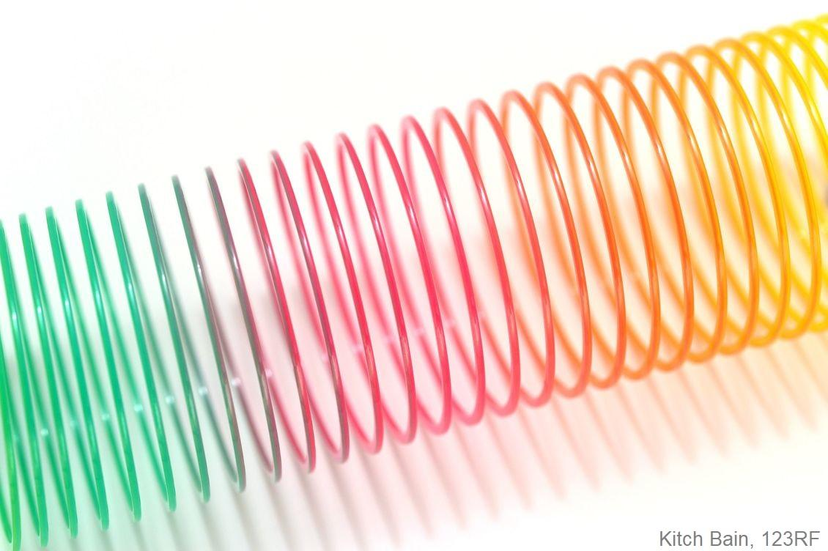
Physics made simple – waves
© Steve Hathaway
Greta Dromgool and Ted Cizadlo
4–4.45pm Thursday 4 April
Collage acknowledgements: Rollercoaster image, Martin Hatch/123RF Ltd; rocket image, Bill Ingalls/NASA; cycling power meter, SRM; slinky image, Kitch Bain/123RF Ltd.
© The University of Waikato Te Whare Wānanga o Waikato. All Rights Reserved | www.sciencelearn.org.nz
All images are copyrighted. For further information, please refer to enquiries@sciencelearn.org.nz

Slide 2
Pokapū Akoranga Pūtaiao
The Science Learning Hub
A trustworthy online resource – produced by educators and scientists for New Zealand teachers and students.
Based on world-class New Zealand science research.
Supported by learning activities, information about the key science ideas and concepts, multimedia tools and other resources.
© The University of Waikato Te Whare Wānanga o Waikato. All Rights Reserved | www.sciencelearn.org.nz
All images are copyrighted. For further information, please refer to enquiries@sciencelearn.org.nz
Notes:
The SLH is funded by the New Zealand Government – MBIE Ministry of Business, Innovation and Employment – under the Curious Minds fund

Slide 3
Index
Topic | Slideshow number(s ) | Video timecode
Introducing the Science Learning Hub and presenters | 1–2 | 00:00
Index and purpose | 3–4 | 00:20
NZ Curriculum | 5–6
What is a wave? | 7–9
Sound waves | 9–16
Performance and science | 17
Parts of a wave | 18
Changing energy in a wave | 19
Waves on the move | 20–21
Science Learning Hub resources | 22–26
© The University of Waikato Te Whare Wānanga o Waikato. All Rights Reserved | www.sciencelearn.org.nz
All images are copyrighted. For further information, please refer to enquiries@sciencelearn.org.nz

Slide 4
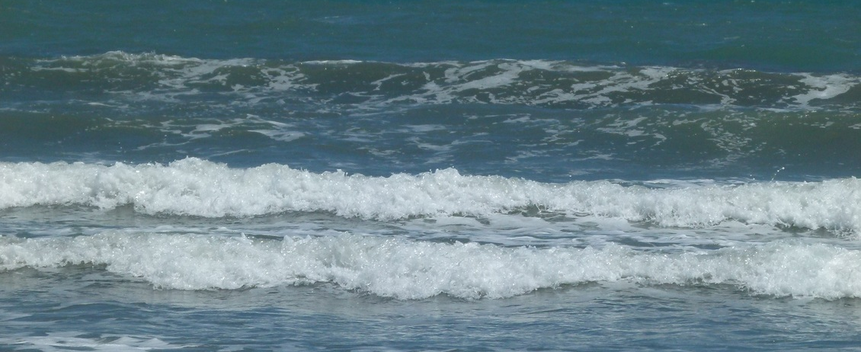
Purpose
In this webinar, we will:
build confidence to teach physics by:
explaining key physics concepts
sharing simple activities.
Freya Bacon-Bootham
© The University of Waikato Te Whare Wānanga o Waikato. All Rights Reserved | www.sciencelearn.org.nz
All images are copyrighted. For further information, please refer to enquiries@sciencelearn.org.nz
Notes:
Image: www.sciencelearn.org.nz/images/142-waves

Slide 5
What does the curriculum say?
Level 1 & 2
Explore everyday examples of physical phenomena, such as movement, forces, electricity and magnetism, light, sound, waves, and heat.
Seek and describe simple patterns in physical phenomena.
© The University of Waikato Te Whare Wānanga o Waikato. All Rights Reserved | www.sciencelearn.org.nz
All images are copyrighted. For further information, please refer to enquiries@sciencelearn.org.nz

Slide 6
What does the curriculum say?
Level 3 & 4
Explore, describe, and represent patterns and trends for everyday examples of physical phenomena, such as movement, forces, electricity and magnetism, light, sound, waves, and heat.
© The University of Waikato Te Whare Wānanga o Waikato. All Rights Reserved | www.sciencelearn.org.nz
All images are copyrighted. For further information, please refer to enquiries@sciencelearn.org.nz

Slide 7
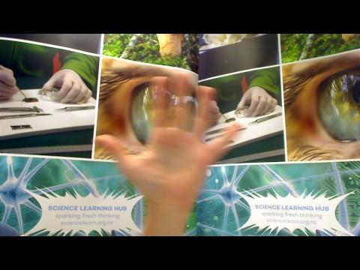
What is a wave?
© The University of Waikato Te Whare Wānanga o Waikato. All Rights Reserved | www.sciencelearn.org.nz
All images are copyrighted. For further information, please refer to enquiries@sciencelearn.org.nz
Notes:
There are many words – like wave – that have an everyday meaning and a scientific meaning. Discussion about the different meanings helps to avoid confusion and alternative conceptions. Developing the knowledge of scientific vocabulary is part of the ‘Communicating in science’ achievement aim.

Slide 8
What is a wave?
A disturbance that transfers energy
But what does this actually mean?
© The University of Waikato Te Whare Wānanga o Waikato. All Rights Reserved | www.sciencelearn.org.nz
All images are copyrighted. For further information, please refer to enquiries@sciencelearn.org.nz

Slide 9
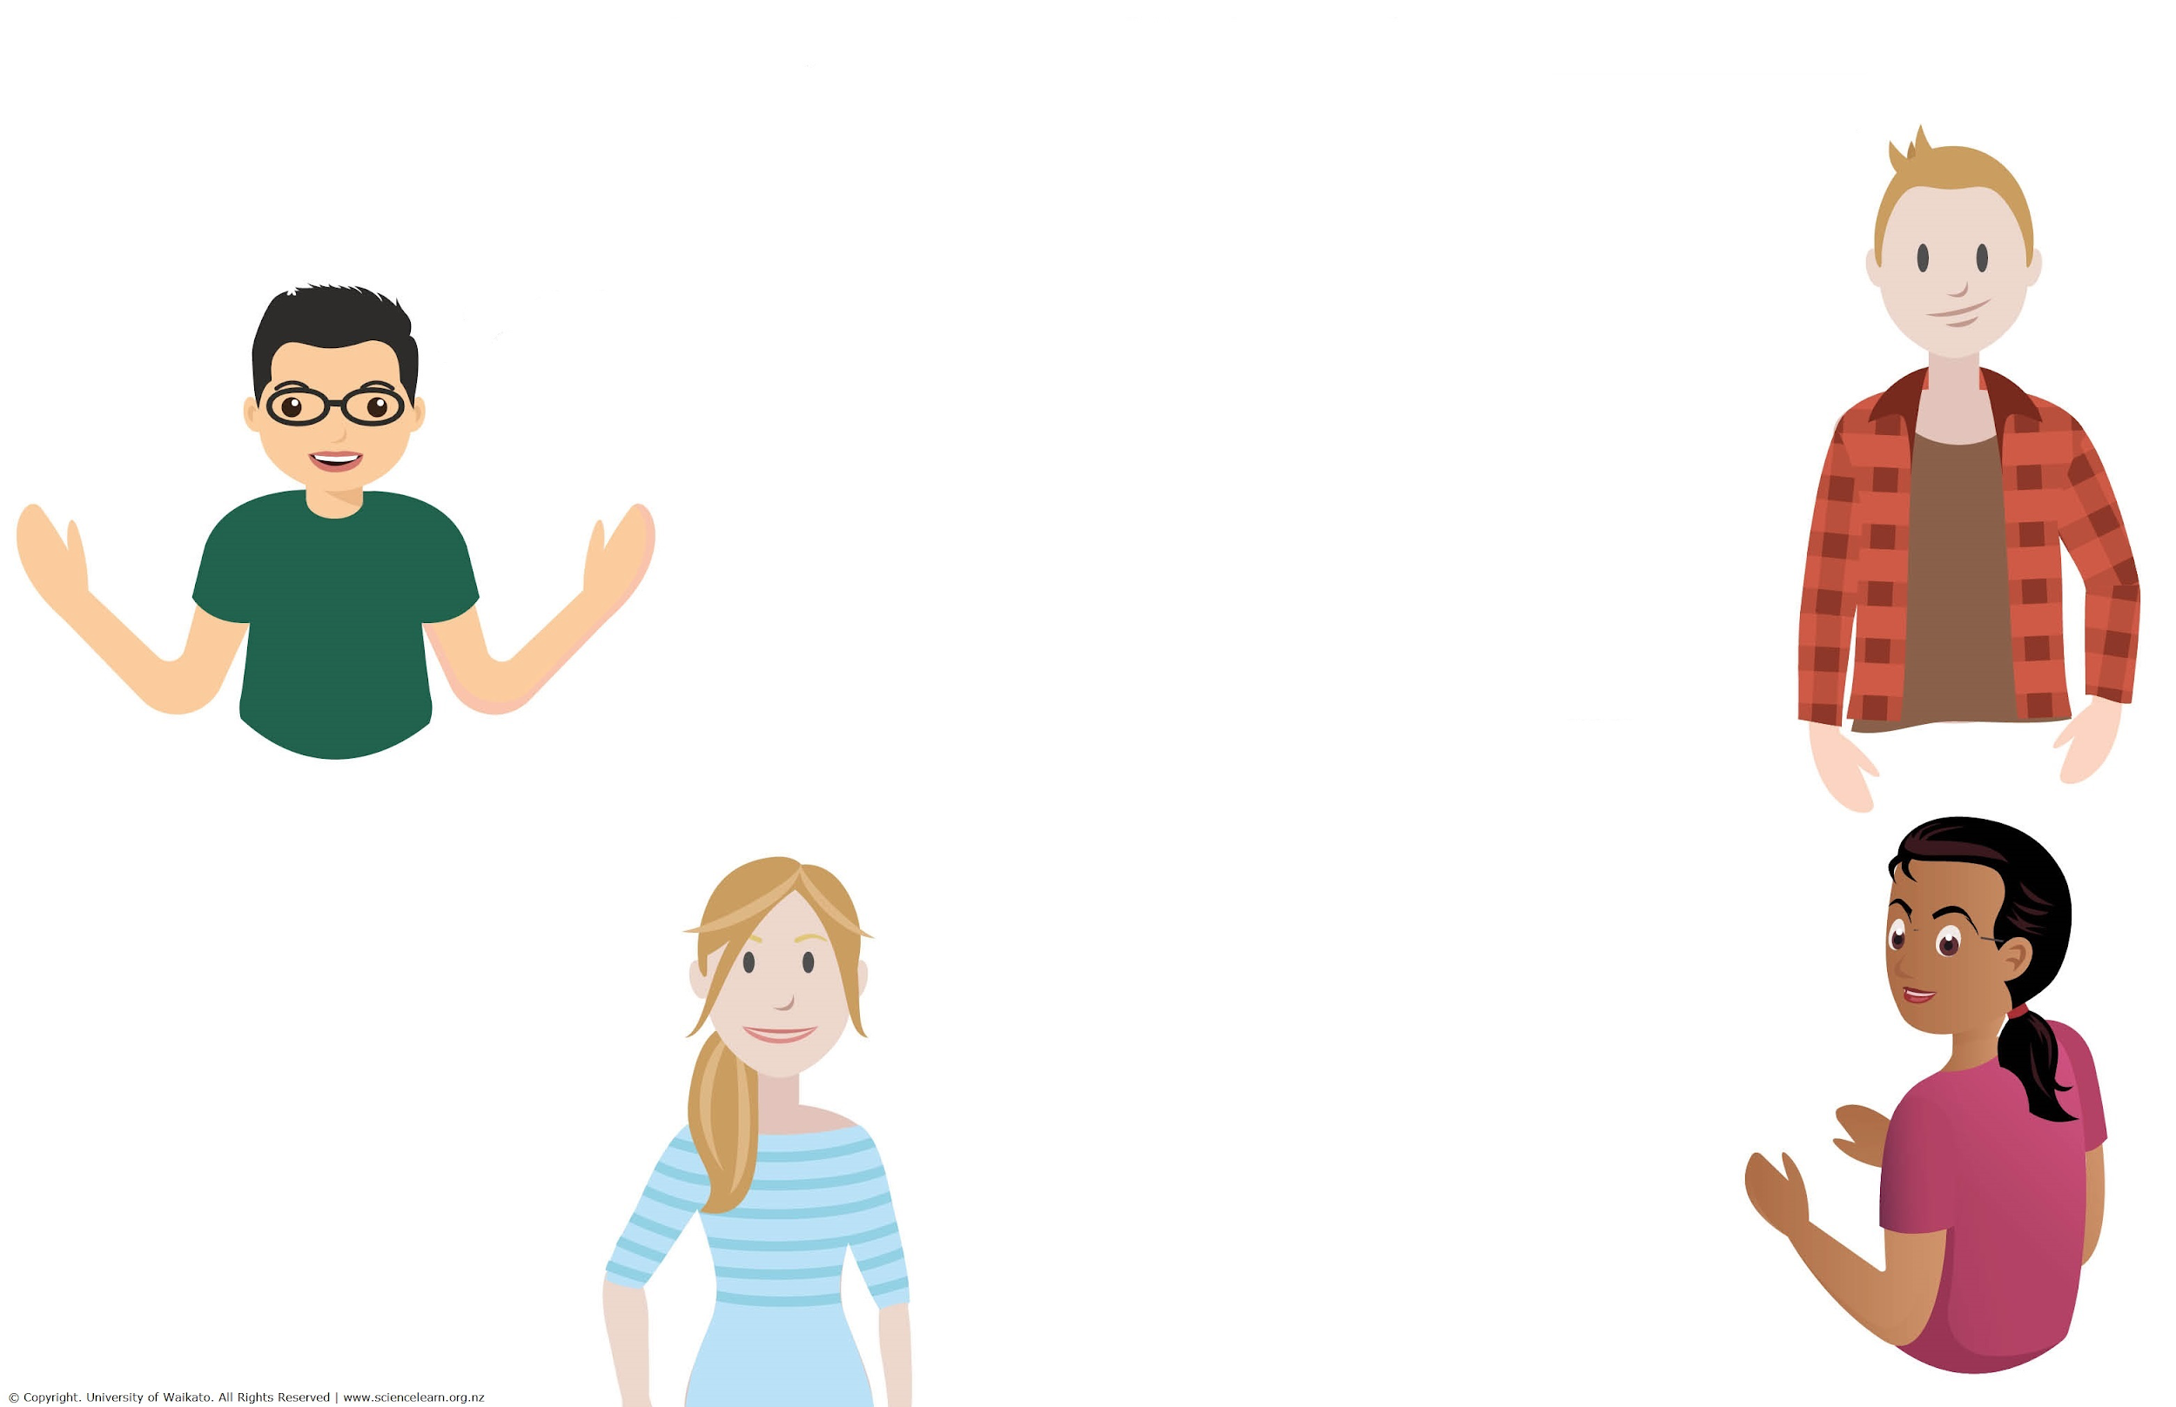
Participant ideas
© The University of Waikato Te Whare Wānanga o Waikato. All Rights Reserved | www.sciencelearn.org.nz
All images are copyrighted. For further information, please refer to enquiries@sciencelearn.org.nz
Notes:
A good way to start thinking about waves is to talk about examples of waves
Seeing, hearing, feeling warmth, surfing, tuning the radio, using a cellphone – these and many more activities involve waves.

Slide 10
Looking closely at sound waves
Sviatlana Zykava/123RF Ltd
© The University of Waikato Te Whare Wānanga o Waikato. All Rights Reserved | www.sciencelearn.org.nz
All images are copyrighted. For further information, please refer to enquiries@sciencelearn.org.nz
Notes:
Image from: www.123rf.com/stock-photo/speaker_stereo.html?oriSearch=speaker&ch=speaker&sti=o6ktkj4gwrf02xvpms|&mediapopup=58727084

Slide 11
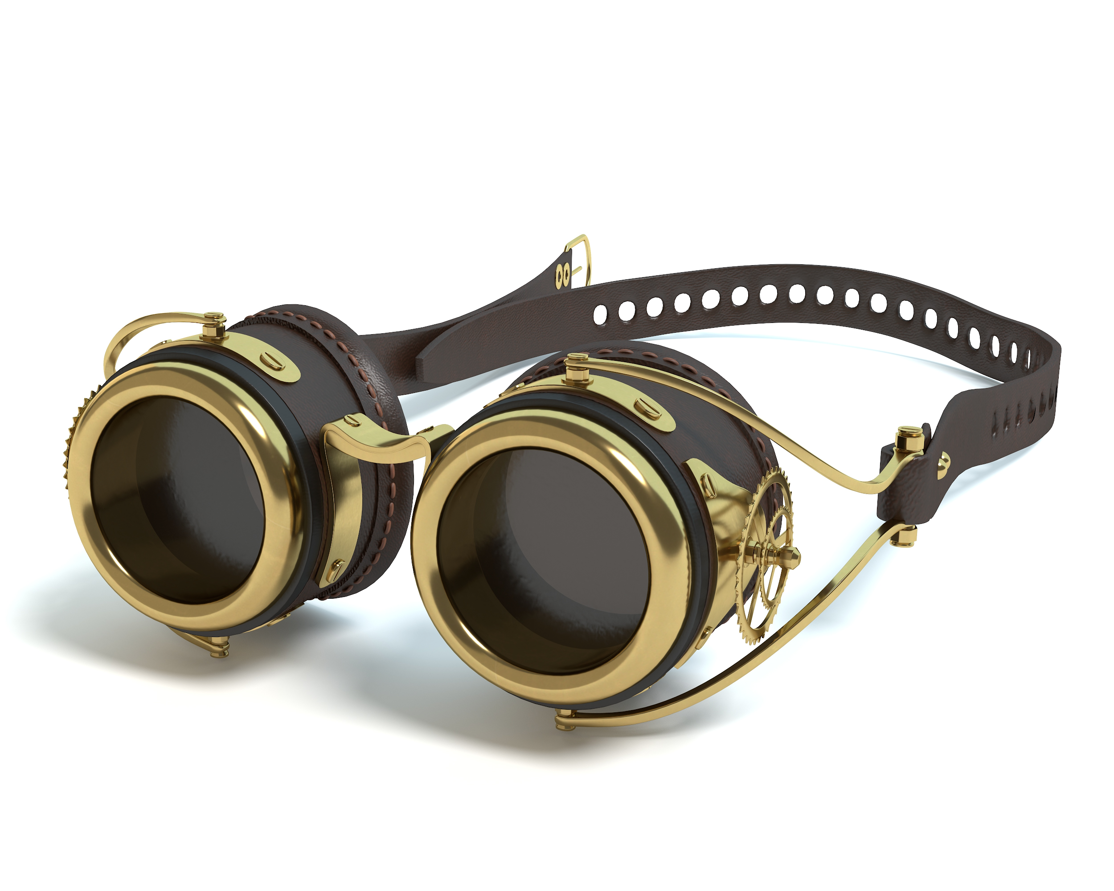
Matter is made of small bits
Wesley Abrams, 123RF Ltd
© The University of Waikato Te Whare Wānanga o Waikato. All Rights Reserved | www.sciencelearn.org.nz
All images are copyrighted. For further information, please refer to enquiries@sciencelearn.org.nz
Notes:
Resources: Chemistry made simple – Atoms webinar: www.sciencelearn.org.nz/resources/2661-chemistry-made-simple-atoms
Image ID : 57873100 Media Type : Photography
Copyright : Wesley Abrams

Slide 12
Looking closely at sound waves
Sviatlana Zykava/123RF Ltd
© The University of Waikato Te Whare Wānanga o Waikato. All Rights Reserved | www.sciencelearn.org.nz
All images are copyrighted. For further information, please refer to enquiries@sciencelearn.org.nz
Notes:
Image: www.sciencelearn.org.nz/images/3736-longitudinal-air-particle-wave
www.123rf.com/stock-photo/speaker_stereo.html?oriSearch=speaker&ch=speaker&sti=o6ktkj4gwrf02xvpms|&mediapopup=58727084

Slide 13
Looking closely at sound waves
© The University of Waikato Te Whare Wānanga o Waikato. All Rights Reserved | www.sciencelearn.org.nz
All images are copyrighted. For further information, please refer to enquiries@sciencelearn.org.nz
Notes:
Image: www.sciencelearn.org.nz/images/3736-longitudinal-air-particle-wave
An actual sound wave in air may look something like this diagram. The dots represent air particles, showing areas of dense air and areas of less dense air.

Slide 14
Looking closely at sound waves
© The University of Waikato Te Whare Wānanga o Waikato. All Rights Reserved | www.sciencelearn.org.nz
All images are copyrighted. For further information, please refer to enquiries@sciencelearn.org.nz
Notes:
Image: www.sciencelearn.org.nz/images/3736-longitudinal-air-particle-wave
An actual sound wave in air may look something like this diagram. The dots represent air particles, showing areas of dense air and areas of less dense air.

Slide 15
Looking closely at sound waves
VS
© The University of Waikato Te Whare Wānanga o Waikato. All Rights Reserved | www.sciencelearn.org.nz
All images are copyrighted. For further information, please refer to enquiries@sciencelearn.org.nz
Notes:
Image: https://www.sciencelearn.org.nz/images/3736-longitudinal-air-particle-wave
An actual sound wave in air may look something like this diagram. The dots represent air particles, showing areas of dense air and areas of less dense air.

Slide 16
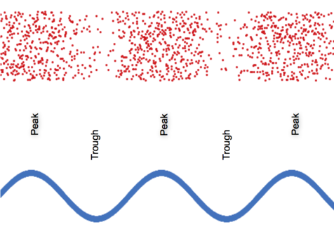
Graphing a sound wave
© The University of Waikato Te Whare Wānanga o Waikato. All Rights Reserved | www.sciencelearn.org.nz
All images are copyrighted. For further information, please refer to enquiries@sciencelearn.org.nz
Notes:
Image: www.sciencelearn.org.nz/images/3737-transverse-longitudinal-wave
Most waves are drawn as transverse waves. The high points of the transverse waves (peaks) represent more dense areas of the longitudinal waves, and the low points (troughs) represent less dense areas.

Slide 17
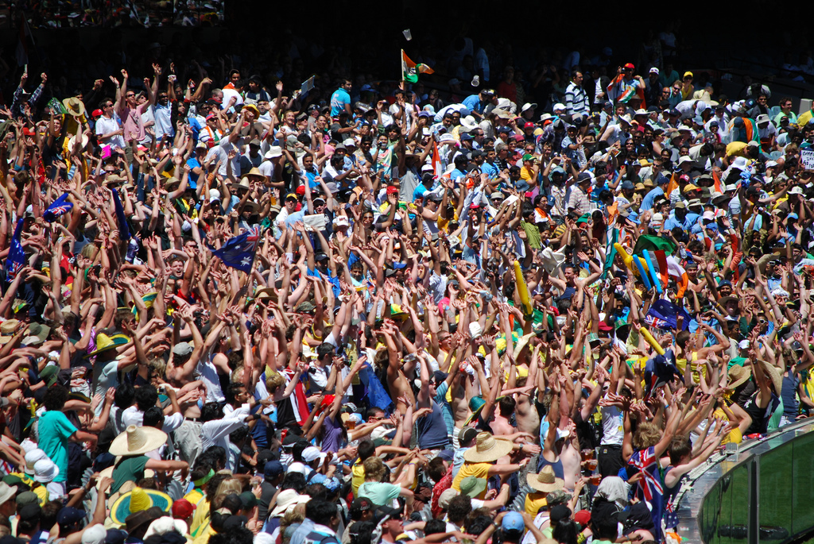
Waves
Using drama can help students to explore abstract science ideas as well as develop an understanding of how scientists use models.
Explore the activity Making Mexican waves
and the PLD article Performing science
Sambo27
© The University of Waikato Te Whare Wānanga o Waikato. All Rights Reserved | www.sciencelearn.org.nz
All images are copyrighted. For further information, please refer to enquiries@sciencelearn.org.nz
Notes:
Resources:
Making Mexican waves: www.sciencelearn.org.nz/resources/130-making-mexican-waves
Using drama in science www.sciencelearn.org.nz/resources/2375-performing-science
Image: www.sciencelearn.org.nz/images/114-mexican-wave

Slide 18
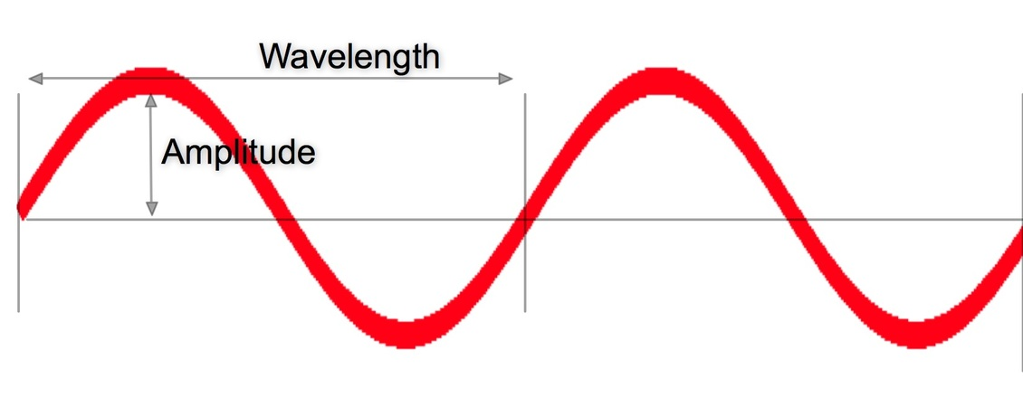
Waves
The three terms used when describing a wave are:
amplitude (the height of a wave)
frequency (the number of waves that pass a point in one second)
wavelength (the length of one wave).
© The University of Waikato Te Whare Wānanga o Waikato. All Rights Reserved | www.sciencelearn.org.nz
All images are copyrighted. For further information, please refer to enquiries@sciencelearn.org.nz
Notes:
Image: www.sciencelearn.org.nz/images/3738-describing-waves

Slide 19
Changing energy
Kitch Bain/123RF Ltd
How could you increase the energy in wave?
© The University of Waikato Te Whare Wānanga o Waikato. All Rights Reserved | www.sciencelearn.org.nz
All images are copyrighted. For further information, please refer to enquiries@sciencelearn.org.nz
Notes:
Resources:
Activity: www.sciencelearn.org.nz/resources/2682-investigating-waves-and-energy
Article: www.sciencelearn.org.nz/resources/120-waves-as-energy-transfer
Image: www.sciencelearn.org.nz/images/3738-describing-waves

Slide 20
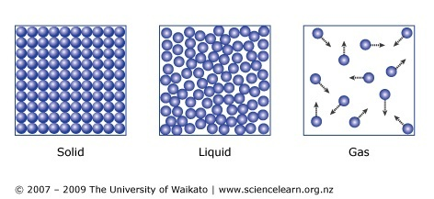
Waves on the move
© The University of Waikato Te Whare Wānanga o Waikato. All Rights Reserved | www.sciencelearn.org.nz
All images are copyrighted. For further information, please refer to enquiries@sciencelearn.org.nz
Notes:
www.sciencelearn.org.nz/resources/572-sound-on-the-move
Image: www.sciencelearn.org.nz/images/838-particles-in-collision

Slide 21
Waves on the move
In sound waves, energy is transferred through vibration of particles.
In electromagnetic waves, energy is transferred through vibrations of electric and magnetic fields.
In water waves, energy is transferred through the vibration of the water particles.
© The University of Waikato Te Whare Wānanga o Waikato. All Rights Reserved | www.sciencelearn.org.nz
All images are copyrighted. For further information, please refer to enquiries@sciencelearn.org.nz
Notes:
Image: www.sciencelearn.org.nz/images/3738-describing-waves

Slide 22
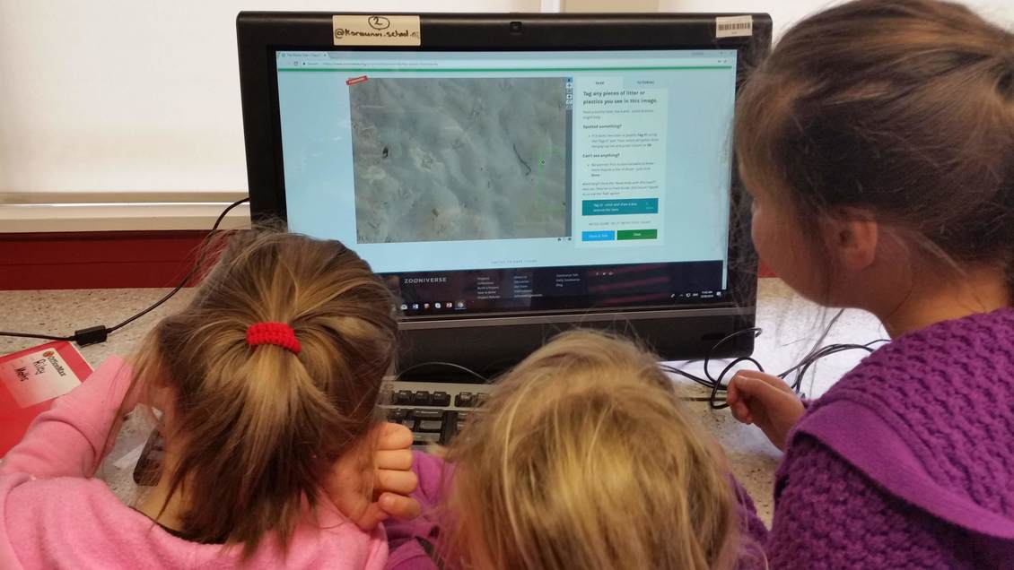
Online citizen science
Dianne Christenson/Koraunui School
© The University of Waikato Te Whare Wānanga o Waikato. All Rights Reserved | www.sciencelearn.org.nz
All images are copyrighted. For further information, please refer to enquiries@sciencelearn.org.nz
Notes:
Image: www.sciencelearn.org.nz/images/3868-identifying-beach-litter-online

Slide 23
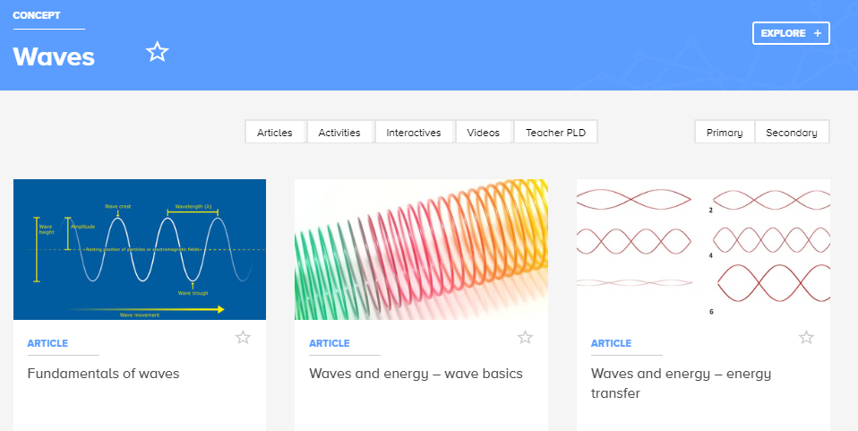
More resources on waves
Kitch Bain/123RF Ltd
© The University of Waikato Te Whare Wānanga o Waikato. All Rights Reserved | www.sciencelearn.org.nz
All images are copyrighted. For further information, please refer to enquiries@sciencelearn.org.nz
Notes:
www.sciencelearn.org.nz/concepts/waves
Images:
www.sciencelearn.org.nz/images/61-wave-length-height-and-frequency
www.sciencelearn.org.nz/images/3739-slinky
www.sciencelearn.org.nz/images/3740-wave-patterns

Slide 24
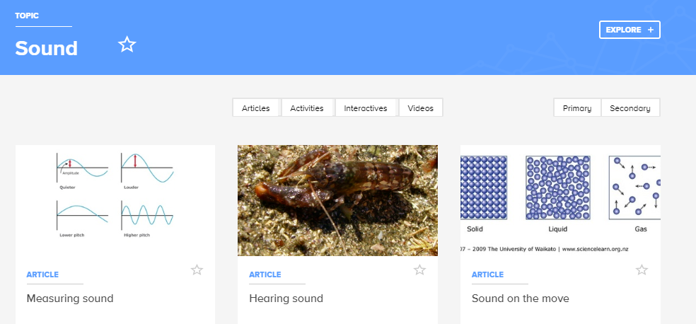
More resources on waves
© The University of Waikato Te Whare Wānanga o Waikato. All Rights Reserved | www.sciencelearn.org.nz
All images are copyrighted. For further information, please refer to enquiries@sciencelearn.org.nz
Notes:
Topic: www.sciencelearn.org.nz/topics/sound
Activity: www.sciencelearn.org.nz/resources/578-sound-detectives
Context idea: www.sciencelearn.org.nz/resources/564-the-noisy-reef-introduction
Images:
www.sciencelearn.org.nz/images/605-graphs-of-sound-waves
www.sciencelearn.org.nz/images/595-new-zealand-snapping-shrimp
www.sciencelearn.org.nz/images/431-particle-nature-of-matter-model

Slide 25
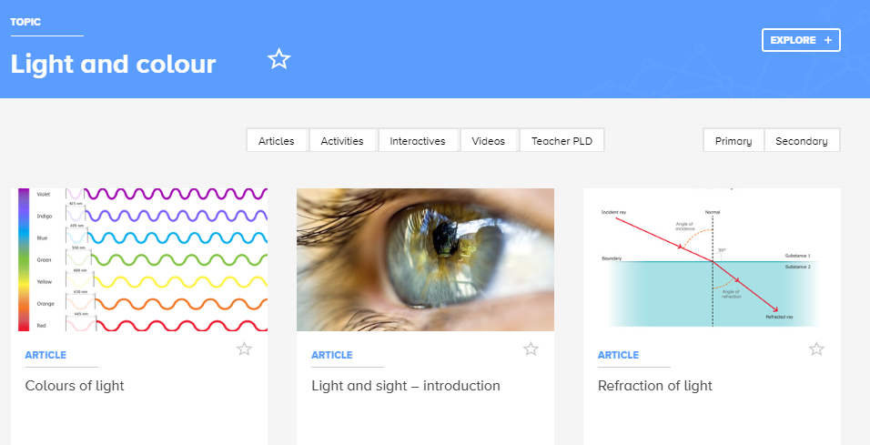
More resources on waves
Erion Cuko
© The University of Waikato Te Whare Wānanga o Waikato. All Rights Reserved | www.sciencelearn.org.nz
All images are copyrighted. For further information, please refer to enquiries@sciencelearn.org.nz
Notes:
Topic: www.sciencelearn.org.nz/topics/light-and-colour
Intro for light: www.sciencelearn.org.nz/resources/171-light-basics
Alternative conceptions: www.sciencelearn.org.nz/resources/63-teacher-resource-alternative-conceptions-about-light
Images:
www.sciencelearn.org.nz/images/37-the-visible-spectrum
www.sciencelearn.org.nz/images/36-the-human-eye
www.sciencelearn.org.nz/images/49-refraction-of-light-in-water

Slide 26
© The University of Waikato Te Whare Wānanga o Waikato. All Rights Reserved | www.sciencelearn.org.nz
All images are copyrighted. For further information, please refer to enquiries@sciencelearn.org.nz
Notes:
Image: www.sciencelearn.org.nz/image_maps/63-the-electromagnetic-spectrum
Picture dictation: www.sciencelearn.org.nz/resources/1033-the-electromagnetic-spectrum-picture-dictation

Slide 27
Thanks
Pokapū Akoranga Pūtaiao
Email us on enquiries@sciencelearn.org.nz
https://twitter.com/NZScienceLearn
www.facebook.com/nzsciencelearn
https://nz.pinterest.com/nzsciencelearn
www.pond.co.nz/community/214015/science-learning-hub/1
www.instagram.com/sciencelearninghubnz
Join us in our discussion channel on Slack.
(Any problems accessing Slack, please contact us via our enquiries email, enquiries@sciencelearn.org.nz.)
Notes:
SLACK: https://slh-talk.slack.com/messages/CDL529ERW/

