Slide 1
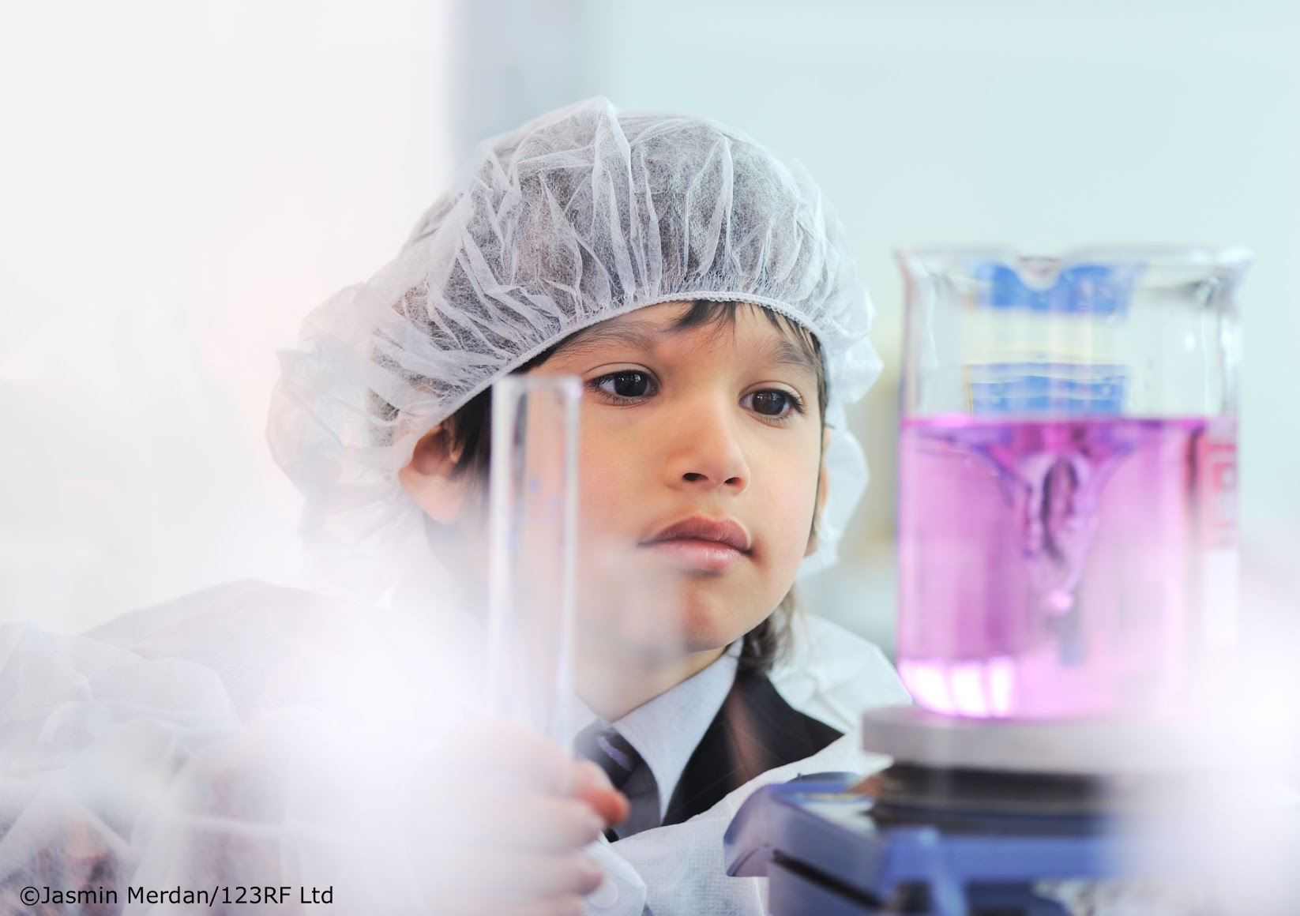
Chemistry in the primary classroom
Greta Dromgool from the Science Learning Hub and the New Zealand Association of Primary Science Educators
© Copyright. University of Waikato. All Rights Reserved | www.sciencelearn.org.nz
All images are copyrighted. For further information, please refer to enquiries@sciencelearn.org.nz
Notes:
Holding slide for Adobe Connect – used shortly before the webinar – to be removed in the published version

Slide 2
© Copyright. The University of Waikato Te Whare Wānanga o Waikato. All Rights Reserved | www.sciencelearn.org.nz
All images are copyrighted. For further information, please refer to enquiries@sciencelearn.org.nz
Notes:
https://nzapse.nzase.org.nz

Slide 3
Pokapū Akoranga Pūtaiao
The Science Learning Hub
A trustworthy online resource – produced by educators and scientists for New Zealand teachers and students.
Based on world-class New Zealand science research.
Supported by learning activities, information about the key science ideas and concepts, multimedia tools and other resources.
© Copyright. The University of Waikato Te Whare Wānanga o Waikato. All Rights Reserved | www.sciencelearn.org.nz
All images are copyrighted. For further information, please refer to enquiries@sciencelearn.org.nz
Notes:
The SLH is funded by the NZ Government – MBIE Ministry of Business, Innovation and Employment – under the Curious Minds fund

Slide 4
Index
Topic | Slideshow number(s ) | Video timecode
Introduction | 1–2 | 00:00
Index | 3 | 00:30
The NZAPSE website and periodic table activities | 5–6 | 01:51
Practical activities: | 7–9 | 02:59
Red cabbage indicator with Sandy Jackson |  | 06:11
Fireworks with Chris Duggan |  | 14:36
Melting activity with Ian Milne |  | 23:02
Mixtures with Mr Science |  | 27:17
Science Learning Hub resources | 10–13 | 34:55
© The University of Waikato Te Whare Wānanga o Waikato. All Rights Reserved | www.sciencelearn.org.nz
All images are copyrighted. For further information, please refer to enquiries@sciencelearn.org.nz

Slide 5
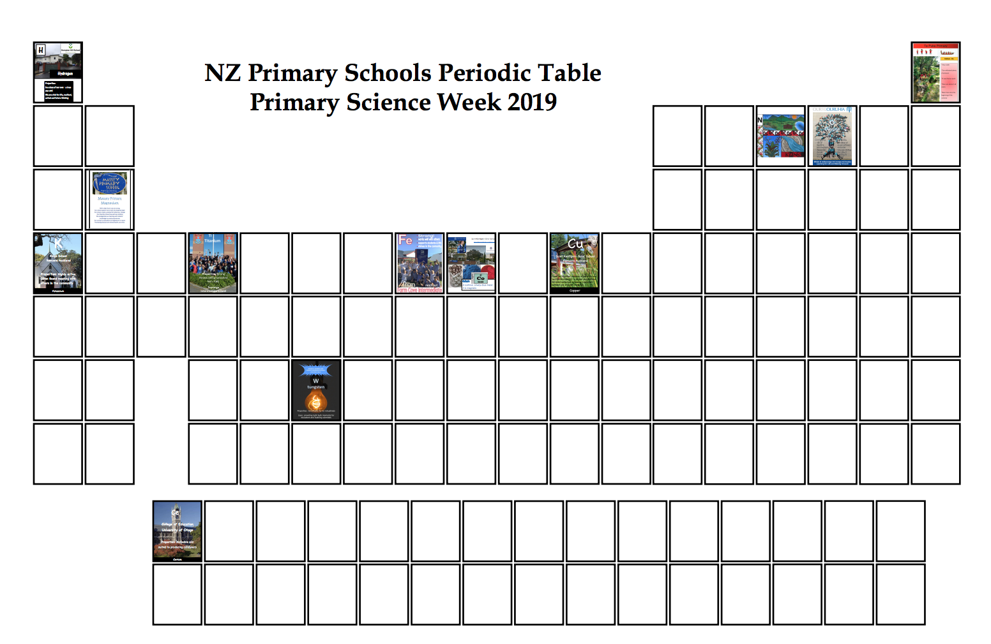
© Copyright. The University of Waikato Te Whare Wānanga o Waikato. All Rights Reserved | www.sciencelearn.org.nz
All images are copyrighted. For further information, please refer to enquiries@sciencelearn.org.nz
Notes:
https://nzapse.nzase.org.nz/primary-science-week-2019/

Slide 6
© Copyright. The University of Waikato Te Whare Wānanga o Waikato. All Rights Reserved | www.sciencelearn.org.nz
All images are copyrighted. For further information, please refer to enquiries@sciencelearn.org.nz
Notes:
https://nzapse.nzase.org.nz/primary-science-week-2019/

Slide 7
Pokapū Akoranga Pūtaiao
The Science Learning Hub
How could you link science activities to the Nature of Science or the science capabilities?
© Copyright. The University of Waikato Te Whare Wānanga o Waikato. All Rights Reserved | www.sciencelearn.org.nz
All images are copyrighted. For further information, please refer to enquiries@sciencelearn.org.nz

Slide 8
© Copyright. The University of Waikato Te Whare Wānanga o Waikato. All Rights Reserved | www.sciencelearn.org.nz
All images are copyrighted. For further information, please refer to enquiries@sciencelearn.org.nz

Slide 9
© Copyright. The University of Waikato Te Whare Wānanga o Waikato. All Rights Reserved | www.sciencelearn.org.nz
All images are copyrighted. For further information, please refer to enquiries@sciencelearn.org.nz
Notes:
https://nzapse.nzase.org.nz/primary-science-week-2019/
https://www.iypt2019.org/

Slide 10
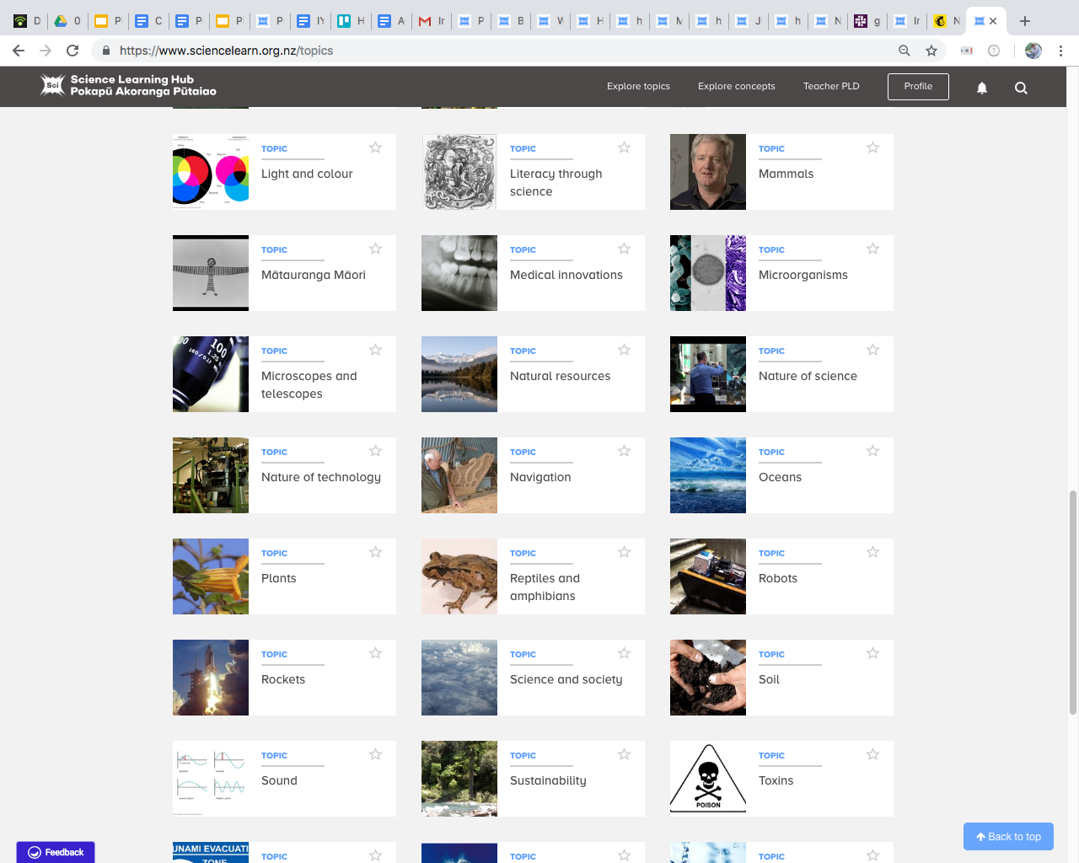
© Copyright. The University of Waikato Te Whare Wānanga o Waikato. All Rights Reserved | www.sciencelearn.org.nz
All images are copyrighted. For further information, please refer to enquiries@sciencelearn.org.nz

Slide 11
Collections tool
© Copyright. The University of Waikato Te Whare Wānanga o Waikato. All Rights Reserved | www.sciencelearn.org.nz
All images are copyrighted. For further information, please refer to enquiries@sciencelearn.org.nz

Slide 12
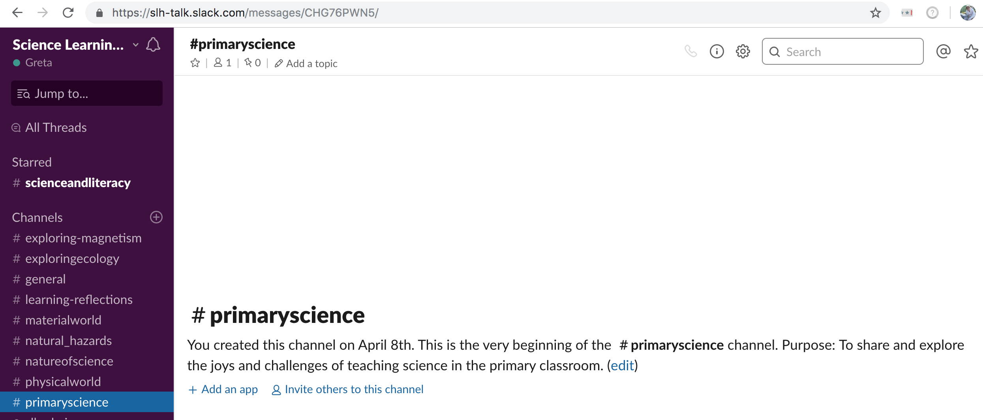
Slack discussion forum
SLACK
© Copyright. The University of Waikato Te Whare Wānanga o Waikato. All Rights Reserved | www.sciencelearn.org.nz
All images are copyrighted. For further information, please refer to enquiries@sciencelearn.org.nz
Notes:
https://slh-talk.slack.com/messages/C750CG0V9/

Slide 13
Thanks
Pokapū Akoranga Pūtaiao
Email us on enquiries@sciencelearn.org.nz
https://twitter.com/NZScienceLearn
www.facebook.com/nzsciencelearn
https://nz.pinterest.com/nzsciencelearn
www.pond.co.nz/community/214015/science-learning-hub/1
www.instagram.com/sciencelearninghubnz
Join us in our discussion channel on Slack.
(Any problems accessing Slack, please contact us via our enquiries email, enquiries@sciencelearn.org.nz.)
Notes:
SLACK: https://slh-talk.slack.com/messages/CDL529ERW/

