Slide 1
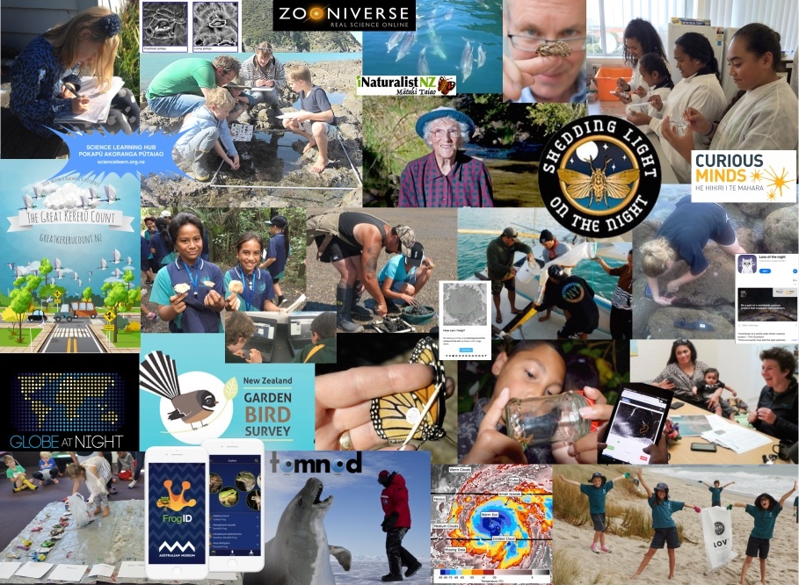
Getting started with citizen science
Greta Dromgool & Sarah Morgan
4–4.45pm Thursday 8 August
© Copyright. Science Learning Hub – Pokapū Akoranga Pūtaiao The University of Waikato Te Whare Wananga o Waikato.
All Rights Reserved | www.sciencelearn.org.nz. All images are copyrighted. For further information, please refer to enquiries@sciencelearn.org.nz

Slide 2
Pokapū Akoranga Pūtaiao
The Science Learning Hub
A trustworthy online resource – produced by educators and scientists for New Zealand teachers and students.
Based on world-class New Zealand science research.
Supported by learning activities, information about the key science ideas and concepts, multimedia tools and other resources.
© Copyright. Science Learning Hub – Pokapū Akoranga Pūtaiao The University of Waikato Te Whare Wananga o Waikato.
All Rights Reserved | www.sciencelearn.org.nz. All images are copyrighted. For further information, please refer to enquiries@sciencelearn.org.nz
Notes:
The SLH is funded by the NZ Government – MBIE Ministry of Business, Innovation and Employment – under the Curious Minds fund

Slide 3
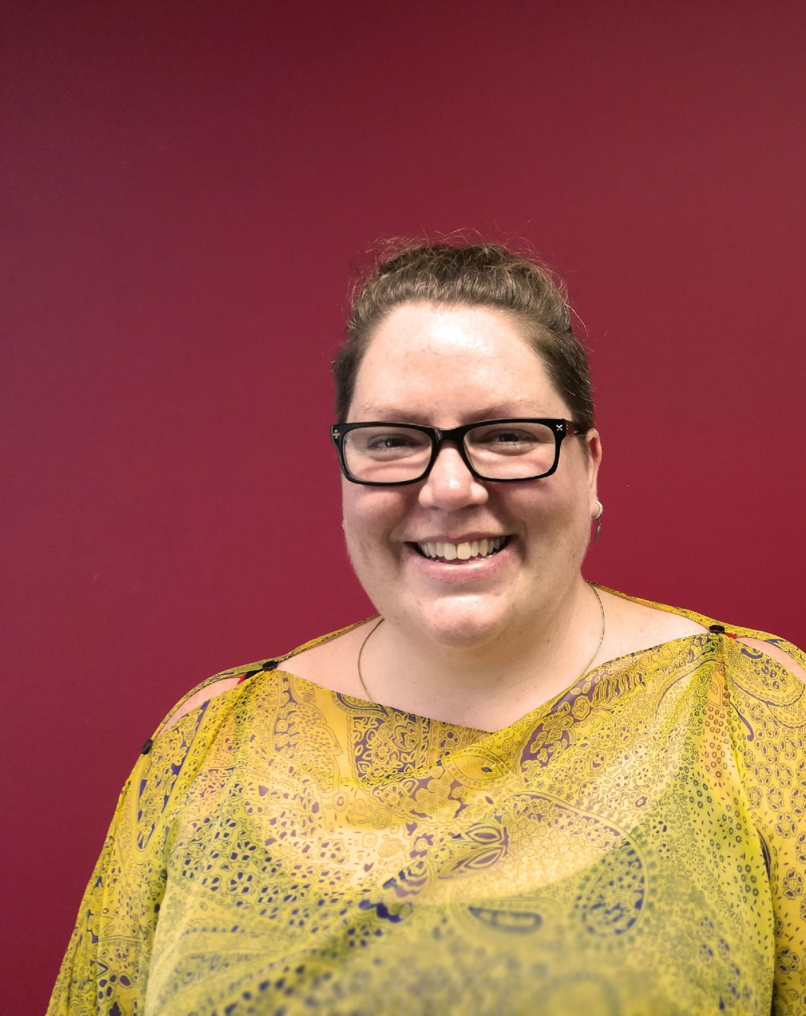
Dr Sarah Morgan
STEM Manager @ COMET Auckland
BSc(Hons), PhD(Otago), GradDipT(Primary).
PhD: Molecular genetics
Research Fellowship (postdoc): Sci-ed translational interventions
Teaching: STEM PBL Coach @ Ormiston Junior College 1day/week
STEM Management: SouthSci, STEM Alliance Aotearoa
Sarah Morgan
© Copyright. Science Learning Hub – Pokapū Akoranga Pūtaiao The University of Waikato Te Whare Wananga o Waikato.
All Rights Reserved | www.sciencelearn.org.nz. All images are copyrighted. For further information, please refer to enquiries@sciencelearn.org.nz
Notes:
Curious Minds PSP: https://www.curiousminds.nz/funding/participatory-science-platform/

Slide 4
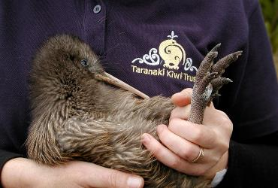
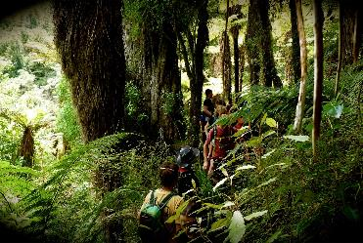
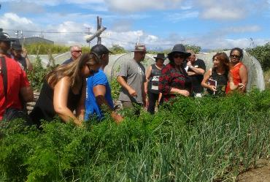
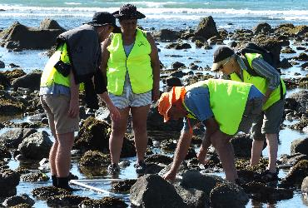
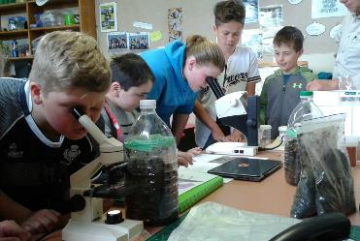
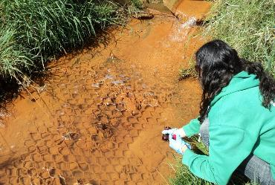
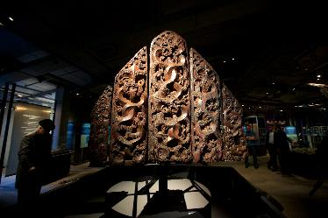
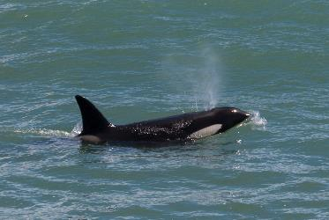
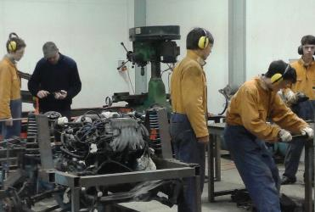
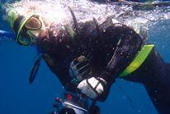
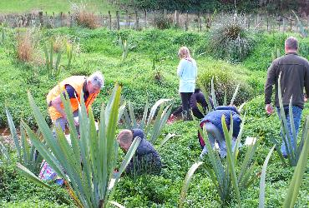
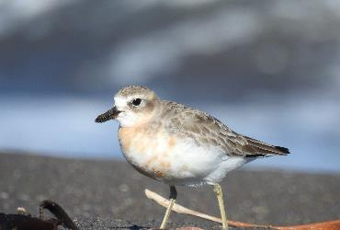
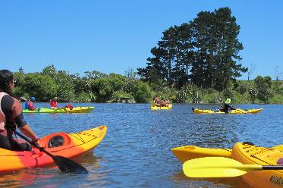
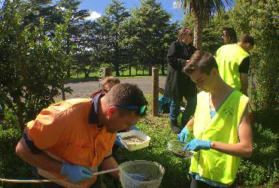
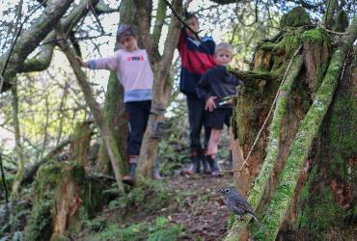
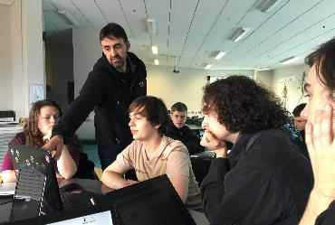
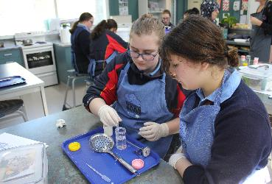
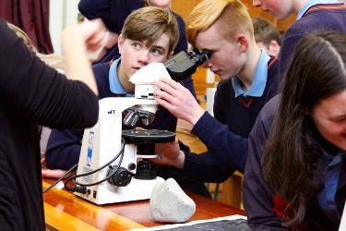
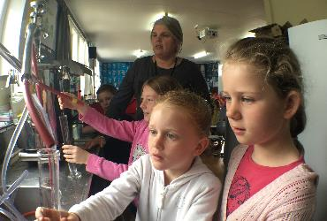
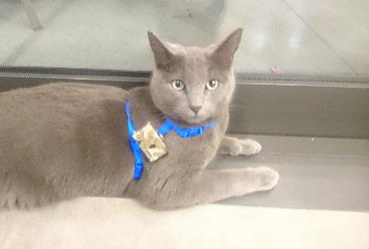
www.curiousminds.nz
Crown Copyright © MBIE. CC-BY 4.0.
© Copyright. Science Learning Hub – Pokapū Akoranga Pūtaiao The University of Waikato Te Whare Wananga o Waikato.
All Rights Reserved | www.sciencelearn.org.nz. All images are copyrighted. For further information, please refer to enquiries@sciencelearn.org.nz

Slide 5
Index
Topic | PowerPoint slide number(s ) | Video timecode
Introducing the Science Learning Hub and presenters | 1–4 | 00:00
Index | 5 | 03:17
Purpose | 6 | 03:29
What is citizen science? | 7–12 | 03:47
Participant experiences | 13 | 09:19
Why bother?, Science capabilities | 14–19 | 10:41
Connecting with scientists | 20–21 | 14:43
Citizen science projects | 22–27 | 15:25
Participatory science and longer-term projects | 28–31 | 18:29
Tips for designing a project | 32–33 | 26:07
SLH links, keep in touch and thanks | 34 | 32:13
© Copyright. University of Waikato. All Rights Reserved | www.sciencelearn.org.nz
All images are copyrighted. For further information, please refer to enquiries@sciencelearn.org.nz

Slide 6
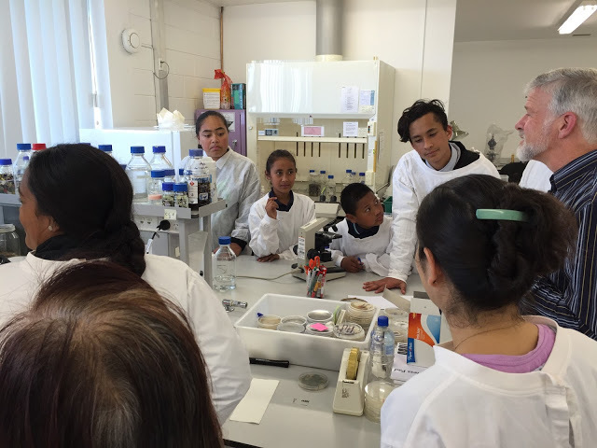
Getting started with citizen science
In this webinar, we will:
explore what we mean by citizen science and why you might want to give it a go
give you some useful tips for getting the most out of the experience
share examples of teachers using citizen science to enhance their science programme.
N. Pattison
Rongomai Primary School
© Copyright. Science Learning Hub – Pokapū Akoranga Pūtaiao The University of Waikato Te Whare Wananga o Waikato.
All Rights Reserved | www.sciencelearn.org.nz. All images are copyrighted. For further information, please refer to enquiries@sciencelearn.org.nz
Notes:
Image: https://www.sciencelearn.org.nz/images/1300-students-with-dr-peter-buchanan

Slide 7
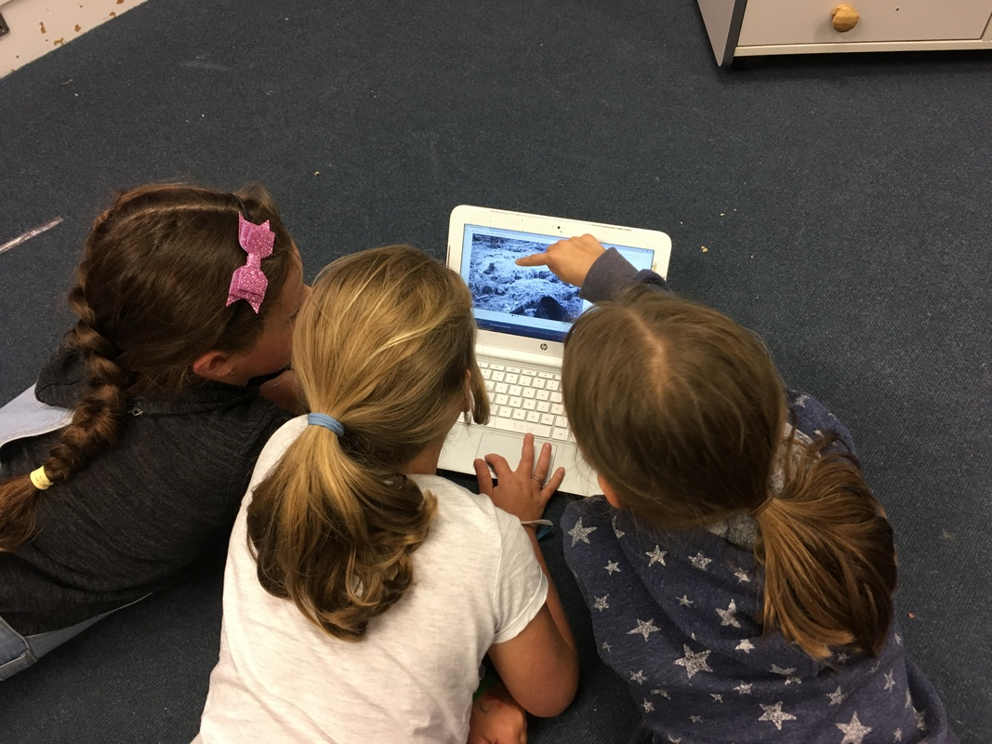
Getting started with citizen science
In our next webinar, we will:
explore online citizen science.
Carol Brieseman
Hampton Hill School
© Copyright. Science Learning Hub – Pokapū Akoranga Pūtaiao The University of Waikato Te Whare Wananga o Waikato.
All Rights Reserved | www.sciencelearn.org.nz. All images are copyrighted. For further information, please refer to enquiries@sciencelearn.org.nz
Notes:
Image: https://www.sciencelearn.org.nz/images/3666-citizen-scientists-identifying-animals

Slide 8
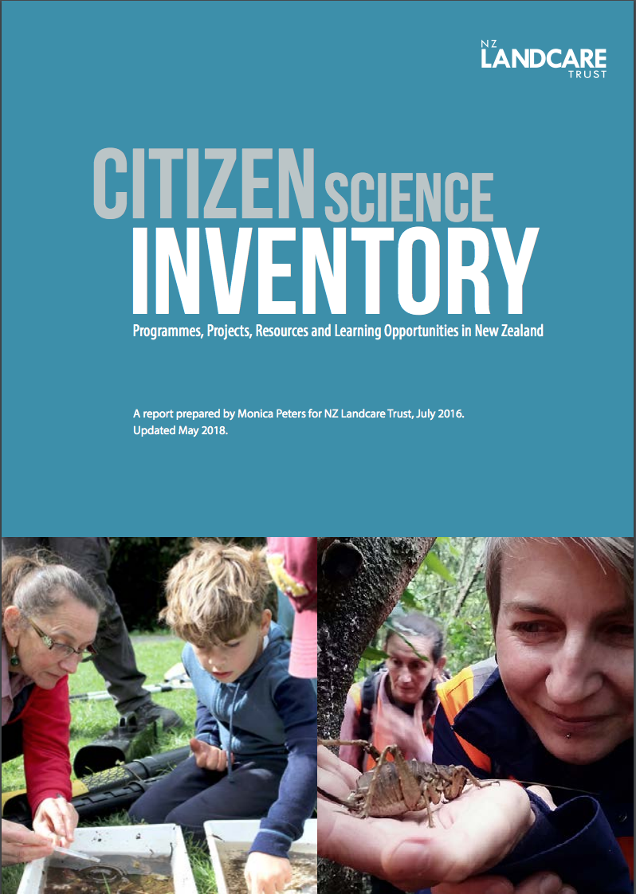
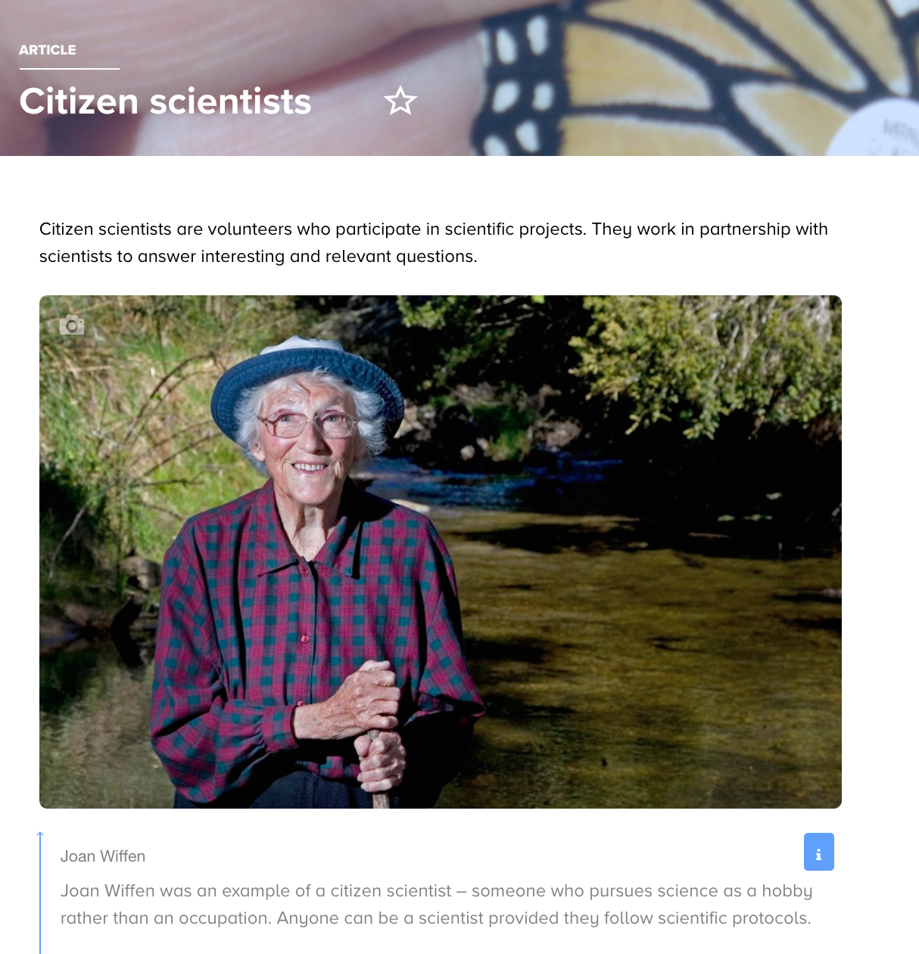
What is it?
Umbrella term (Andrea Wiggins)
Non-scientists involved in science projects
NZPA/John Cowpland
NZ Landcare Trust
© Copyright. Science Learning Hub – Pokapū Akoranga Pūtaiao The University of Waikato Te Whare Wananga o Waikato.
All Rights Reserved | www.sciencelearn.org.nz. All images are copyrighted. For further information, please refer to enquiries@sciencelearn.org.nz
Notes:
Inventory: https://www.landcare.org.nz/file/citizen-science-inventory-updated-may-2018-lr/open
SLH article on citizen science: https://www.sciencelearn.org.nz/resources/512-citizen-scientists
SLH Topic: https://www.sciencelearn.org.nz/topics/citizen-science

Slide 9
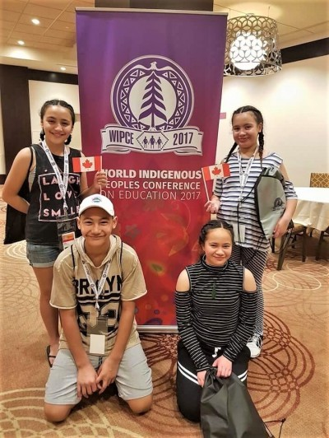
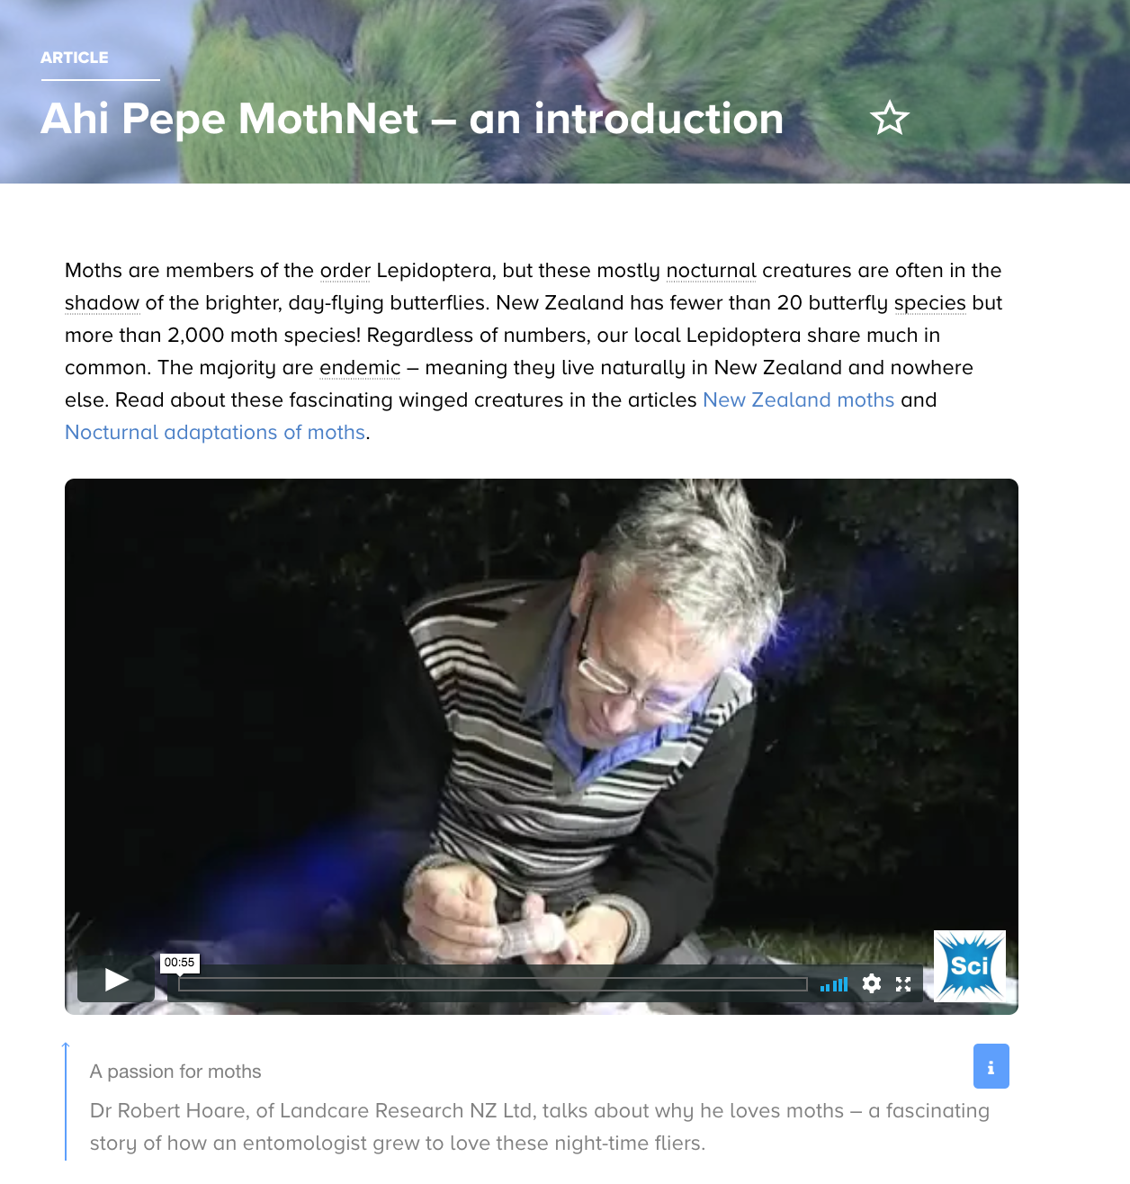
Mātauranga and citizen science
Connecting to key ideas such as kaitiakitanga.
Marcia Cassidy
© Copyright. Science Learning Hub – Pokapū Akoranga Pūtaiao The University of Waikato Te Whare Wananga o Waikato.
All Rights Reserved | www.sciencelearn.org.nz. All images are copyrighted. For further information, please refer to enquiries@sciencelearn.org.nz
Notes:
Image: https://www.sciencelearn.org.nz/images/3558-tamariki-at-wipce
Ahi Pepe intro article: https://www.sciencelearn.org.nz/resources/2618-ahi-pepe-mothnet-an-introduction
Kaitiakitanga: https://www.sciencelearn.org.nz/resources/2544-understanding-kaitiakitanga

Slide 10
Getting started with citizen science
What is it?
Scientists
Community
Organisation
Science
Coordinator
Citizens/
students
Teachers/
school
© Copyright. Science Learning Hub – Pokapū Akoranga Pūtaiao The University of Waikato Te Whare Wananga o Waikato.
All Rights Reserved | www.sciencelearn.org.nz. All images are copyrighted. For further information, please refer to enquiries@sciencelearn.org.nz
Notes:
https://www.landcare.org.nz/file/citizen-science-inventory-updated-may-2018-lr/open

Slide 11
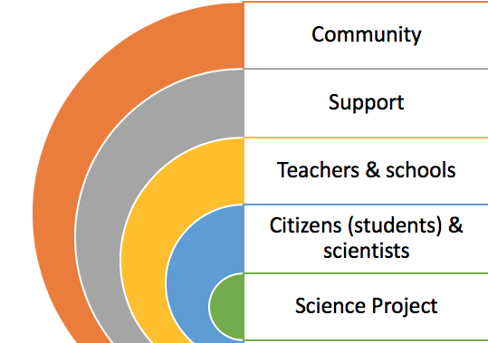
Getting started with citizen science
What is it?
© Copyright. Science Learning Hub – Pokapū Akoranga Pūtaiao The University of Waikato Te Whare Wananga o Waikato.
All Rights Reserved | www.sciencelearn.org.nz. All images are copyrighted. For further information, please refer to enquiries@sciencelearn.org.nz

Slide 12
Getting started with citizen science
What is it?
Connecting with scientists
One-off data-collection event
Longer-term projects, e.g. participatory science
© Copyright. Science Learning Hub – Pokapū Akoranga Pūtaiao The University of Waikato Te Whare Wananga o Waikato.
All Rights Reserved | www.sciencelearn.org.nz. All images are copyrighted. For further information, please refer to enquiries@sciencelearn.org.nz
Notes:
https://www.landcare.org.nz/file/citizen-science-inventory-updated-may-2018-lr/open

Slide 13
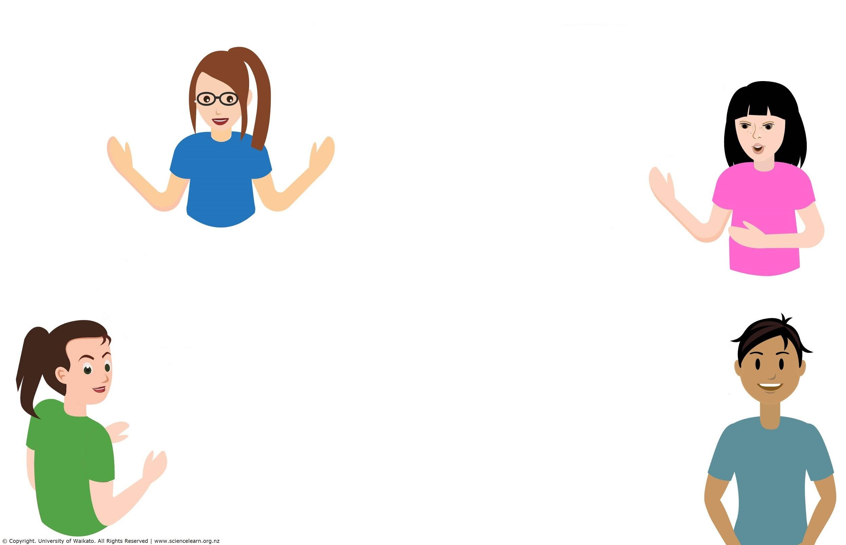
Participant experiences?
© Copyright. Science Learning Hub – Pokapū Akoranga Pūtaiao The University of Waikato Te Whare Wananga o Waikato.
All Rights Reserved | www.sciencelearn.org.nz. All images are copyrighted. For further information, please refer to enquiries@sciencelearn.org.nz
Notes:
https://www.landcare.org.nz/file/citizen-science-inventory-updated-may-2018-lr/open

Slide 14
Why bother?
© Copyright. Science Learning Hub – Pokapū Akoranga Pūtaiao The University of Waikato Te Whare Wananga o Waikato.
All Rights Reserved | www.sciencelearn.org.nz. All images are copyrighted. For further information, please refer to enquiries@sciencelearn.org.nz
Notes:
Slide 3 from Butterflies PLD: https://www.sciencelearn.org.nz/resources/2217-teachers-using-the-hub-butterflies-and-citizen-science
Real-life contexts

Slide 15
Science capabilities
Citizen science supports the development of science capabilities.
The New Zealand Curriculum says all students should become “responsible citizens in a society in which science plays a significant role”.
Each capability encapsulates something that is needed for that ambitious goal to be met.
© Copyright. Science Learning Hub – Pokapū Akoranga Pūtaiao The University of Waikato Te Whare Wananga o Waikato.
All Rights Reserved | www.sciencelearn.org.nz. All images are copyrighted. For further information, please refer to enquiries@sciencelearn.org.nz
Notes:
NZASE article: http://nzscienceteacher.co.nz/index.php/curriculum-literacy/key-competencies-capabilities/unlocking-the-idea-of-capabilities-in-science/#.XT_zPpMzbVq

Slide 16
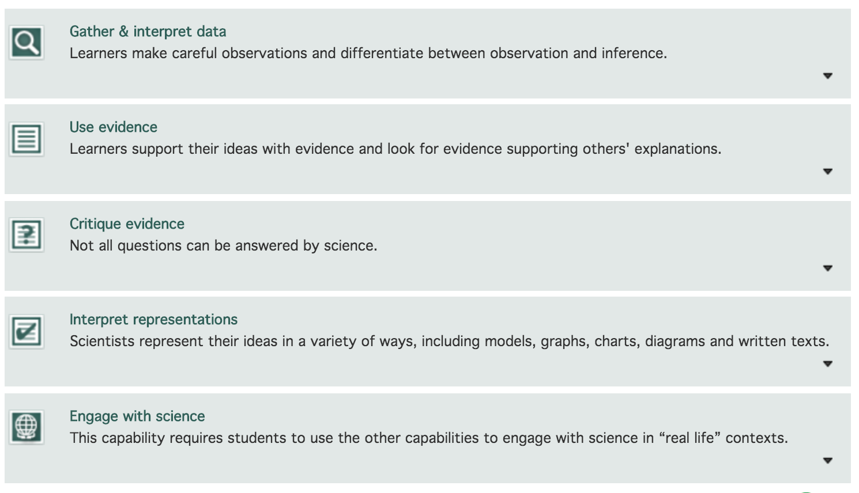
What are science capabilities?
https://scienceonline.tki.org.nz/Science-capabilities-for-citizenship
Crown Copyright
© Copyright. Science Learning Hub – Pokapū Akoranga Pūtaiao The University of Waikato Te Whare Wananga o Waikato.
All Rights Reserved | www.sciencelearn.org.nz. All images are copyrighted. For further information, please refer to enquiries@sciencelearn.org.nz
Notes:
Image from: https://scienceonline.tki.org.nz/Science-capabilities-for-citizenship/Introducing-five-science-capabilities

Slide 17
Science capabilities
Gather data
Engage with science
© Copyright. Science Learning Hub – Pokapū Akoranga Pūtaiao The University of Waikato Te Whare Wananga o Waikato.
All Rights Reserved | www.sciencelearn.org.nz. All images are copyrighted. For further information, please refer to enquiries@sciencelearn.org.nz
Notes:
Science capability progressions: http://scienceonline.tki.org.nz/Progress-and-Achievement-in-Science
UNLOCKING THE IDEA OF ‘CAPABILITIES’ IN SCIENCE: The biggest challenge of all relates to dispositions. You can’t make people critically engage with science. If we want today’s students to do so as tomorrow’s citizens, we have to show them how, give them lots of practice and support them to see these as things they can do, and want to do, for themselves. A few unrelated experiences in school science experiments won’t be enough because demonstrations of capability are multifaceted and context-specific, and you have to want to deploy them. For these reasons, capability building requires lots of related experiences that make a powerful impression on students and that build over time.

Slide 18
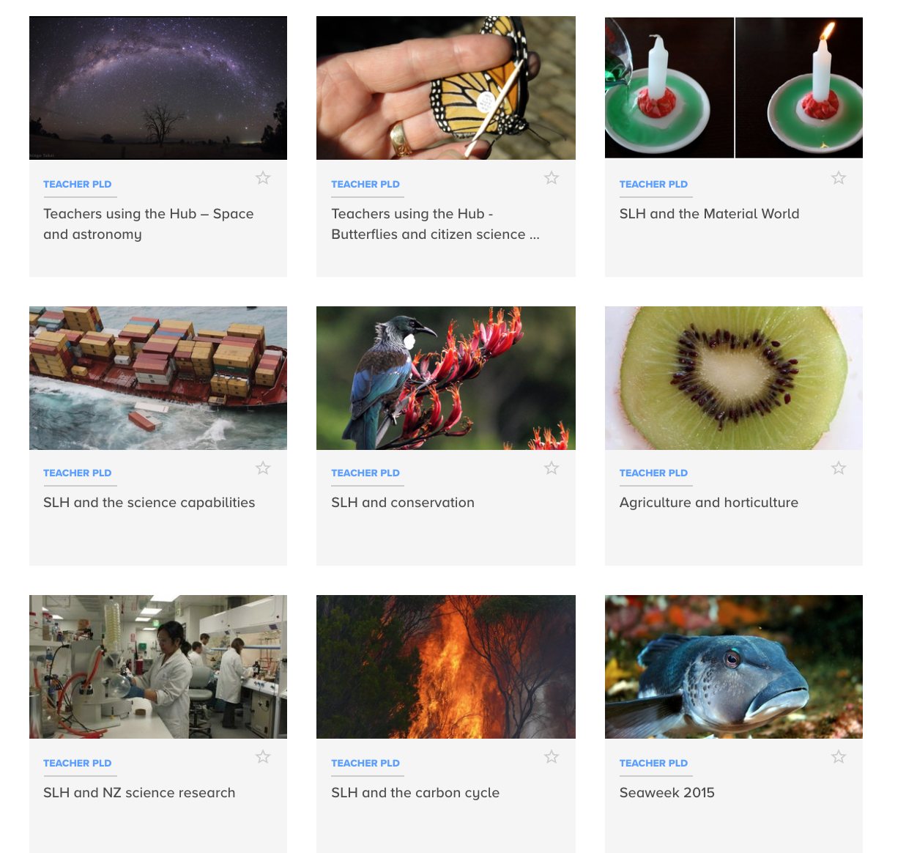
What are science capabilities?
Link content and Nature of Science strands, NZC statement and key competencies.
© Copyright. Science Learning Hub – Pokapū Akoranga Pūtaiao The University of Waikato Te Whare Wananga o Waikato.
All Rights Reserved | www.sciencelearn.org.nz. All images are copyrighted. For further information, please refer to enquiries@sciencelearn.org.nz
Notes:
https://www.sciencelearn.org.nz/resources/2245-slh-and-the-science-capabilities

Slide 19
Getting started with citizen science
What is it?
Connecting with scientists
One-off data-collection event
Longer-term projects, e.g. participatory science
© Copyright. Science Learning Hub – Pokapū Akoranga Pūtaiao The University of Waikato Te Whare Wananga o Waikato.
All Rights Reserved | www.sciencelearn.org.nz. All images are copyrighted. For further information, please refer to enquiries@sciencelearn.org.nz
Notes:
https://www.landcare.org.nz/file/citizen-science-inventory-updated-may-2018-lr/open

Slide 20
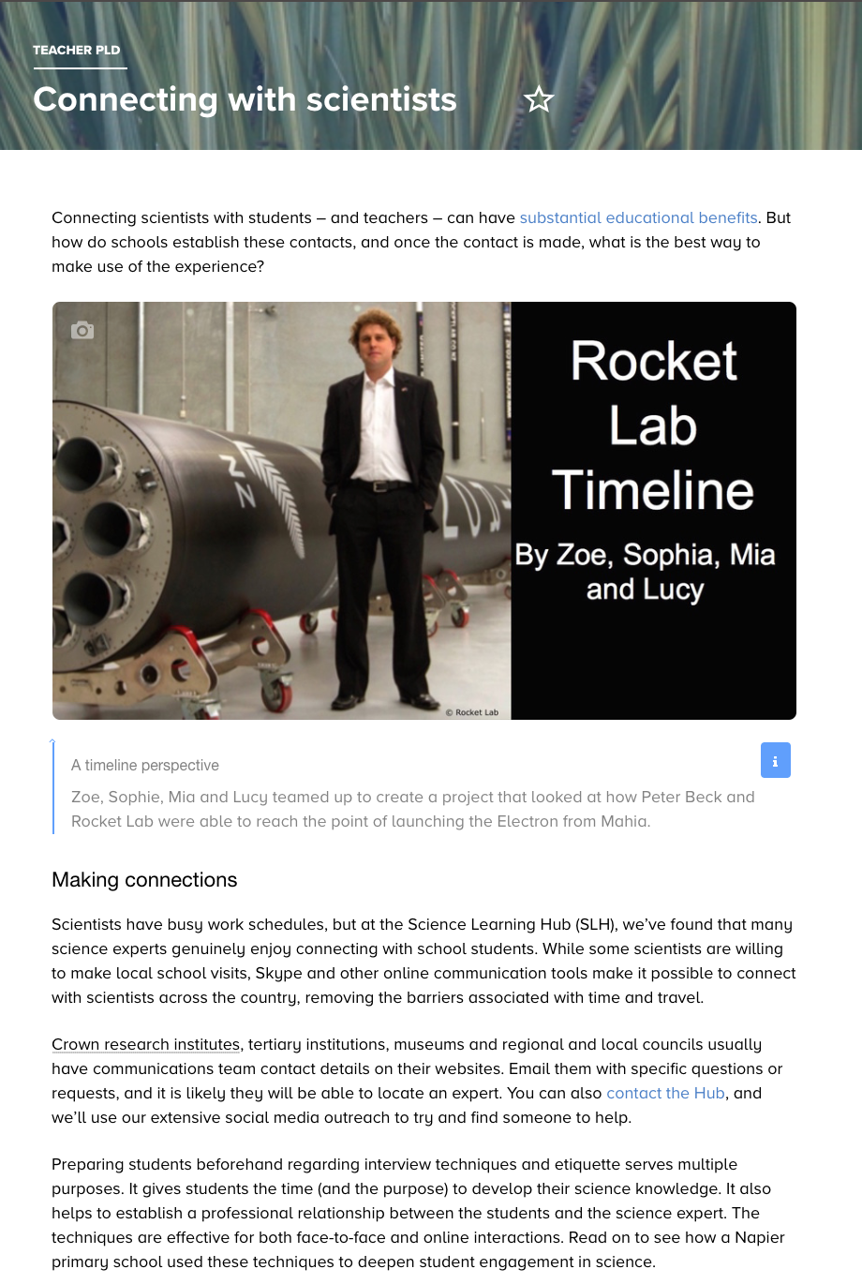
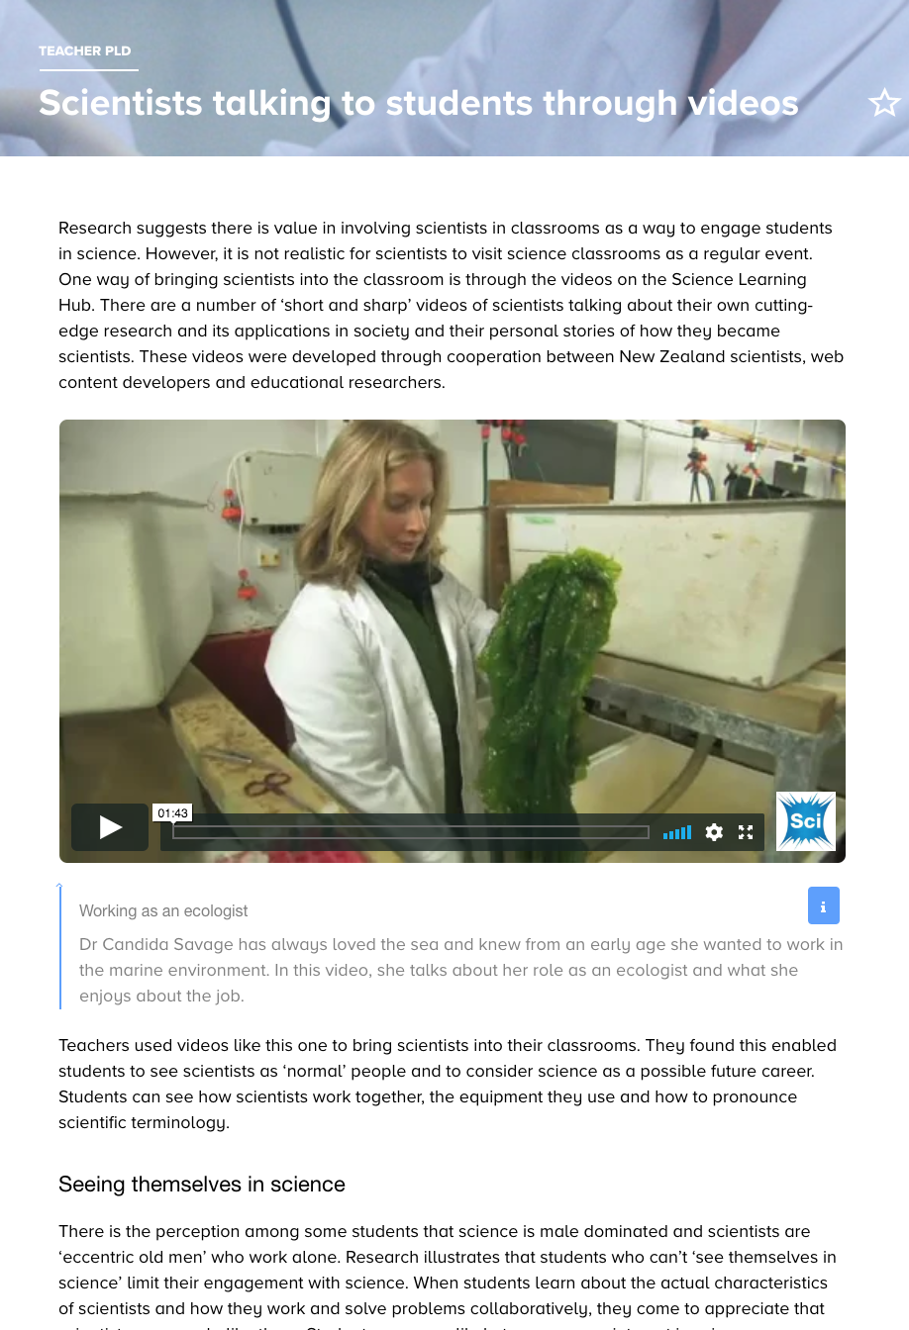
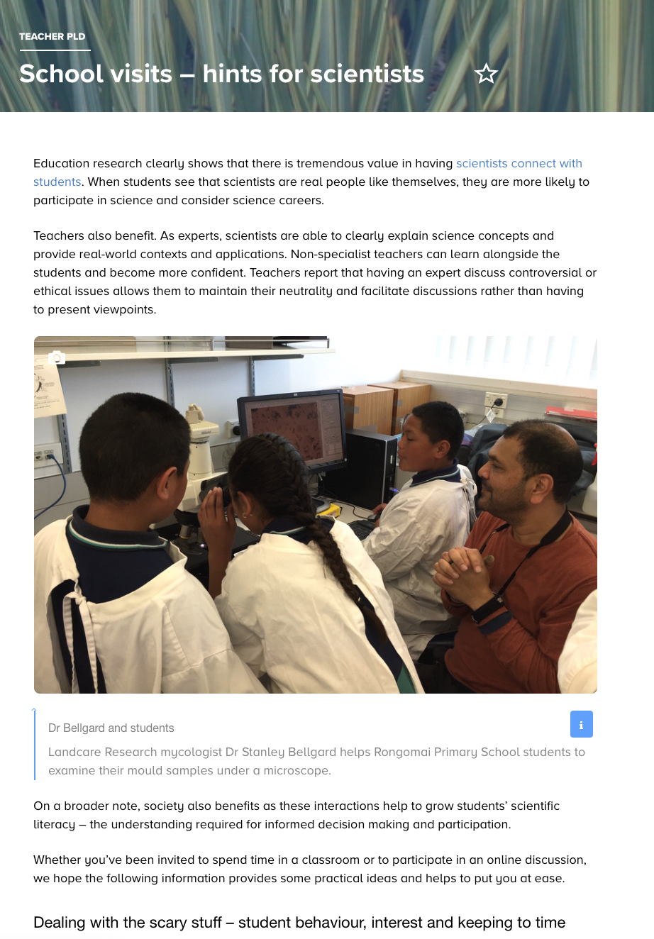
Connecting with scientists
N. Pattison
Rongomai Primary School
© Copyright. Science Learning Hub – Pokapū Akoranga Pūtaiao The University of Waikato Te Whare Wananga o Waikato.
All Rights Reserved | www.sciencelearn.org.nz. All images are copyrighted. For further information, please refer to enquiries@sciencelearn.org.nz
Notes:
Image: https://www.sciencelearn.org.nz/resources/2317-scientists-talking-to-students-through-videos
https://www.sciencelearn.org.nz/resources/2565-communicating-with-scientists-interview-techniques-and-protocols
Connecting with scientists: https://www.sciencelearn.org.nz/resources/2559-connecting-with-scientists
School visits: https://www.sciencelearn.org.nz/resources/2578-school-visits-hints-for-scientists

Slide 21
Connecting with scientists
Email us enquiries@sciencelearn.org.nz
https://twitter.com/NZScienceLearn
www.facebook.com/nzsciencelearn
https://nz.pinterest.com/nzsciencelearn
www.instagram.com/sciencelearninghubnz
Join us in our discussion channel on Slack.
(Any problems accessing Slack, please contact us via our enquiries email, enquiries@sciencelearn.org.nz.)
Notes:
Don’t forget the SLH can help
SLACK: https://slh-talk.slack.com/messages/CDL529ERW/

Slide 22
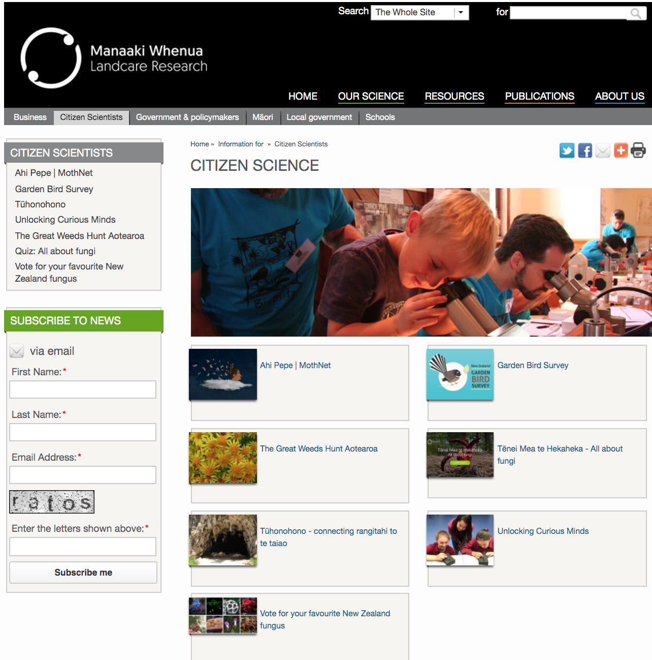
Citizen science projects
Manaaki Whenua — Landcare Research
© Copyright. Science Learning Hub – Pokapū Akoranga Pūtaiao The University of Waikato Te Whare Wananga o Waikato.
All Rights Reserved | www.sciencelearn.org.nz. All images are copyrighted. For further information, please refer to enquiries@sciencelearn.org.nz
Notes:
Image1 : https://www.landcareresearch.co.nz/information-for/citizen-science
Image 2: https://www.landcareresearch.co.nz/science/plants-animals-fungi/animals/birds/garden-bird-surveys

Slide 23
Going further with citizen science
Connecting with scientists
One-off data-collection event
Longer-term projects, e.g. participatory science
© Copyright. Science Learning Hub – Pokapū Akoranga Pūtaiao The University of Waikato Te Whare Wananga o Waikato.
All Rights Reserved | www.sciencelearn.org.nz. All images are copyrighted. For further information, please refer to enquiries@sciencelearn.org.nz
Notes:
https://www.landcare.org.nz/file/citizen-science-inventory-updated-may-2018-lr/open

Slide 24
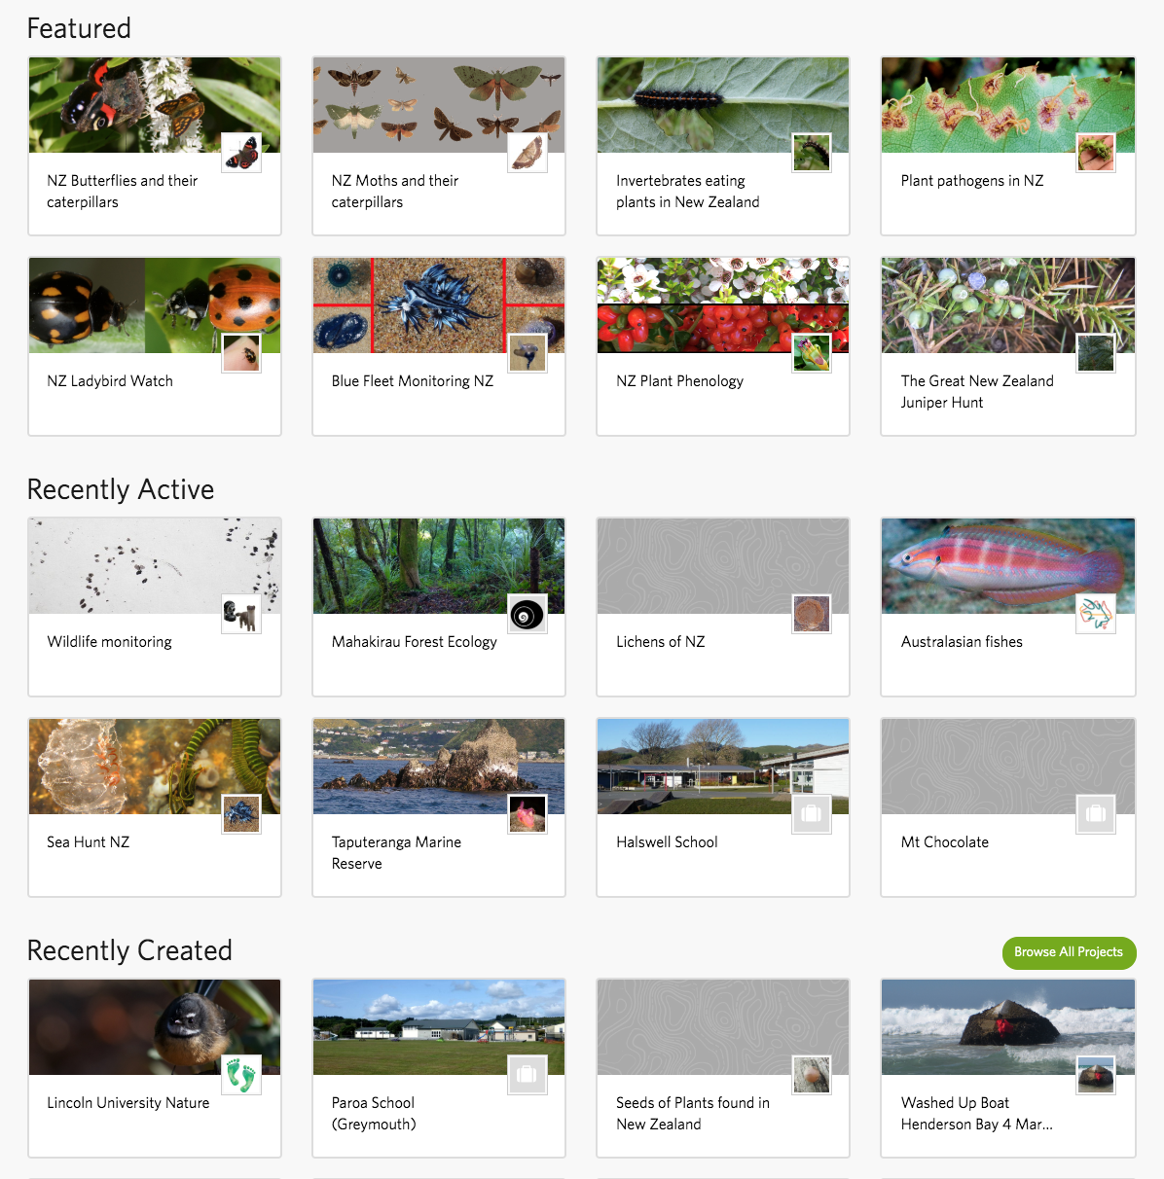
Citizen science projects
iNaturalist NZ
Mātaki Taiao
© Copyright. Science Learning Hub – Pokapū Akoranga Pūtaiao The University of Waikato Te Whare Wananga o Waikato.
All Rights Reserved | www.sciencelearn.org.nz. All images are copyrighted. For further information, please refer to enquiries@sciencelearn.org.nz
Notes:
Image1:https://www.sciencelearn.org.nz/images/3895-inaturalist-nz-mataki-taiao
Image 2: https://inaturalist.nz/projects
https://www.sciencelearn.org.nz/resources/2753-inaturalist
https://inaturalist.nz/projects

Slide 25
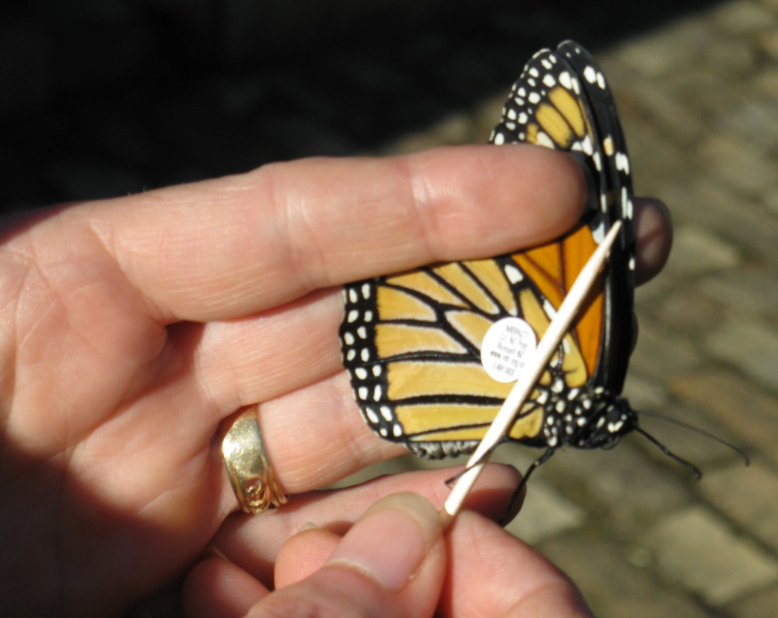
Citizen science projects
© Copyright. Science Learning Hub – Pokapū Akoranga Pūtaiao The University of Waikato Te Whare Wananga o Waikato.
All Rights Reserved | www.sciencelearn.org.nz. All images are copyrighted. For further information, please refer to enquiries@sciencelearn.org.nz
Notes:
Image: https://www.sciencelearn.org.nz/images/549-tagged-butterfly
PLD: https://www.sciencelearn.org.nz/resources/2217-teachers-using-the-hub-butterflies-and-citizen-science
Monarch trust: https://www.monarch.org.nz/
Tagging: https://www.monarch.org.nz/introduction-to-research/taggingtransects/

Slide 26
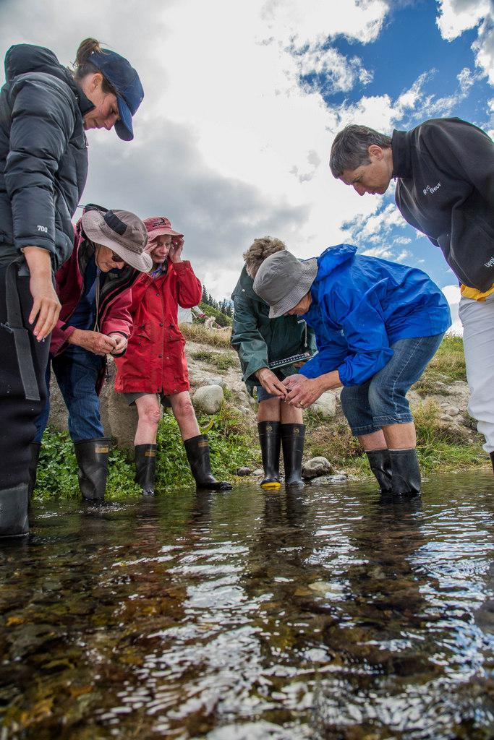
Citizen science projects
NIWA
© Copyright. Science Learning Hub – Pokapū Akoranga Pūtaiao The University of Waikato Te Whare Wananga o Waikato.
All Rights Reserved | www.sciencelearn.org.nz. All images are copyrighted. For further information, please refer to enquiries@sciencelearn.org.nz
Notes:
NIWA: https://www.niwa.co.nz/freshwater/management-tools/water-quality-tools/stream-health-monitoring-and-assessment-kit

Slide 27
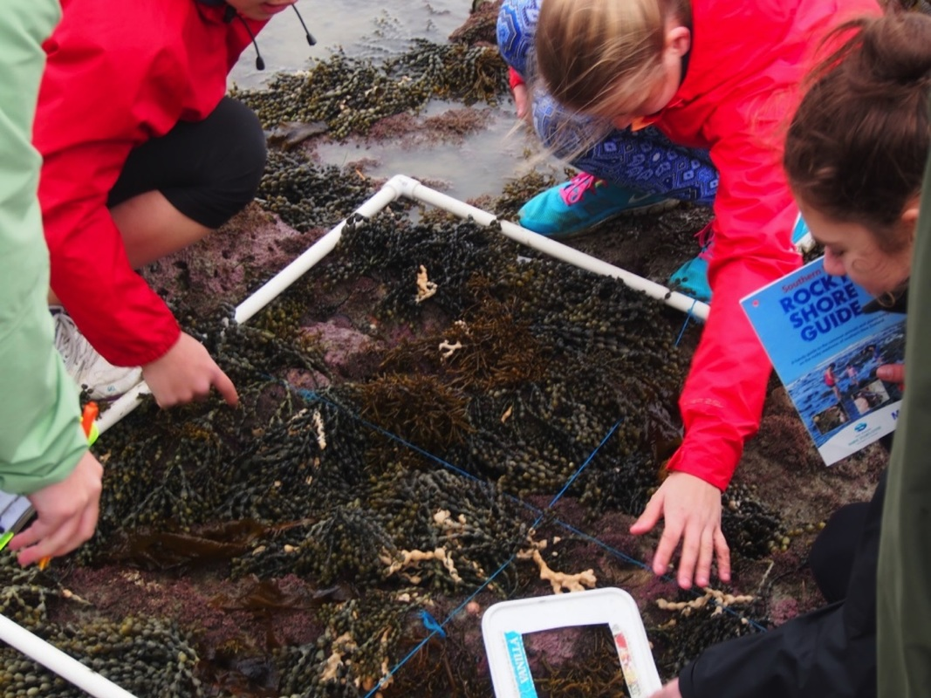
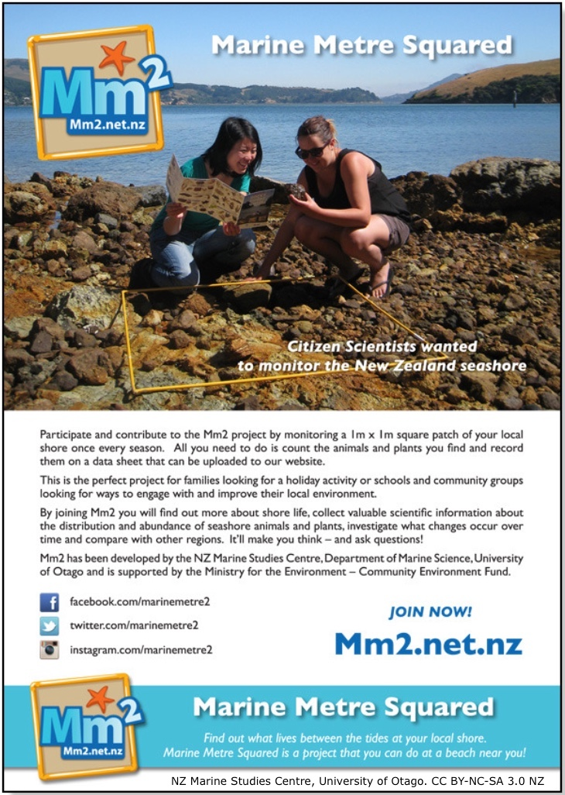
Citizen science projects
Otago Science in Action
NZ Marine Studies Centre, University of Otago. CC BY-NC-SA 3.0 NZ
© Copyright. Science Learning Hub – Pokapū Akoranga Pūtaiao The University of Waikato Te Whare Wananga o Waikato.
All Rights Reserved | www.sciencelearn.org.nz. All images are copyrighted. For further information, please refer to enquiries@sciencelearn.org.nz
Notes:
Image: https://www.sciencelearn.org.nz/images/2961-using-a-quadrat
Image 2: https://www.sciencelearn.org.nz/images/2965-marine-metre-squared
Image 3: https://www.mm2.net.nz/news/1
Article: https://www.sciencelearn.org.nz/resources/2730-marine-metre-squared
TKI link: http://scienceonline.tki.org.nz/Science-capabilities-for-citizenship/Introducing-five-science-capabilities/Critique-evidence/Marine-Metre-Squared

Slide 28
Going further with citizen science
Connecting with scientists
One-off data-collection event
Longer-term projects, e.g. participatory science
© Copyright. Science Learning Hub – Pokapū Akoranga Pūtaiao The University of Waikato Te Whare Wananga o Waikato.
All Rights Reserved | www.sciencelearn.org.nz. All images are copyrighted. For further information, please refer to enquiries@sciencelearn.org.nz
Notes:
https://www.landcare.org.nz/file/citizen-science-inventory-updated-may-2018-lr/open

Slide 29
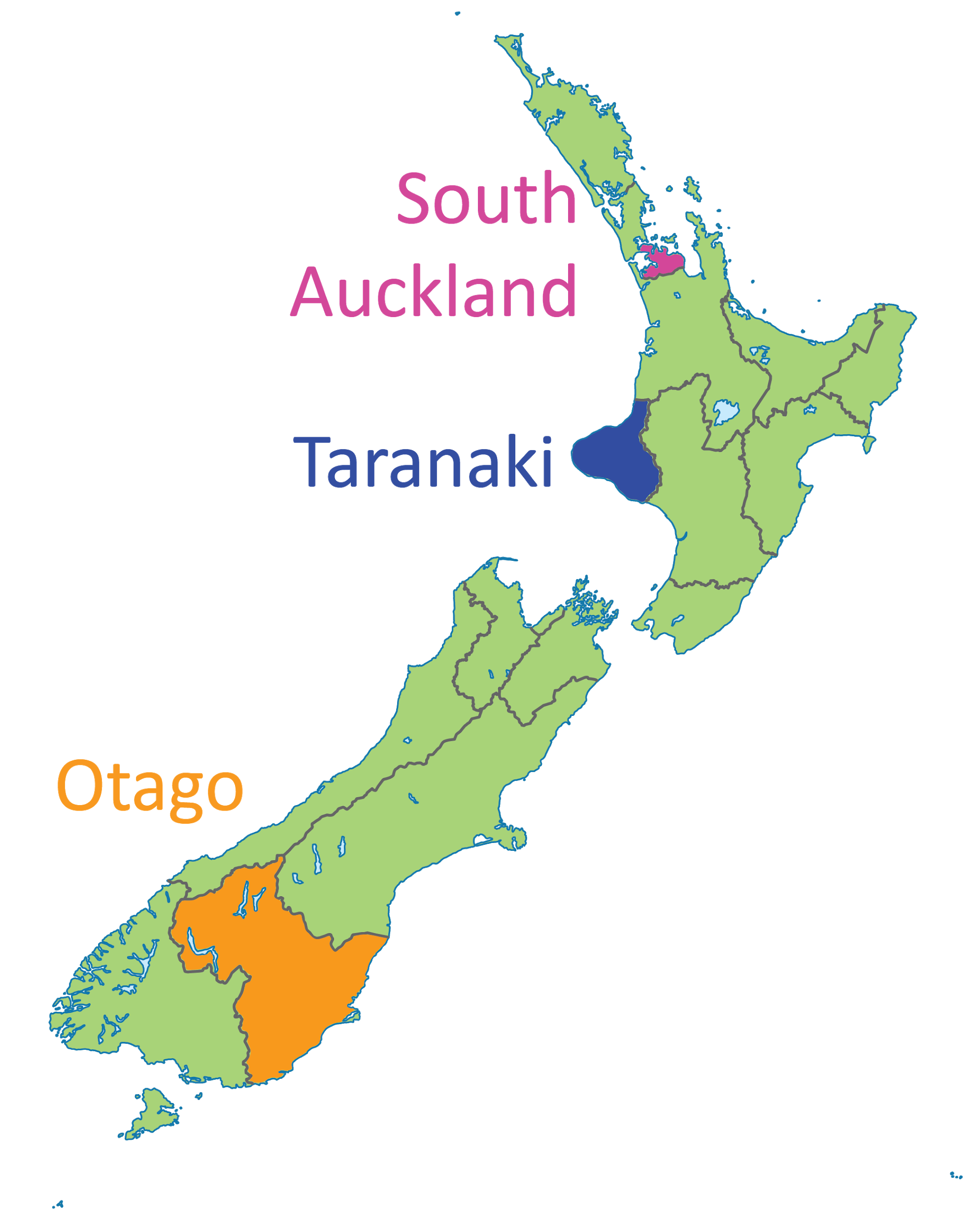
Pedagogical rigour
Engagement
Robust science
Participatory
science
© Copyright. Science Learning Hub – Pokapū Akoranga Pūtaiao The University of Waikato Te Whare Wananga o Waikato.
All Rights Reserved | www.sciencelearn.org.nz. All images are copyrighted. For further information, please refer to enquiries@sciencelearn.org.nz
Notes:
Learn more about PSPs:
Curious Minds: https://www.curiousminds.nz/funding/participatory-science-platform/
RNZ interview https://www.rnz.co.nz/national/programmes/up-this-way/audio/2018627997/extreme-citizen-science

Slide 30
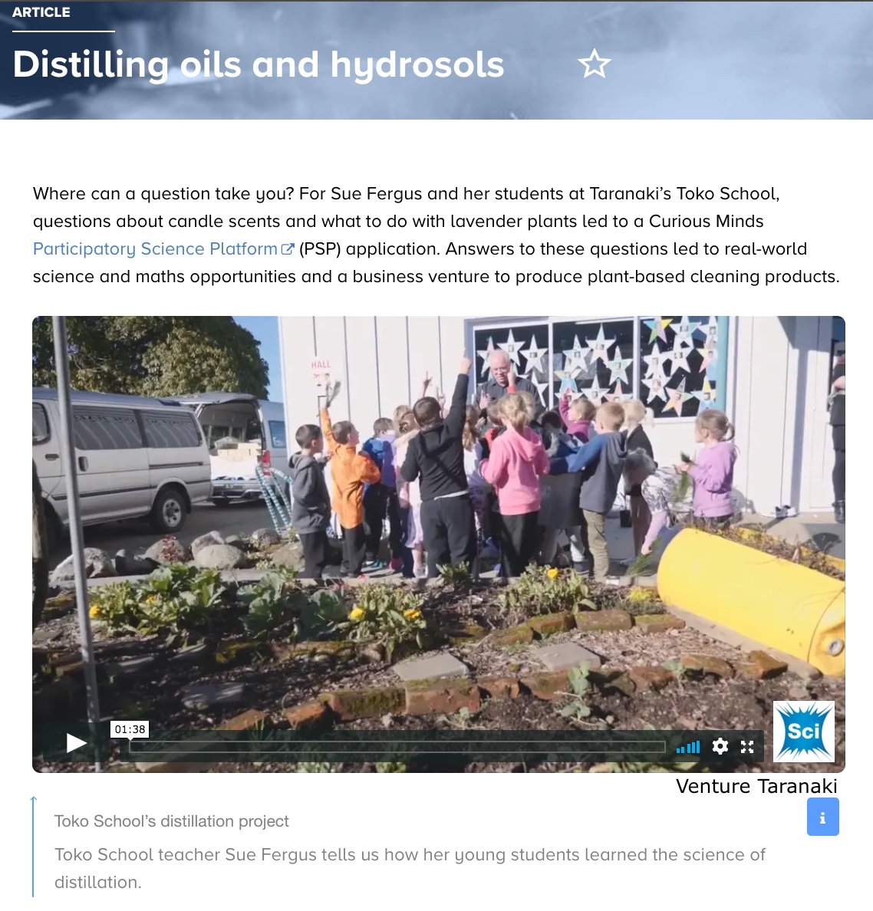
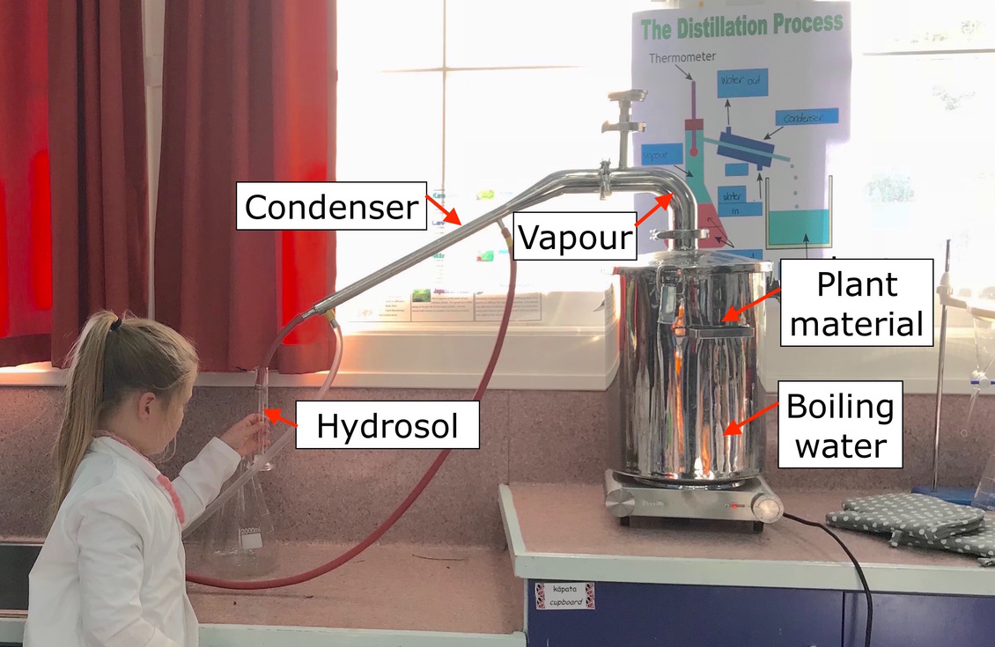
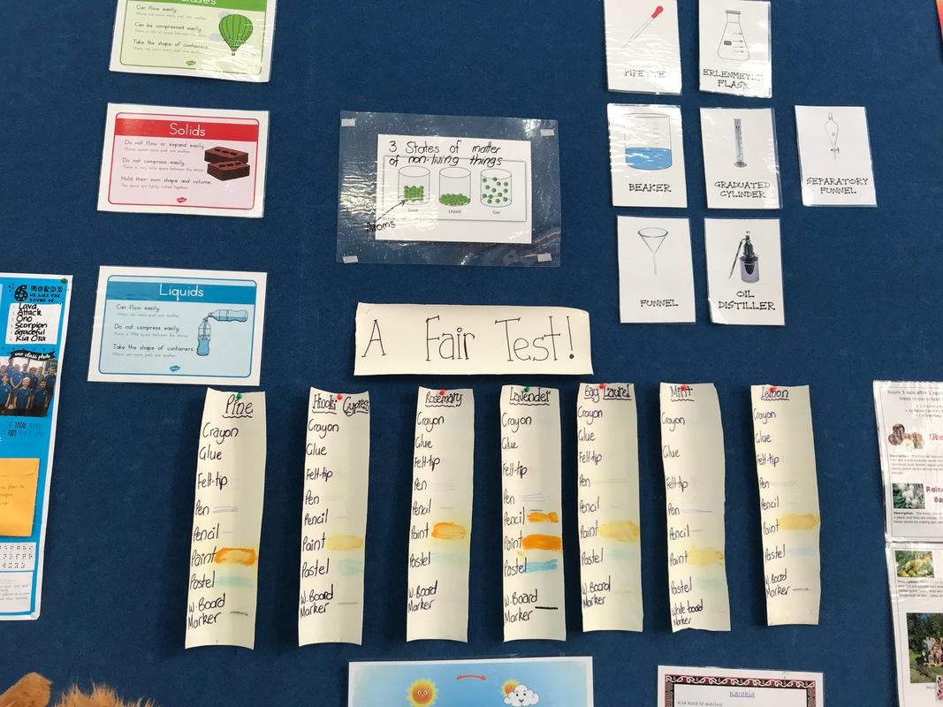
Going further with citizen science
© Copyright. Science Learning Hub – Pokapū Akoranga Pūtaiao The University of Waikato Te Whare Wananga o Waikato.
All Rights Reserved | www.sciencelearn.org.nz. All images are copyrighted. For further information, please refer to enquiries@sciencelearn.org.nz
Notes:
Image 1: https://www.sciencelearn.org.nz/images/3575-steam-distillation-unit-at-toko-school
Image 2: https://www.sciencelearn.org.nz/images/3576-distillation-and-science-concepts
Article: https://www.sciencelearn.org.nz/resources/2625-distilling-oils-and-hydrosols

Slide 31
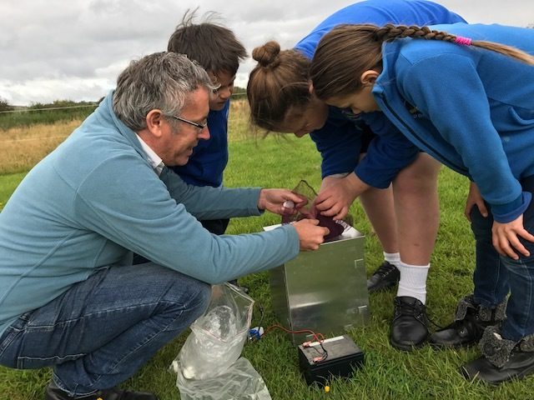
Going further with citizen science
© Copyright. Science Learning Hub – Pokapū Akoranga Pūtaiao The University of Waikato Te Whare Wananga o Waikato.
All Rights Reserved | www.sciencelearn.org.nz. All images are copyrighted. For further information, please refer to enquiries@sciencelearn.org.nz
Notes:
Image: https://www.sciencelearn.org.nz/images/3181-using-a-heath-moth-trap
Article: https://www.sciencelearn.org.nz/resources/2617-scientists-and-tamariki-working-together

Slide 32
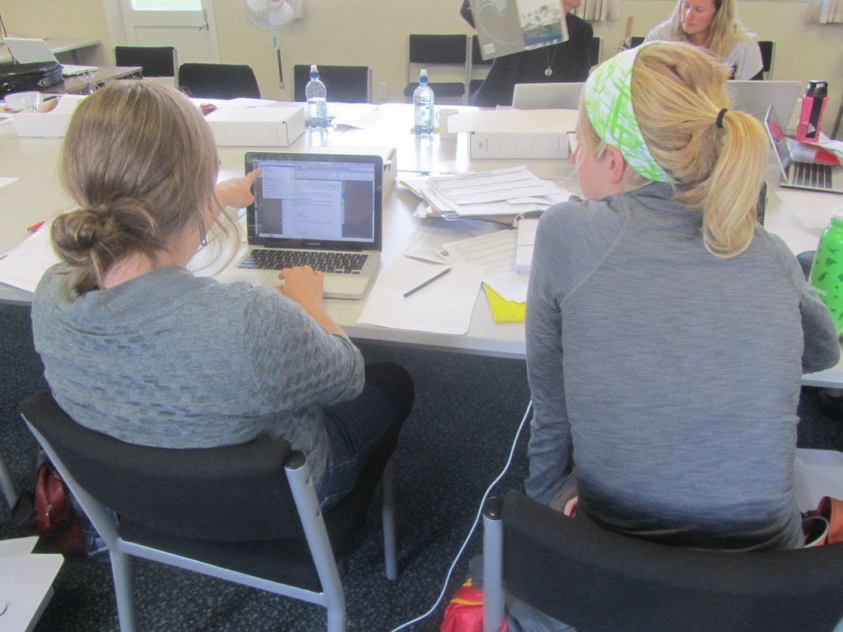
Design your own
Greta Dromgool
© Copyright. Science Learning Hub – Pokapū Akoranga Pūtaiao The University of Waikato Te Whare Wananga o Waikato.
All Rights Reserved | www.sciencelearn.org.nz. All images are copyrighted. For further information, please refer to enquiries@sciencelearn.org.nz
Notes:
Image: https://www.sciencelearn.org.nz/images/3047-teacher-workshops
Planning: https://www.sciencelearn.org.nz/resources/2740-planning-for-students-to-be-citizen-scientists
Sarah’s document on co-design: https://docs.google.com/document/d/1EGLR5VGsEFbJMpQcUGcfC6htV06TyFmR/edit
Eco explorers PLD: https://www.sciencelearn.org.nz/resources/2610-eco-explorers

Slide 33
How can you embed your project in
the school curriculum and make it transdisciplinary?
Set/allocate dedicated class time.
Work with other teachers – team-teach if possible. Weird combos are often unexpectedly great – e.g. art and health, languages and maths.
Construct your project from the start to consciously address several curriculum learning areas and achievement objectives.
Consider designing the project with your students, involving them in the choice of curriculum learning areas and construction of the learning objectives.
© Copyright. Science Learning Hub – Pokapū Akoranga Pūtaiao The University of Waikato Te Whare Wananga o Waikato.
All Rights Reserved | www.sciencelearn.org.nz. All images are copyrighted. For further information, please refer to enquiries@sciencelearn.org.nz
Notes:
https://docs.google.com/presentation/d/1MdAAjRKjwqqDfNY6TNVAl5zSUyb94mqY/edit#slide=id.p13
We love to help, and we have a bunch of Curious Minds ambassadors standing by …
Sarah Morgan | 027 283 3412 | sarah.morgan@cometauckland.org.nz

Slide 34
Thanks
Pokapū Akoranga Pūtaiao
Email us enquiries@sciencelearn.org.nz
https://twitter.com/NZScienceLearn
www.facebook.com/nzsciencelearn
https://nz.pinterest.com/nzsciencelearn
www.instagram.com/sciencelearninghubnz
Join us in our discussion channel on Slack.
(Any problems accessing Slack, please contact us via our enquiries email, enquiries@sciencelearn.org.nz.)
Notes:
SLACK: https://slh-talk.slack.com/messages/CDL529ERW/

