Slide 1
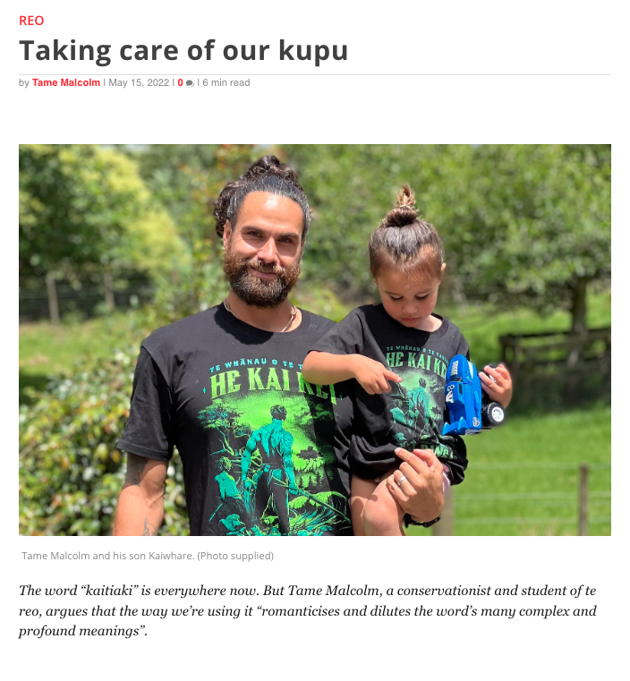
Kaitiakitanga
with Tame Malcolm
Screengrab from https://e-tangata.co.nz/reo/taking-care-of-our-kupu/ and photograph © Tame Malcolm
4–4:45 pm Thursday 2 June
© Copyright. Science Learning Hub – Pokapū Akoranga Pūtaiao The University of Waikato Te Whare Wananga o Waikato.
All Rights Reserved | www.sciencelearn.org.nz. All images are copyrighted. For further information, please refer to enquiries@sciencelearn.org.nz

Slide 2
The Science Learning Hub
A trustworthy online resource – produced by educators and scientists
Based on world-class New Zealand science research
Supported by learning activities, information about the key science ideas and concepts, multimedia tools and other resources
Written for New Zealand teachers and students
Notes:
The Science Learning Hub is funded by the New Zealand government – MBIE Ministry of Business, Innovation and Employment – under the Curious Minds fund.

Slide 3
Index
Topic | Slideshow number(s ) | Video timecode
Welcome | 1 | 00:00
Introducing the Science Learning Hub | 2 | 00:09
Index | 3 | 00:26
Purpose | 4 | 00:33
Tame and Te Tira Whakamātaki | 5–6 | 01:02
Kaitiakitanga meaning | 7 | 03:15
Pūrakau | 8–14 | 19:19
Karakia | 15–16 | 31:30
Resources | 17 | 42:05
SLH links, keep in touch and thanks | 18 | 43:12
© Copyright. The University of Waikato Te Whare Wananga o Waikato l Science Learning Hub – Pokapū Akoranga Pūtaiao. All Rights Reserved
All images are copyrighted. For further information, please refer to enquiries@sciencelearn.org.nz.

Slide 4
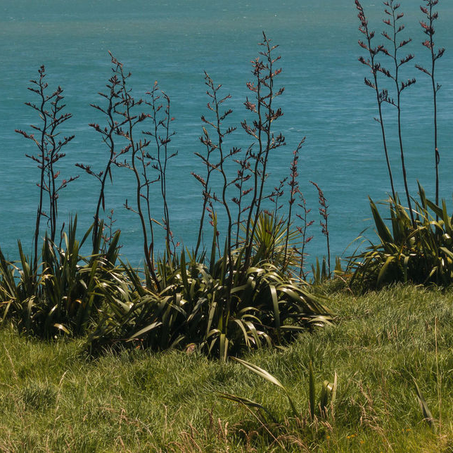
Purpose
To develop our understanding of kaitiakitanga
To share pūrākau connected to kaitiakitanga
To inspire you to reflect on your inclusion of this concept in your teaching
Rights: Pstedrak, 123RF Ltd
© Copyright. Science Learning Hub – Pokapū Akoranga Pūtaiao The University of Waikato Te Whare Wananga o Waikato.
All Rights Reserved | www.sciencelearn.org.nz. All images are copyrighted. For further information, please refer to enquiries@sciencelearn.org.nz
Notes:
https://www.sciencelearn.org.nz/images/3308-harakeke-for-stream-restoration

Slide 5
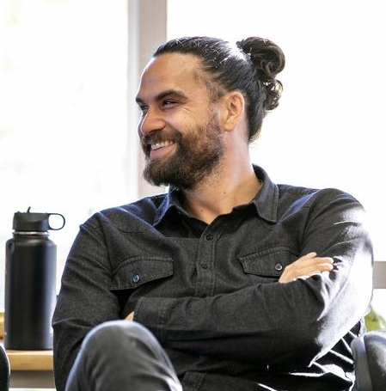
Tame Malcolm
Rights: Te Rawhitiroa Photography
© Copyright. Science Learning Hub – Pokapū Akoranga Pūtaiao The University of Waikato Te Whare Wananga o Waikato.
All Rights Reserved | www.sciencelearn.org.nz. All images are copyrighted. For further information, please refer to enquiries@sciencelearn.org.nz

Slide 6
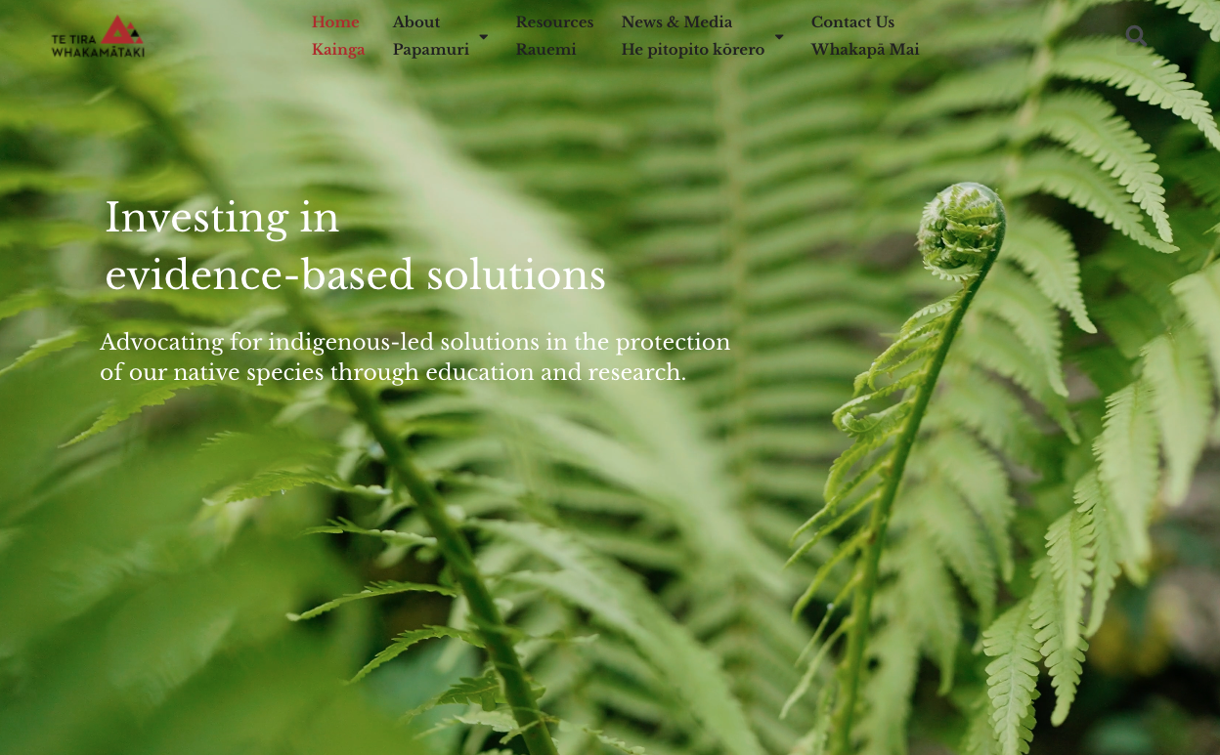
https://ttw.nz/
© Copyright. Science Learning Hub – Pokapū Akoranga Pūtaiao The University of Waikato Te Whare Wananga o Waikato.
All Rights Reserved | www.sciencelearn.org.nz. All images are copyrighted. For further information, please refer to enquiries@sciencelearn.org.nz

Slide 7
Kaitiaki
Screengrab from https://e-tangata.co.nz/reo/taking-care-of-our-kupu/ and photograph © Tame Malcolm
© Copyright. Science Learning Hub – Pokapū Akoranga Pūtaiao The University of Waikato Te Whare Wananga o Waikato.
All Rights Reserved | www.sciencelearn.org.nz. All images are copyrighted. For further information, please refer to enquiries@sciencelearn.org.nz

Slide 8
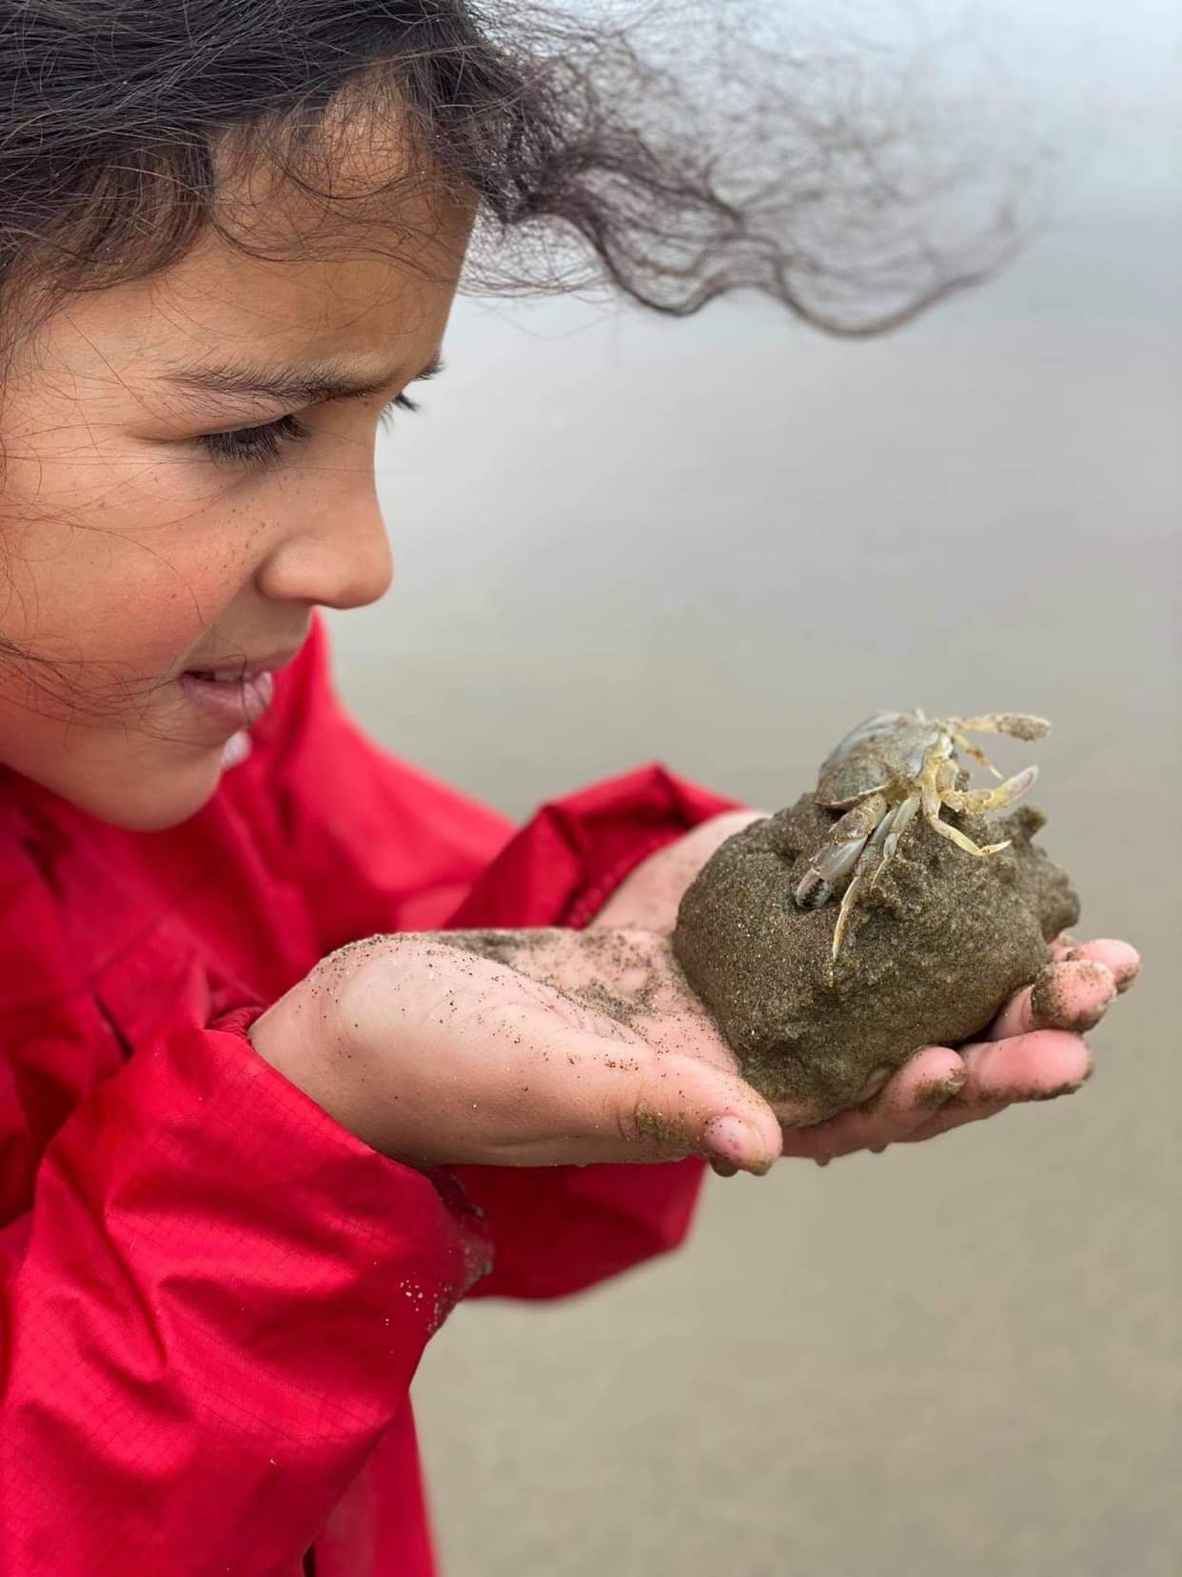
Pūrākau
Copyright S.C. Lucich
© Copyright. Science Learning Hub – Pokapū Akoranga Pūtaiao The University of Waikato Te Whare Wananga o Waikato.
All Rights Reserved | www.sciencelearn.org.nz. All images are copyrighted. For further information, please refer to enquiries@sciencelearn.org.nz

Slide 9
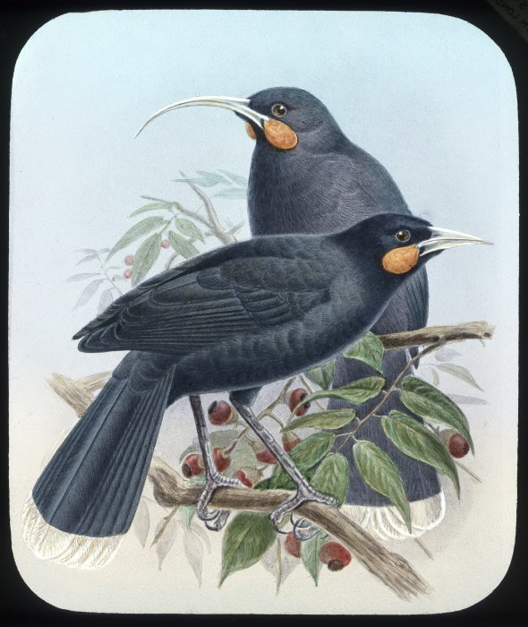
Pūrākau
Rights: Huia birds, male and female. Harris, Esme, fl 1980-1981:Photographs. Ref: PA11-046-11. Alexander Turnbull Library, Wellington, New Zealand. /records/23081750
© Copyright. Science Learning Hub – Pokapū Akoranga Pūtaiao The University of Waikato Te Whare Wananga o Waikato.
All Rights Reserved | www.sciencelearn.org.nz. All images are copyrighted. For further information, please refer to enquiries@sciencelearn.org.nz
Notes:
https://www.sciencelearn.org.nz/images/3655-the-extinct-huia

Slide 10
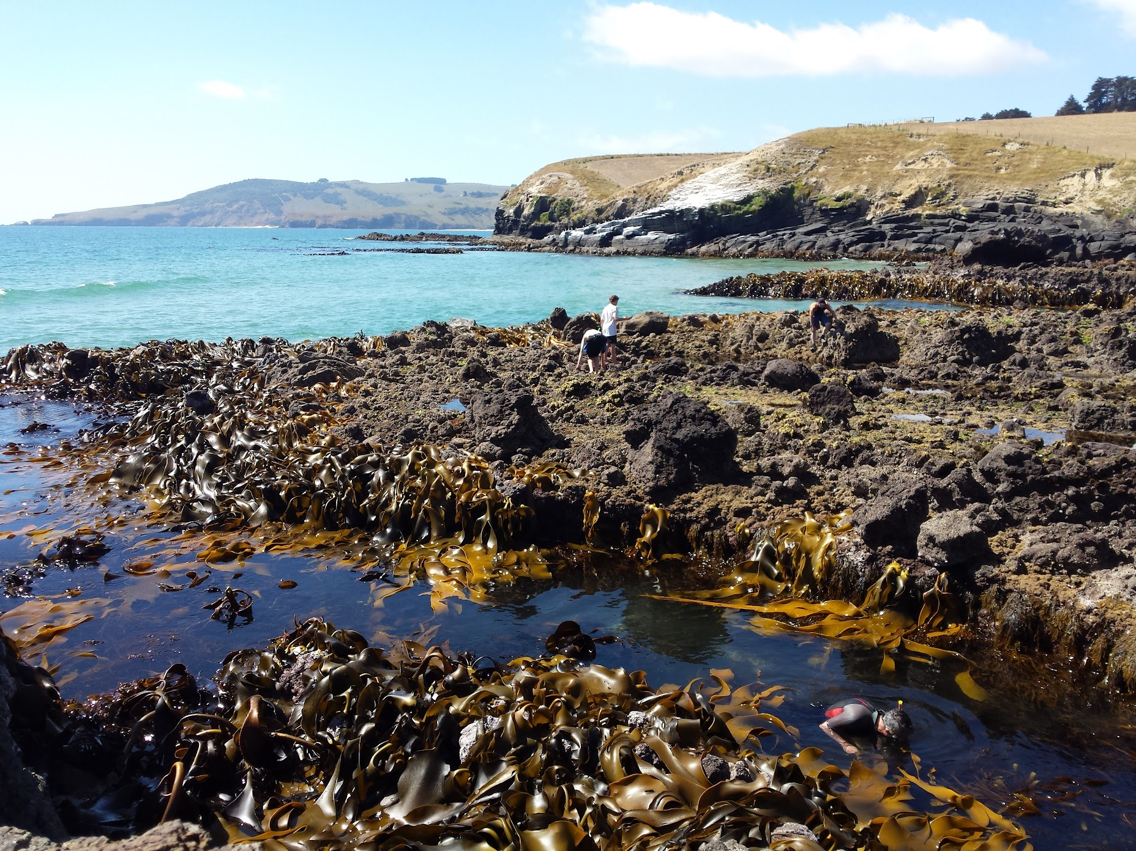
Pūrākau
Private collection
© Copyright. Science Learning Hub – Pokapū Akoranga Pūtaiao The University of Waikato Te Whare Wananga o Waikato.
All Rights Reserved | www.sciencelearn.org.nz. All images are copyrighted. For further information, please refer to enquiries@sciencelearn.org.nz

Slide 11
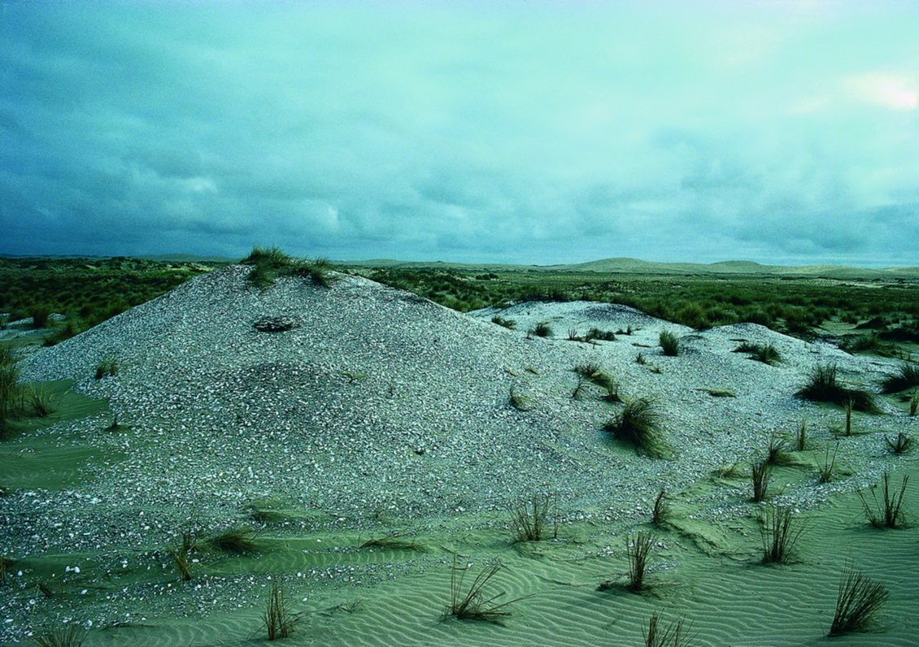
Pūrākau
Rights: New Zealand Historic Places Trust
© Copyright. Science Learning Hub – Pokapū Akoranga Pūtaiao The University of Waikato Te Whare Wananga o Waikato.
All Rights Reserved | www.sciencelearn.org.nz. All images are copyrighted. For further information, please refer to enquiries@sciencelearn.org.nz
Notes:
https://www.sciencelearn.org.nz/images/1774-midden

Slide 12
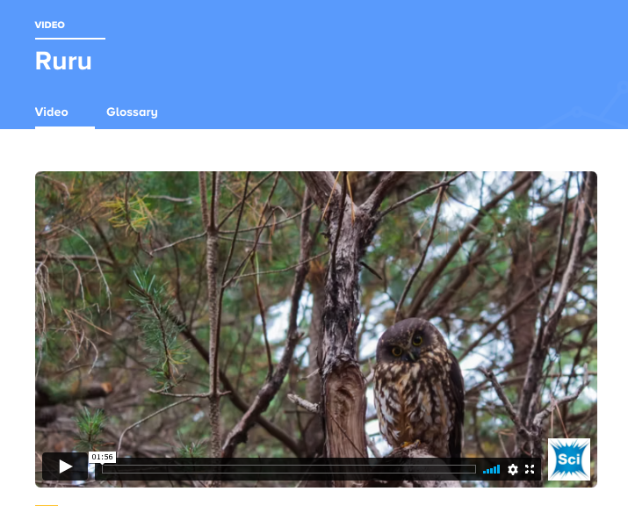
Pūrākau
Screengrab from video footage, Nick Bradsworth.
© Copyright. Science Learning Hub – Pokapū Akoranga Pūtaiao The University of Waikato Te Whare Wananga o Waikato.
All Rights Reserved | www.sciencelearn.org.nz. All images are copyrighted. For further information, please refer to enquiries@sciencelearn.org.nz
Notes:
https://www.sciencelearn.org.nz/videos/2020-ruru

Slide 13
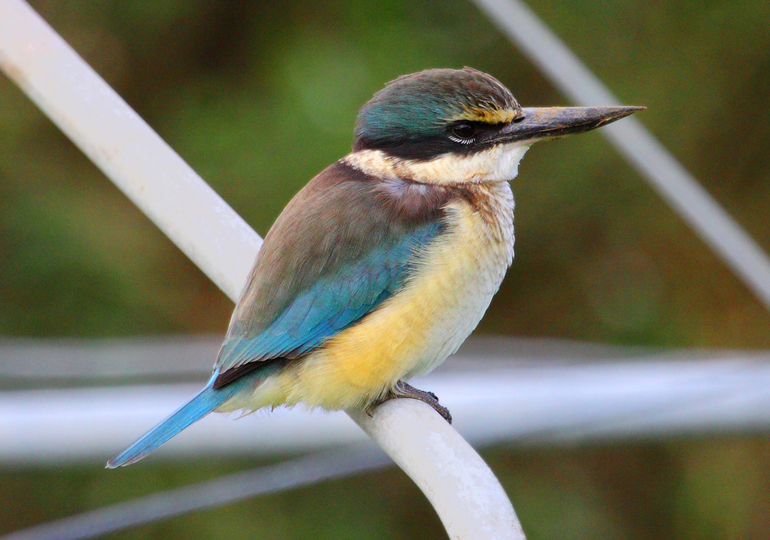
Pūrākau
Rights: Dave Young, CC BY 2.0
© Copyright. Science Learning Hub – Pokapū Akoranga Pūtaiao The University of Waikato Te Whare Wananga o Waikato.
All Rights Reserved | www.sciencelearn.org.nz. All images are copyrighted. For further information, please refer to enquiries@sciencelearn.org.nz
Notes:
https://www.sciencelearn.org.nz/videos/2020-ruru

Slide 14
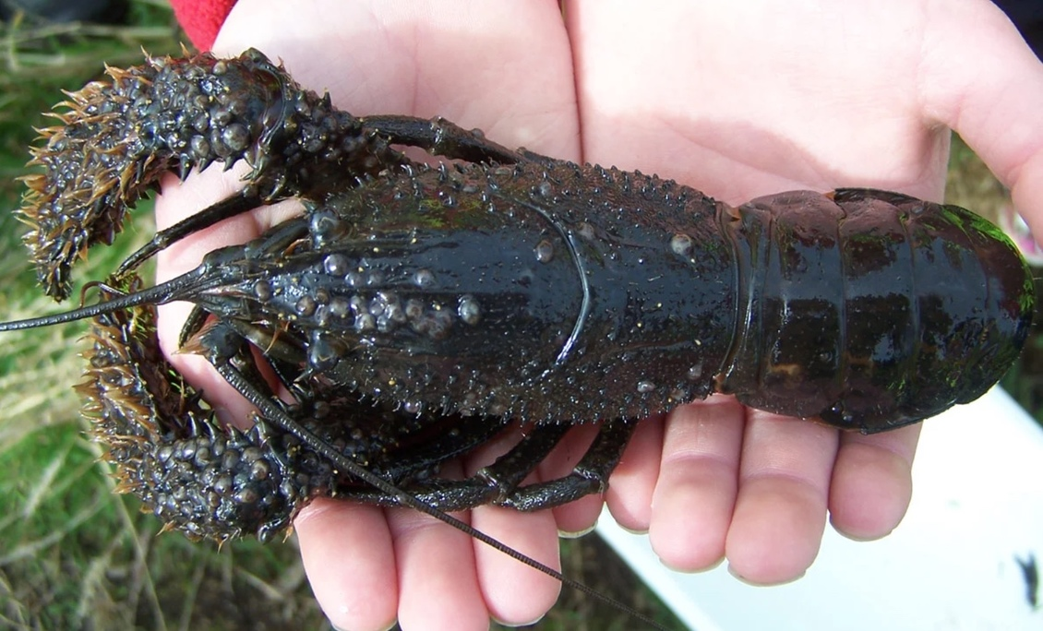
Pūrākau
Rights: DOC, CC BY 4.0
© Copyright. Science Learning Hub – Pokapū Akoranga Pūtaiao The University of Waikato Te Whare Wananga o Waikato.
All Rights Reserved | www.sciencelearn.org.nz. All images are copyrighted. For further information, please refer to enquiries@sciencelearn.org.nz
Notes:
https://www.sciencelearn.org.nz/images/4479-koura

Slide 15
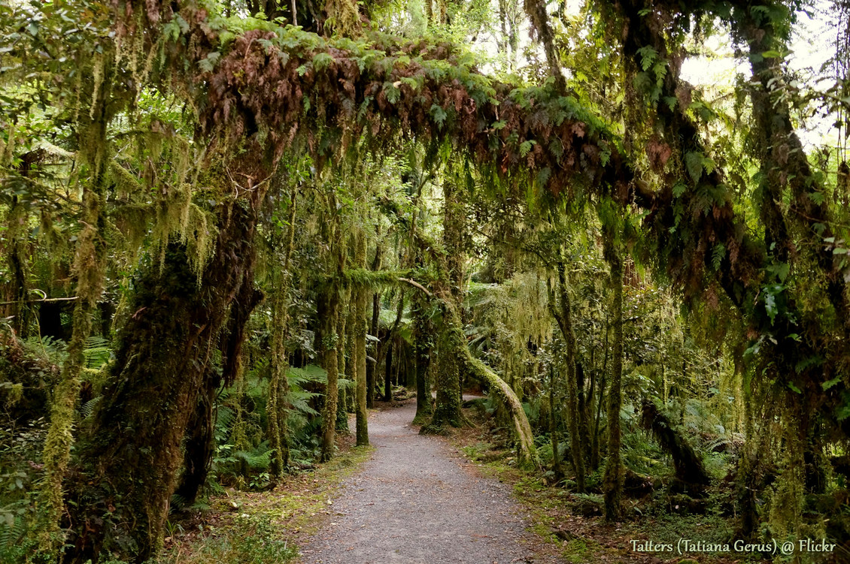
Karakia
Rights: Tatiana Gerus/Tatters, CC BY-NC-ND 2.0
© Copyright. Science Learning Hub – Pokapū Akoranga Pūtaiao The University of Waikato Te Whare Wananga o Waikato.
All Rights Reserved | www.sciencelearn.org.nz. All images are copyrighted. For further information, please refer to enquiries@sciencelearn.org.nz
Notes:
https://www.sciencelearn.org.nz/images/1874-lichen-on-forest-trees

Slide 16
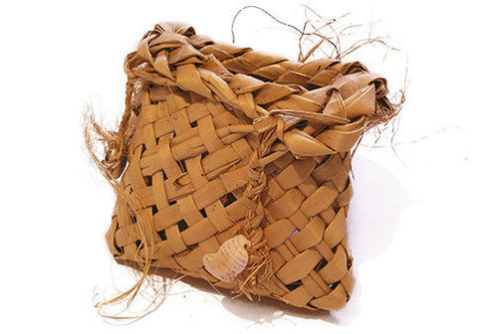
Karakia
Image licensed through sxc.hu
© Copyright. Science Learning Hub – Pokapū Akoranga Pūtaiao The University of Waikato Te Whare Wananga o Waikato.
All Rights Reserved | www.sciencelearn.org.nz. All images are copyrighted. For further information, please refer to enquiries@sciencelearn.org.nz
Notes:
https://www.sciencelearn.org.nz/images/2452-kete

Slide 17
Resources
Enviroschools
Research by Dr Kura Paul-Burke and Dr Lesley Rameka
Pūtātara
Connected 2020 Level 3 – Kaitiakitanga
Others? Please share.
© Copyright. Science Learning Hub – Pokapū Akoranga Pūtaiao The University of Waikato Te Whare Wananga o Waikato.
All Rights Reserved | www.sciencelearn.org.nz. All images are copyrighted. For further information, please refer to enquiries@sciencelearn.org.nz
Notes:
https://www.sciencelearn.org.nz/resources/2544-understanding-kaitiakitanga
https://researchcommons.waikato.ac.nz/bitstream/handle/10289/11216/Kaitiakitanga%20-%20FINAL.pdf?sequence=11
https://enviroschools.org.nz/creating-change/stories/taonga-o-kaitiakitanga/

Slide 18
Thanks – want to keep in touch?
Email us on enquiries@sciencelearn.org.nz
https://twitter.com/NZScienceLearn
www.facebook.com/nzsciencelearn
https://nz.pinterest.com/nzsciencelearn
www.instagram.com/sciencelearninghubnz
Join us in our discussion channel on Slack (http://slh-talk.slack.com).
(Any problems accessing Slack, please contact us via our enquiries email, enquiries@sciencelearn.org.nz.)
Notes:
Feedback/more of this?
Certificates

