Slide 1
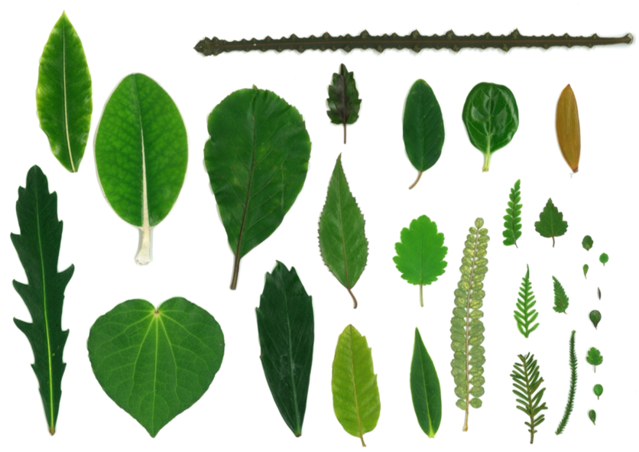
He rauemi reo Māori mō ngā rākau
Te reo Māori plant resources
4–4:45 pm Thursday 27 July 2023
© Copyright. Science Learning Hub – Pokapū Akoranga Pūtaiao The University of Waikato Te Whare Wananga o Waikato.
All Rights Reserved | www.sciencelearn.org.nz. All images are copyrighted. For further information, please refer to enquiries@sciencelearn.org.nz

Slide 2
Index
Topic | Slideshow number(s) | Video timecode
Welcome | 1 | 00:00
Index | 2 | 00:27
Introducing Dr Norm Mason | 3–4 | 00:41
Purpose | 5 | 04:33
Acknowledgements | 6 | 05:20
Rongoā collection | 7–8 | 07:04
Ngā rākau ❘ Trees | 9–10 | 08:13
He aha hoki tērā rākau? ❘ What kind of tree is that? | 11–12 | 11:12
He pūnaha whakarōpū ❘ Classifying and identifying plants | 13–18 | 19:20
Te haenga me te ruinga o te kākano ❘ Pollination and seed dispersal | 19–21 | 27:48
Ngā kākano ❘ Seeds | 22–25 | 30:28
Ngā rau o te rākau ❘ Tree leaves | 26–32 | 35:14
SLH links, keep in touch and thanks | 33 | 39:13
© Copyright. Science Learning Hub – Pokapū Akoranga Pūtaiao The University of Waikato Te Whare Wananga o Waikato.
All Rights Reserved | www.sciencelearn.org.nz. All images are copyrighted. For further information, please refer to enquiries@sciencelearn.org.nz

Slide 3
Dr Norm Mason
Ecologist based in the Waikato since 2007
Manaaki Whenua – Landcare Research
Te reo Māori learning
Reoora.com
Unlocking Curious Minds, Te Kura o Waharoa,
House of Science
© Copyright. Science Learning Hub – Pokapū Akoranga Pūtaiao The University of Waikato Te Whare Wananga o Waikato.
All Rights Reserved | www.sciencelearn.org.nz. All images are copyrighted. For further information, please refer to enquiries@sciencelearn.org.nz

Slide 4
The Science Learning Hub
A trustworthy online resource – produced by educators and scientists
Based on world-class New Zealand science research
Supported by learning activities, information about the key science ideas and concepts, multimedia tools and other resources
Written for New Zealand teachers and students
Notes:
Greta -
The Science Learning Hub is funded by the New Zealand government – Ministry of Business, Innovation and Employment (MBIE) – under the Curious Minds fund.

Slide 5
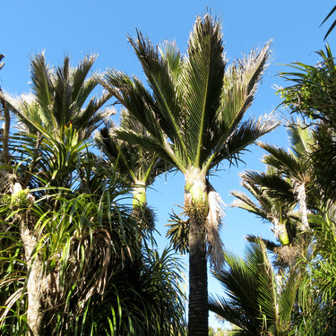
Purpose
Introduce bilingual rākau/tree resources
Highlight key concepts found in the resources
Discuss teaching and learning opportunities
Share links to supporting resources
Katja Schulz.
Sourced from iNaturalistNZ. CC BY 4.0.
© Copyright. Science Learning Hub – Pokapū Akoranga Pūtaiao The University of Waikato Te Whare Wananga o Waikato.
All Rights Reserved | www.sciencelearn.org.nz. All images are copyrighted. For further information, please refer to enquiries@sciencelearn.org.nz

Slide 6
Ngā mihi nui
Mokoro Gillett
Te Wharekura o Te Rau Aroha
Jillian Tipene
© Copyright. Science Learning Hub – Pokapū Akoranga Pūtaiao The University of Waikato Te Whare Wananga o Waikato.
All Rights Reserved | www.sciencelearn.org.nz. All images are copyrighted. For further information, please refer to enquiries@sciencelearn.org.nz

Slide 7
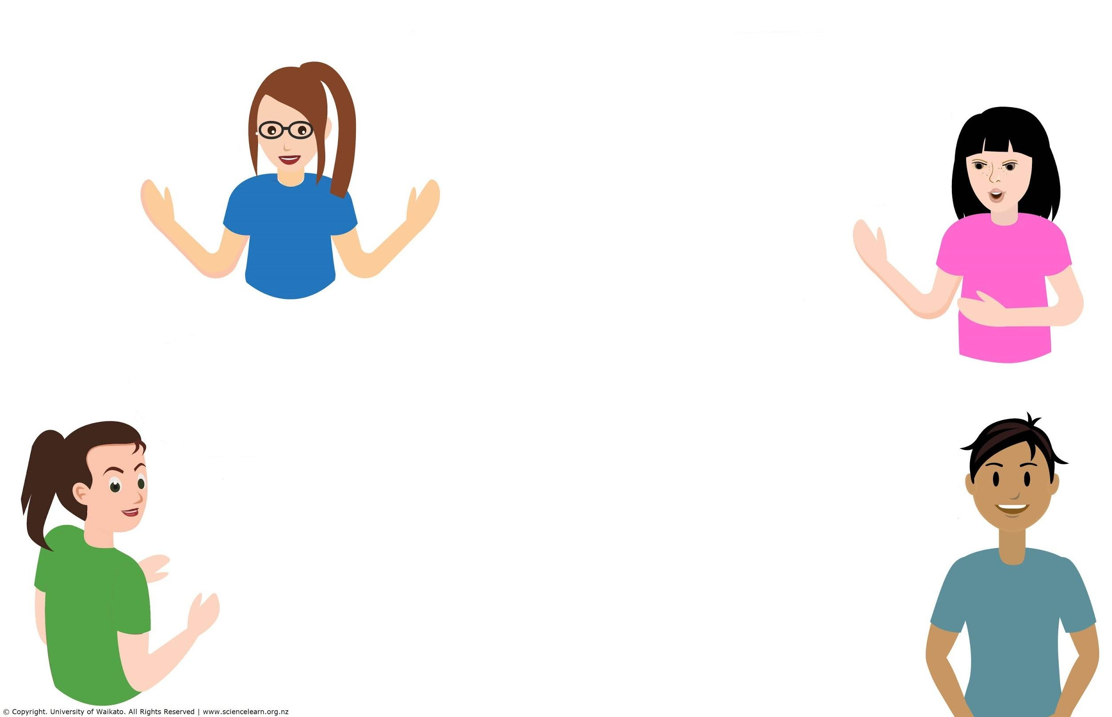
Registration questions:
Rongoā
© Copyright. Science Learning Hub – Pokapū Akoranga Pūtaiao The University of Waikato Te Whare Wananga o Waikato.
All Rights Reserved | www.sciencelearn.org.nz. All images are copyrighted. For further information, please refer to enquiries@sciencelearn.org.nz

Slide 8
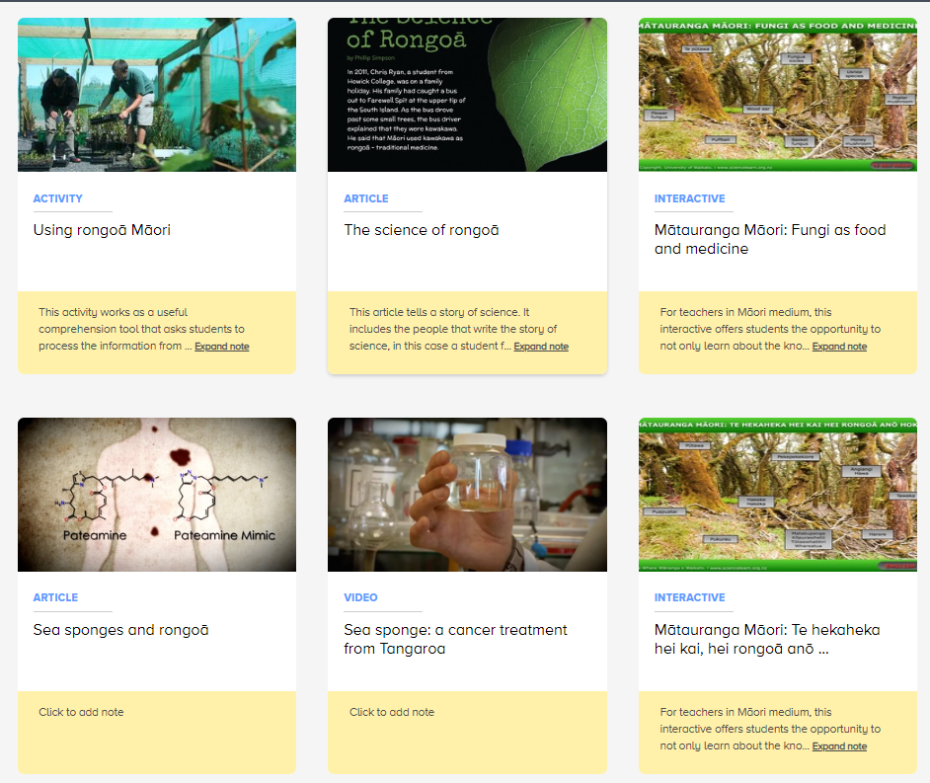
Rongoā collection
© Copyright. Science Learning Hub – Pokapū Akoranga Pūtaiao The University of Waikato Te Whare Wananga o Waikato.
All Rights Reserved | www.sciencelearn.org.nz. All images are copyrighted. For further information, please refer to enquiries@sciencelearn.org.nz
Notes:
Science Learning Hub collection: https://www.sciencelearn.org.nz/collections/shared/1ee4f149a71f1d348a2031615c9b046b
Te Papa: https://www.tepapa.govt.nz/discover-collections/read-watch-play/maori/maori-medicine
Waka Huia Rob McGowan: https://www.youtube.com/watch?v=-MOtY38Shfk

Slide 9
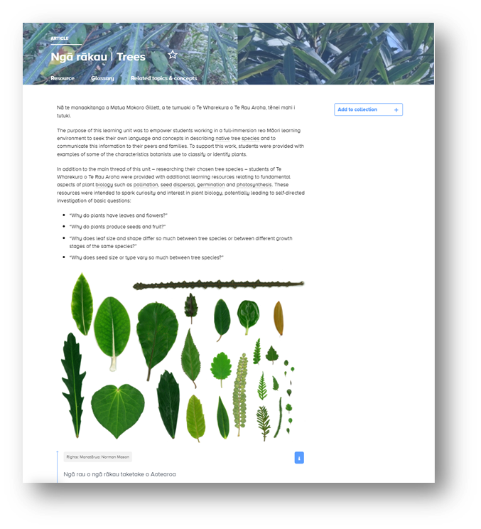
Ngā rākau Trees
Purpose
Word downloads in te reo Māori
© Copyright. Science Learning Hub – Pokapū Akoranga Pūtaiao The University of Waikato Te Whare Wananga o Waikato.
All Rights Reserved | www.sciencelearn.org.nz. All images are copyrighted. For further information, please refer to enquiries@sciencelearn.org.nz
Notes:
https://www.sciencelearn.org.nz/resources/3167-nga-rakau-trees

Slide 10
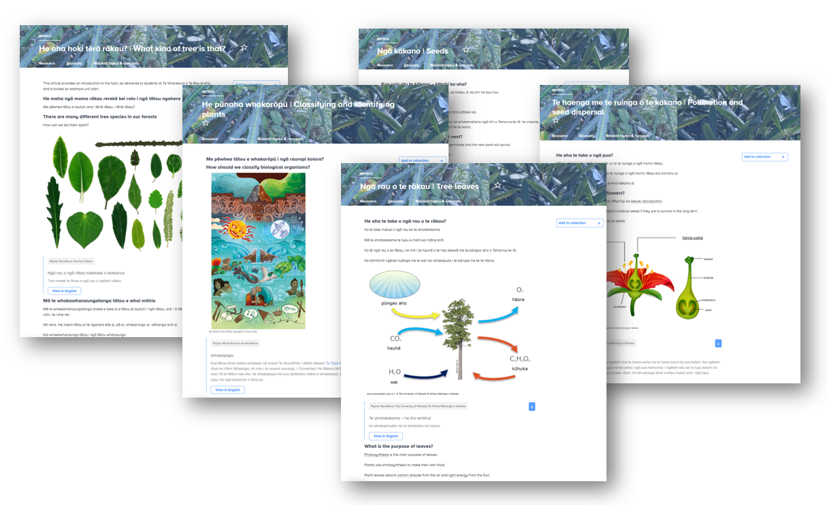
© Copyright. Science Learning Hub – Pokapū Akoranga Pūtaiao The University of Waikato Te Whare Wananga o Waikato.
All Rights Reserved | www.sciencelearn.org.nz. All images are copyrighted. For further information, please refer to enquiries@sciencelearn.org.nz

Slide 11
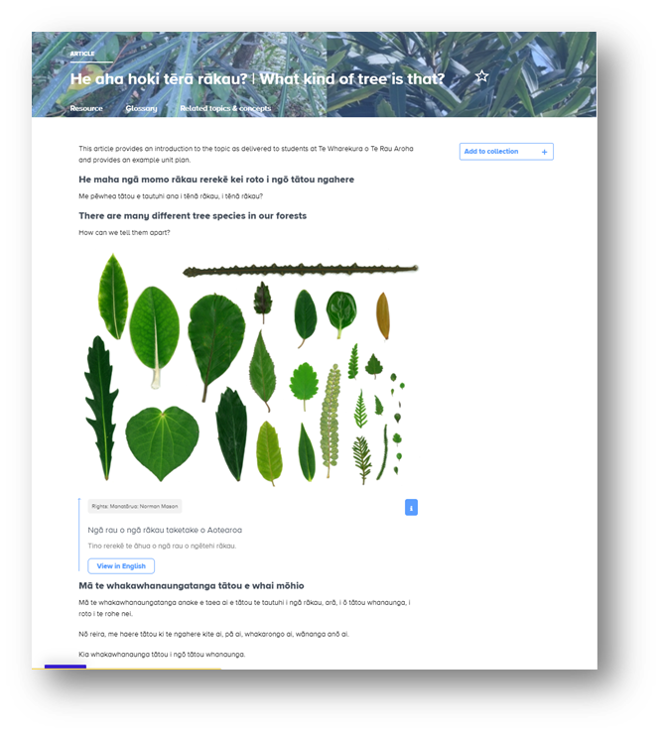
He aha hoki tērā rākau? What kind of tree is that?
Introduction
Unit plan outline
© Copyright. Science Learning Hub – Pokapū Akoranga Pūtaiao The University of Waikato Te Whare Wananga o Waikato.
All Rights Reserved | www.sciencelearn.org.nz. All images are copyrighted. For further information, please refer to enquiries@sciencelearn.org.nz
Notes:
https://www.sciencelearn.org.nz/resources/3165-he-aha-hoki-tera-rakau-what-kind-of-tree-is-that

Slide 12
© Copyright. Science Learning Hub – Pokapū Akoranga Pūtaiao The University of Waikato Te Whare Wananga o Waikato.
All Rights Reserved | www.sciencelearn.org.nz. All images are copyrighted. For further information, please refer to enquiries@sciencelearn.org.nz
Notes:
https://www.sciencelearn.org.nz/images/4942-there-are-many-native-trees ❘ https://www.sciencelearn.org.nz/images/4930-nga-rau-o-nga-rakau-taketake-o-aotearoa

Slide 13
He pūnaha whakarōpū
Classifying and identifying plants
© Copyright. Science Learning Hub – Pokapū Akoranga Pūtaiao The University of Waikato Te Whare Wananga o Waikato.
All Rights Reserved | www.sciencelearn.org.nz. All images are copyrighted. For further information, please refer to enquiries@sciencelearn.org.nz
Notes:
https://www.sciencelearn.org.nz/resources/3168-he-punaha-whakaropu-classifying-and-identifying-plants

Slide 14
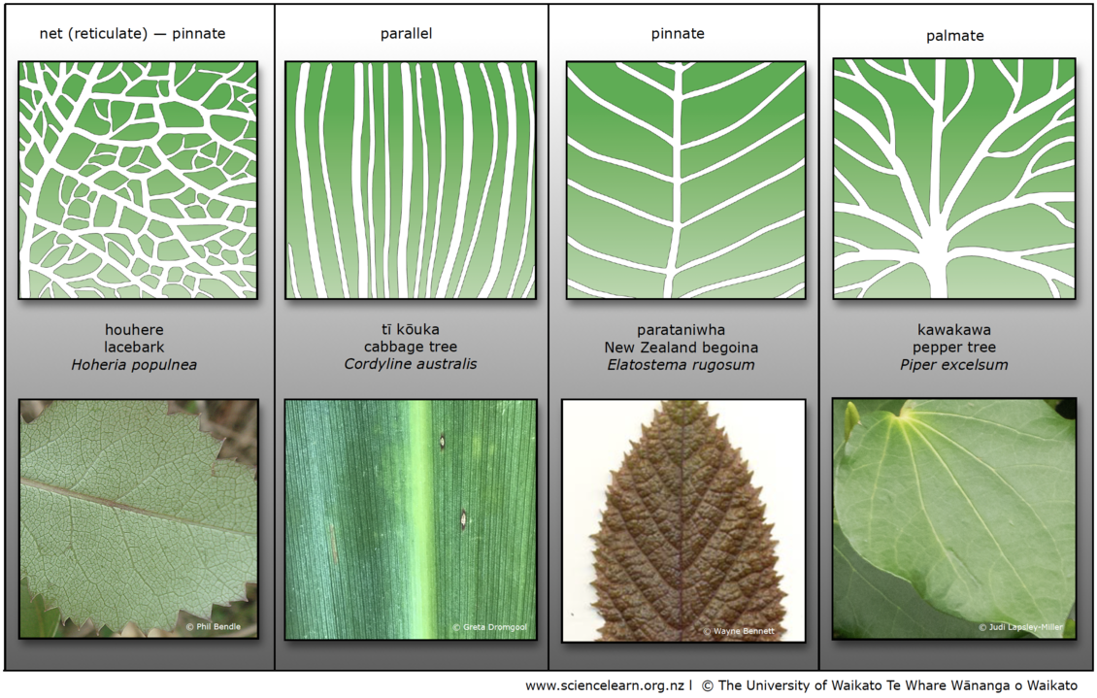
© Copyright. Science Learning Hub – Pokapū Akoranga Pūtaiao The University of Waikato Te Whare Wananga o Waikato.
All Rights Reserved | www.sciencelearn.org.nz. All images are copyrighted. For further information, please refer to enquiries@sciencelearn.org.nz
Notes:
https://www.sciencelearn.org.nz/images/5001-leaf-venation-patterns ❘ https://www.sciencelearn.org.nz/images/5002-te-whakararangi-i-nga-iarau

Slide 15
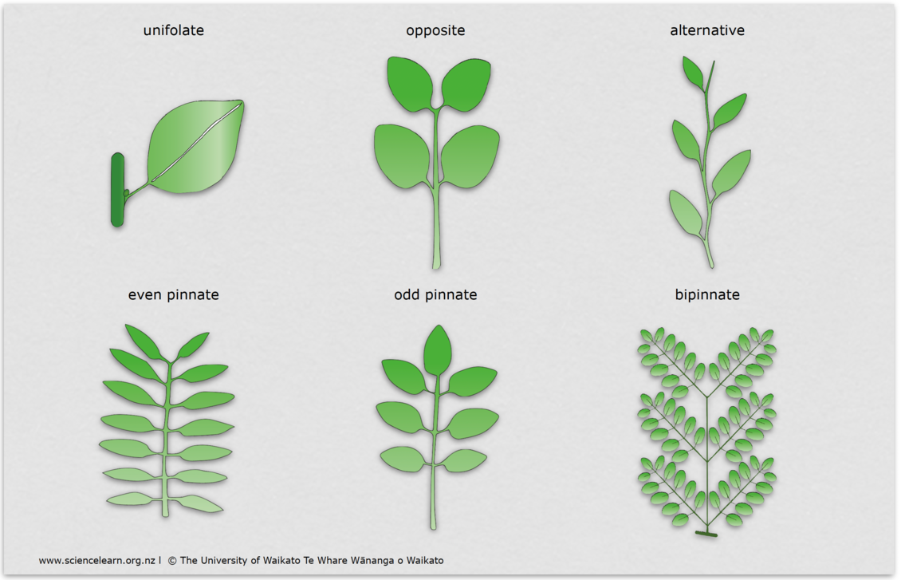
© Copyright. Science Learning Hub – Pokapū Akoranga Pūtaiao The University of Waikato Te Whare Wananga o Waikato.
All Rights Reserved | www.sciencelearn.org.nz. All images are copyrighted. For further information, please refer to enquiries@sciencelearn.org.nz
Notes:
https://www.sciencelearn.org.nz/images/5000-leaf-arrangement ❘ https://www.sciencelearn.org.nz/images/4999-te-whakatakoto-i-nga-rau

Slide 16
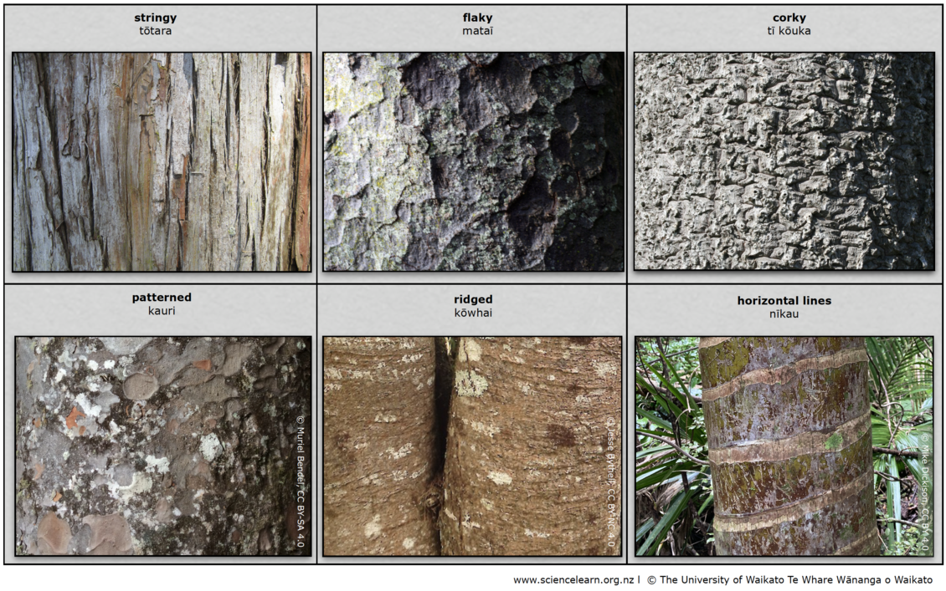
© Copyright. Science Learning Hub – Pokapū Akoranga Pūtaiao The University of Waikato Te Whare Wananga o Waikato.
All Rights Reserved | www.sciencelearn.org.nz. All images are copyrighted. For further information, please refer to enquiries@sciencelearn.org.nz
Notes:
https://www.sciencelearn.org.nz/images/5004-bark-texture-rough-or-smooth ❘ https://www.sciencelearn.org.nz/images/5003-te-kakano-o-te-kiri-tapa-rauangi-ranei

Slide 17
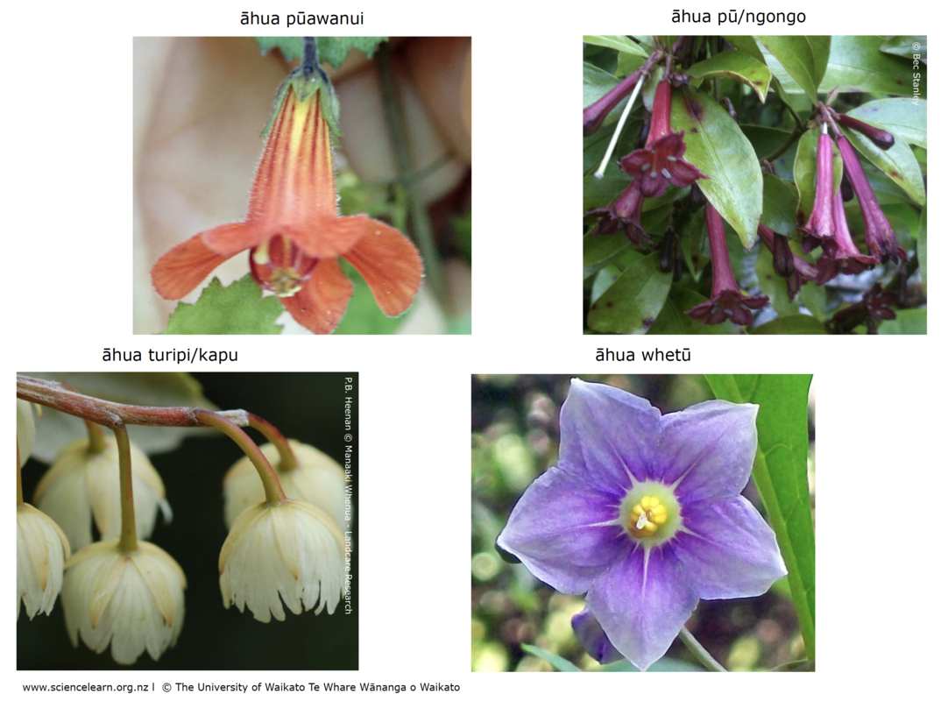
© Copyright. Science Learning Hub – Pokapū Akoranga Pūtaiao The University of Waikato Te Whare Wananga o Waikato.
All Rights Reserved | www.sciencelearn.org.nz. All images are copyrighted. For further information, please refer to enquiries@sciencelearn.org.nz
Notes:
https://www.sciencelearn.org.nz/images/4987-flower-shape ❘ https://www.sciencelearn.org.nz/images/4988-te-ahua-o-nga-pua

Slide 18
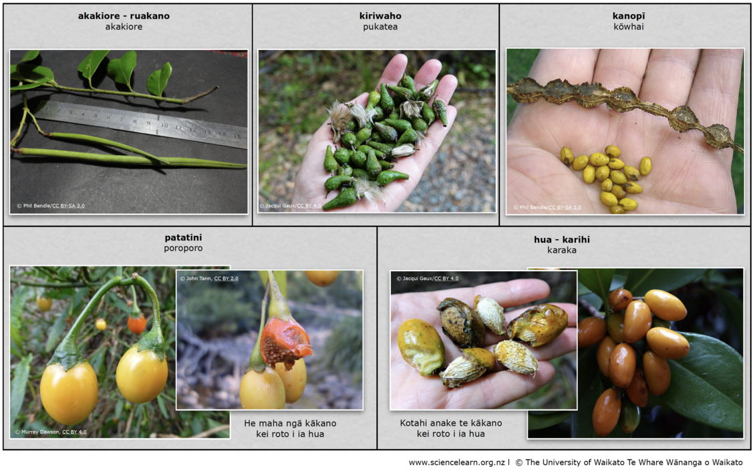
© Copyright. Science Learning Hub – Pokapū Akoranga Pūtaiao The University of Waikato Te Whare Wananga o Waikato.
All Rights Reserved | www.sciencelearn.org.nz. All images are copyrighted. For further information, please refer to enquiries@sciencelearn.org.nz
Notes:
https://www.sciencelearn.org.nz/images/4993-characteristics-of-fruits ❘ https://www.sciencelearn.org.nz/images/4994-nga-ahuatanga-o-nga-hua

Slide 19
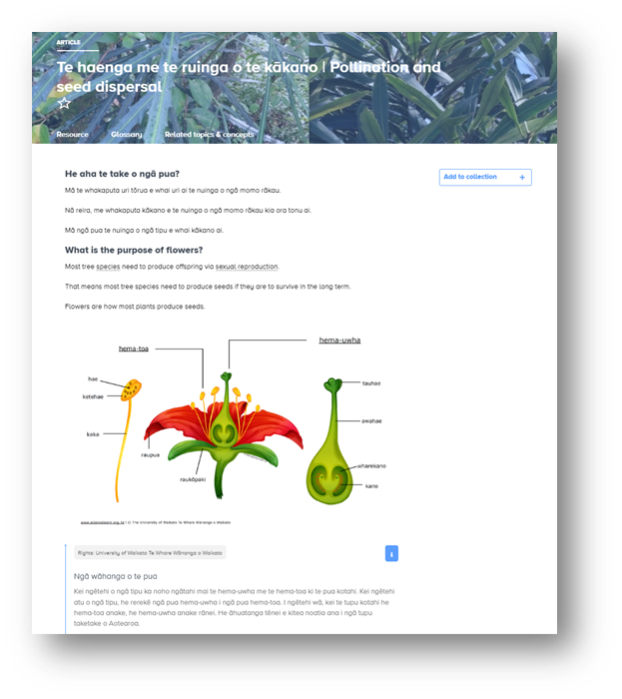
Te haenga me te ruinga o te kākano Pollination and seed dispersal
© Copyright. Science Learning Hub – Pokapū Akoranga Pūtaiao The University of Waikato Te Whare Wananga o Waikato.
All Rights Reserved | www.sciencelearn.org.nz. All images are copyrighted. For further information, please refer to enquiries@sciencelearn.org.nz
Notes:
https://www.sciencelearn.org.nz/resources/3169-te-haenga-me-te-ruinga-o-te-kakano-pollination-and-seed-dispersal

Slide 20
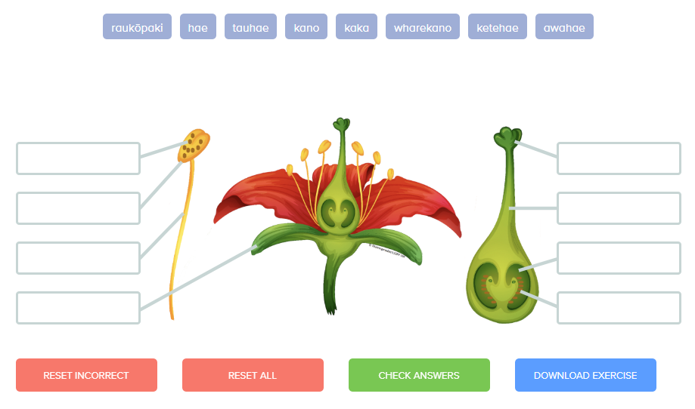
© Copyright. Science Learning Hub – Pokapū Akoranga Pūtaiao The University of Waikato Te Whare Wananga o Waikato.
All Rights Reserved | www.sciencelearn.org.nz. All images are copyrighted. For further information, please refer to enquiries@sciencelearn.org.nz
Notes:
https://www.sciencelearn.org.nz/resources/3199-labelling-the-parts-of-a-pua-flower

Slide 21
© Copyright. Science Learning Hub – Pokapū Akoranga Pūtaiao The University of Waikato Te Whare Wananga o Waikato.
All Rights Reserved | www.sciencelearn.org.nz. All images are copyrighted. For further information, please refer to enquiries@sciencelearn.org.nz
Notes:
https://www.sciencelearn.org.nz/resources/2536-pollination-resources-planning-pathways

Slide 22
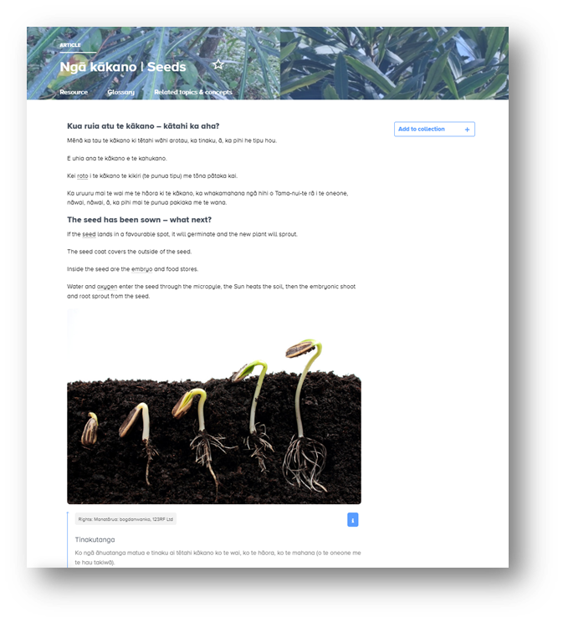
Ngā kākano Seeds
Germination
Types of seed producing plants
© Copyright. Science Learning Hub – Pokapū Akoranga Pūtaiao The University of Waikato Te Whare Wananga o Waikato.
All Rights Reserved | www.sciencelearn.org.nz. All images are copyrighted. For further information, please refer to enquiries@sciencelearn.org.nz
Notes:
https://www.sciencelearn.org.nz/resources/3170-nga-kakano-seeds
DOC propagation guides: https://www.doc.govt.nz/get-involved/run-a-project/restoration-advice/native-plant-restoration/ecosource-seeds/collection-and-propagation-guide-trees/

Slide 23
© Copyright. Science Learning Hub – Pokapū Akoranga Pūtaiao The University of Waikato Te Whare Wananga o Waikato.
All Rights Reserved | www.sciencelearn.org.nz. All images are copyrighted. For further information, please refer to enquiries@sciencelearn.org.nz
Notes:
https://www.sciencelearn.org.nz/images/4958-the-different-types-of-seed-producing-plants ❘ https://www.sciencelearn.org.nz/images/4959-nga-momo-tipu-e-whai-ai-i-nga-kakano

Slide 24
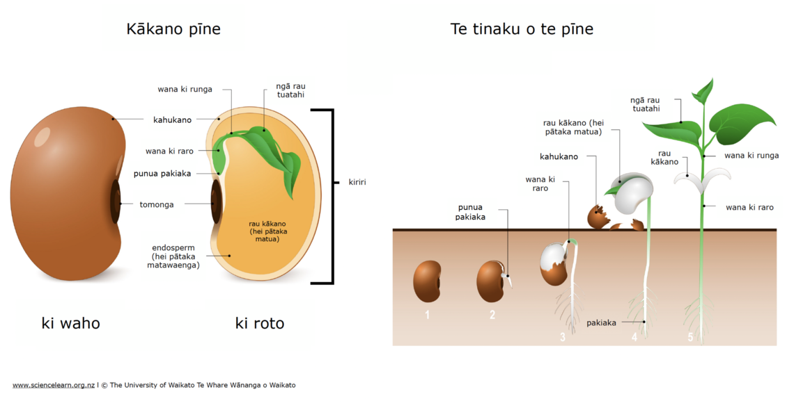
© Copyright. Science Learning Hub – Pokapū Akoranga Pūtaiao The University of Waikato Te Whare Wananga o Waikato.
All Rights Reserved | www.sciencelearn.org.nz. All images are copyrighted. For further information, please refer to enquiries@sciencelearn.org.nz
Notes:
https://www.sciencelearn.org.nz/images/4960-diagram-showing-the-germination-of-a-dicotyledon ❘ https://www.sciencelearn.org.nz/images/4961-he-hoahoa-mo-te-tinakutanga-o-te-pataka-rua

Slide 25
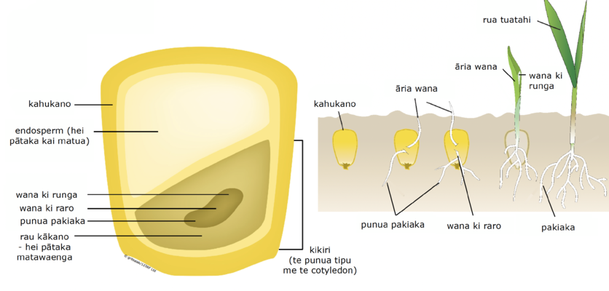

Slide 26
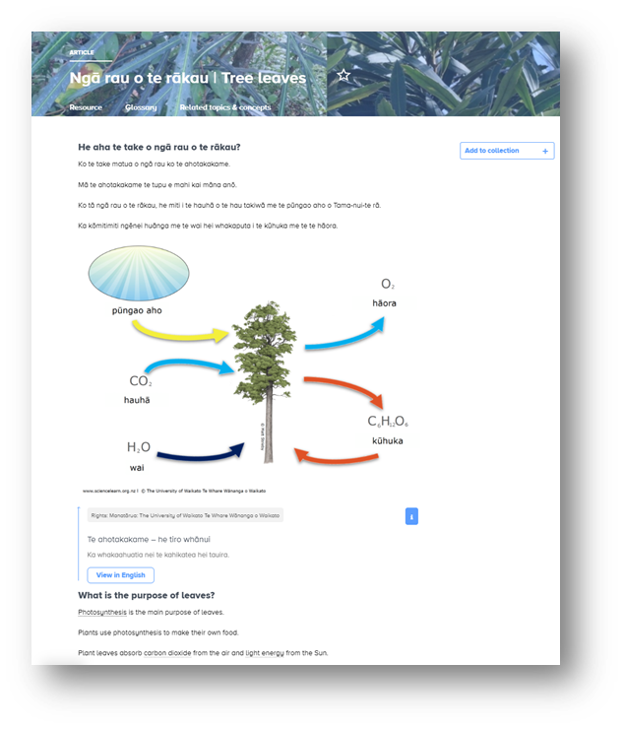
Ngā rau o te rākau
Tree leaves
© Copyright. Science Learning Hub – Pokapū Akoranga Pūtaiao The University of Waikato Te Whare Wananga o Waikato.
All Rights Reserved | www.sciencelearn.org.nz. All images are copyrighted. For further information, please refer to enquiries@sciencelearn.org.nz
Notes:
https://www.sciencelearn.org.nz/resources/3171-nga-rau-o-te-rakau-tree-leaves

Slide 27
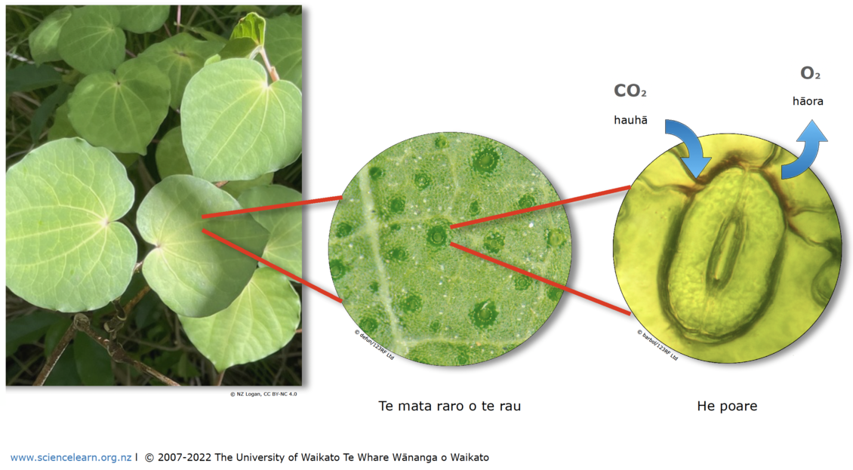
© Copyright. Science Learning Hub – Pokapū Akoranga Pūtaiao The University of Waikato Te Whare Wananga o Waikato.
All Rights Reserved | www.sciencelearn.org.nz. All images are copyrighted. For further information, please refer to enquiries@sciencelearn.org.nz
Notes:
https://www.sciencelearn.org.nz/images/4969-stomata ❘ https://www.sciencelearn.org.nz/images/4970-nga-poare

Slide 28
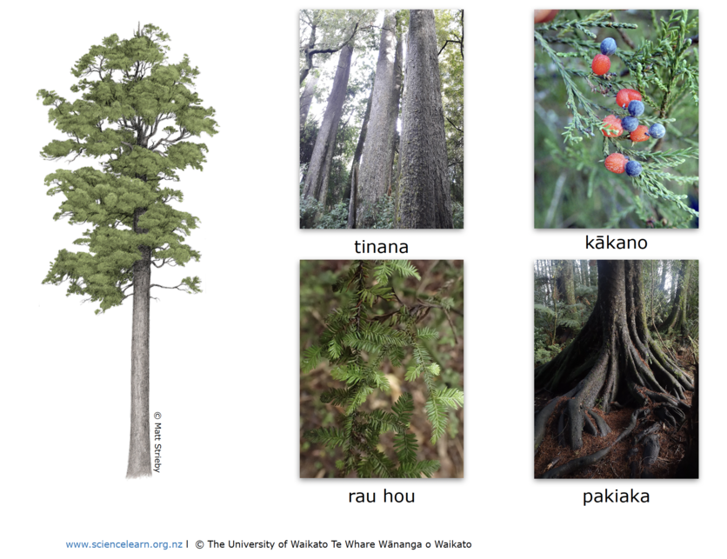
© Copyright. Science Learning Hub – Pokapū Akoranga Pūtaiao The University of Waikato Te Whare Wananga o Waikato.
All Rights Reserved | www.sciencelearn.org.nz. All images are copyrighted. For further information, please refer to enquiries@sciencelearn.org.nz
Notes:
https://www.sciencelearn.org.nz/images/4971-all-the-different-parts-of-a-tree-are-made-using-the-glucose-produced-by-photosynthesis ❘ https://www.sciencelearn.org.nz/images/4972-ka-hangaia-e-te-rakau-ngona-wahanga-katoa-i-te-kuhuka-e-puta-ai-i-te-ahotakakame

Slide 29
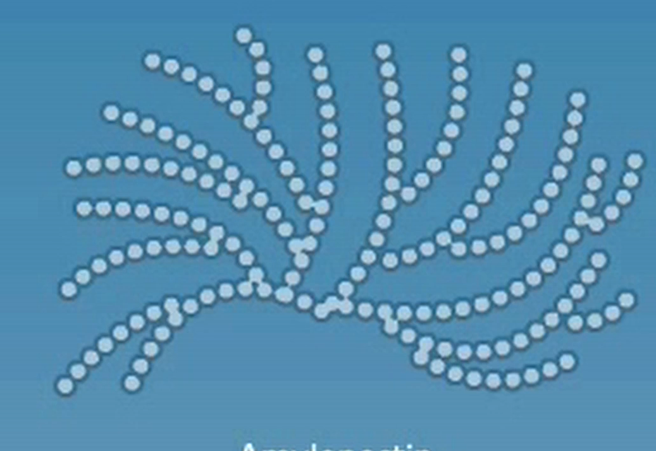
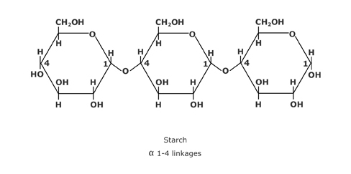
Plants store glucose as starch – which is just long chains of glucose molecules
© Copyright. Science Learning Hub – Pokapū Akoranga Pūtaiao The University of Waikato Te Whare Wananga o Waikato.
All Rights Reserved | www.sciencelearn.org.nz. All images are copyrighted. For further information, please refer to enquiries@sciencelearn.org.nz
Notes:
Food macromolecules: https://www.sciencelearn.org.nz/resources/1833-unlocking-the-energy-in-foods – nice link to kai.

Slide 30
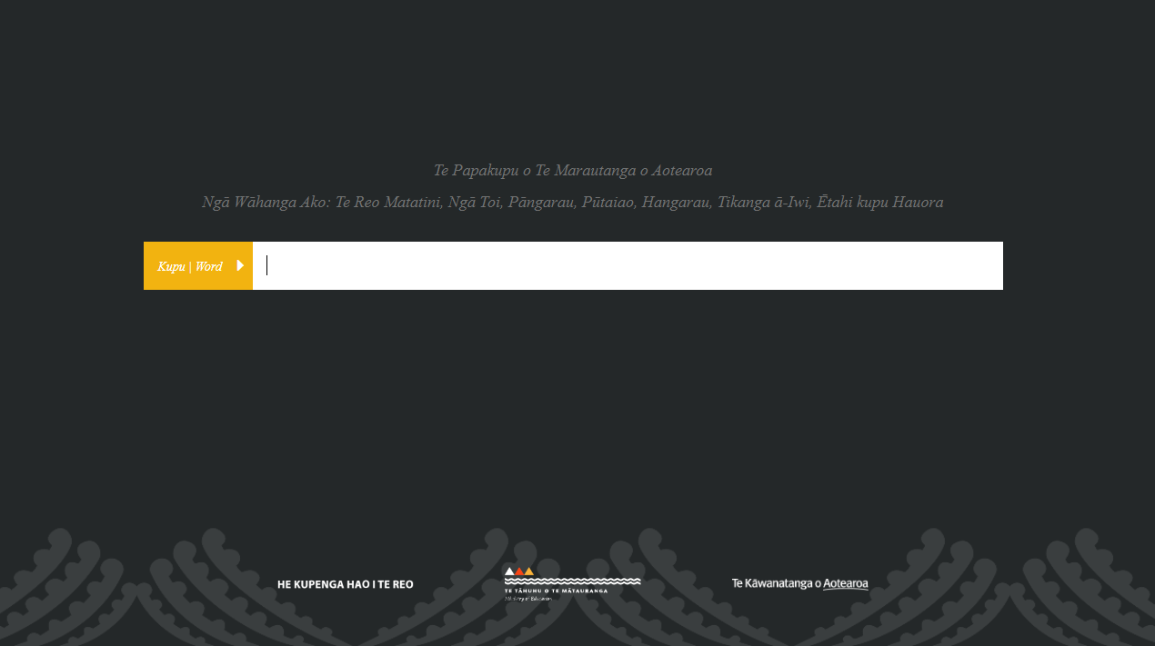
Paekupu.co.nz
All rights reserved. Copyright © He Kupenga Hao i te Reo 2023
© Copyright. Science Learning Hub – Pokapū Akoranga Pūtaiao The University of Waikato Te Whare Wananga o Waikato.
All Rights Reserved | www.sciencelearn.org.nz. All images are copyrighted. For further information, please refer to enquiries@sciencelearn.org.nz
Notes:
https://paekupu.co.nz

Slide 31
Ahotakakame
from Paekupu.co.nz
All rights reserved. Copyright © He Kupenga Hao i te Reo 2023. www.paekupu.co.nz
© Copyright. Science Learning Hub – Pokapū Akoranga Pūtaiao The University of Waikato Te Whare Wananga o Waikato.
All Rights Reserved | www.sciencelearn.org.nz. All images are copyrighted. For further information, please refer to enquiries@sciencelearn.org.nz
Notes:
https://paekupu.co.nz/word/ahotakakame

Slide 32
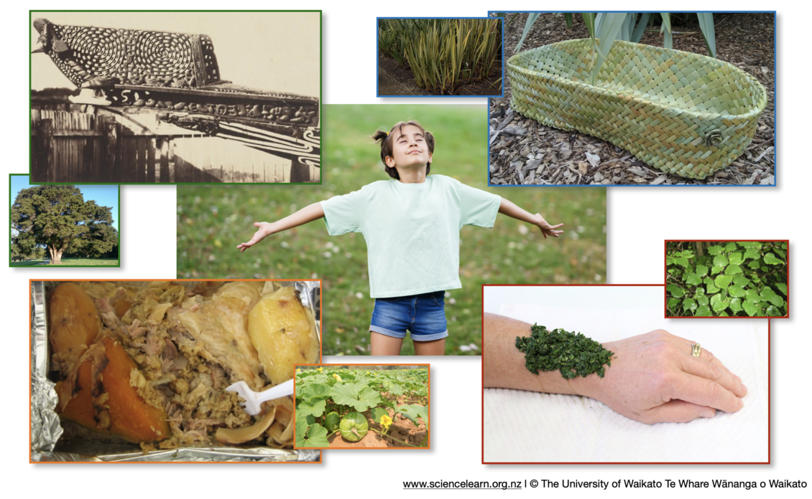
Image acknowledgements: Tōtara prow Tauihu, Waka taua Te Toki a Tapiri, Reverend John Kinder. Circa 1865. Auckland Art Gallery Toi o Tāmaki. Accession No 1983/22/15. Harakeke bassinet, Sue Scheele. Nō roto mai i Te Reo o Te Repo – The Voice of the Wetland. Hāngī meal by Juli R, CC BY-NC-ND 2.0. Kawakawa poultice, photo by Simon Waterfield, from Connected article: The Science of Rongoā. Crown Copyright.
© Copyright. Science Learning Hub – Pokapū Akoranga Pūtaiao The University of Waikato Te Whare Wananga o Waikato.
All Rights Reserved | www.sciencelearn.org.nz. All images are copyrighted. For further information, please refer to enquiries@sciencelearn.org.nz
Notes:
https://www.sciencelearn.org.nz/images/4977-photosynthesis-benefits ❘ https://www.sciencelearn.org.nz/images/4978-nga-painga-o-te-ahotakakame

Slide 33
Thanks – want to keep in touch?
Email us on enquiries@sciencelearn.org.nz
https://twitter.com/NZScienceLearn
www.facebook.com/nzsciencelearn
https://nz.pinterest.com/nzsciencelearn
www.instagram.com/sciencelearninghubnz
Notes:
https://www.landcareresearch.co.nz/about-us/our-people/norman-mason

